Slide 1
Viagra Vasodilator
By Luis Q., Marco Rodriguez, and
Philip

Slide 2
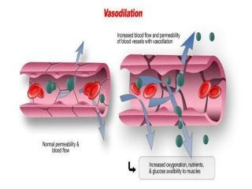
How does Vasodilators work?
Vasodilators are medications that open (dilate) blood vessels. They affect the muscles in the walls of the arteries and veins, preventing the muscles from tightening and the walls from narrowing. As a result, blood flows more easily through the vessels. The heart doesn't have to pump as hard, reducing blood pressure.

Slide 4
When was Viagra invented?
Its application in 1997 to the Food and Drug Administration was rapidly approved based on the solidity of the research; by 1998 Viagra was approved--not as a heart medication--but as the very first oral treatment for men with ED.

Slide 5
What is Sildenafil?
Sildenafil, sold under the brand name Viagra among others, is a medication used to treat erectile dysfunction and pulmonary arterial hypertension. It is unclear if it is effective for treating sexual dysfunction in women. It is taken by mouth or by injection into a vein.

Slide 6
What is Viagra?
Viagra, the brand name of the drug sildenafil, which was the first major erectile dysfunction (ED) medication on the market and is made by Pfizer.
It's a vasodilator type drug, which was approved in 1998.
Viagra works by increasing blood flow to your penis, which helps you have and keep an erection.

Slide 7
Viagra Mechanism of Action

Slide 8
Viagra Sales Chart
Pfizer’s worldwide known erectile dysfunction product Viagra generated around 500 million U.S. dollars in revenue in 2019. Sales of this drug have decreased steadily over the past seven years, especially because patent protection expired outside the U.S. in 2012. In the United States, several drug manufacturers are currently allowed to market generic versions of Viagra (sildenafil), even if the patent is set to expire in 2020.

Slide 10
IR of Viagra

Slide 11
NMR of Water Vapor

Slide 12
MS of Viagra

Slide 13
Sildenafil Bioavailability over time

Slide 14
Side Effect of Viagra on the heart

