Slide 1
Viagra (Vasodilator)
By:Julius Chapa

Slide 2
The man to invent was Doctor Nicholas Terret where in March 27th, 1998 he made the drug as a high blood pressure alternative and it became widely used by everyone in 1998.
This Photo by Unknown author is licensed under CC BY-ND.

Slide 3
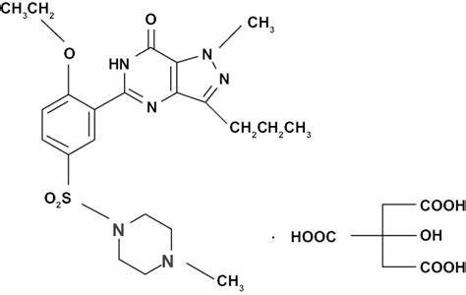
it treats erectile dysfunction. It's caused by just getting older or for other reasons like stress and lack of testosterone it helps with erectile dysfuntion by making a chemical enzyme called phosphodiesterase type S known as PDES but it helps people yearly.it really only has one side effect sometimes it goes and effects to long but it also lowers blood pressure but that’s really it

Slide 4
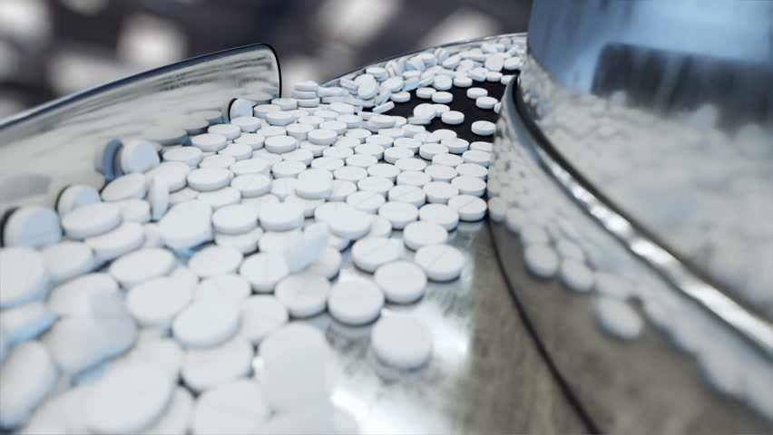
Since it helps so many people the production it cost 70$ dollars for one that’s a brand like viagra but to just get the main component PDES into a pill will cost 40$ dollars but net total was 500 million in the year 2019

Slide 5
other brand are aronix, liberize, nipatra, revatio, and grandipam the main component is known as sidenfil the chemical makeup is C22H30N6O45
I think the side effects are minor for what it helps with and it may even help with different symptoms like blood pressure.

