Slide 1
Viagra
The Little Blue Pill

Slide 2
Background
In 1991 Dr. Nicholas Terret is named in the British patent for sildenafil citrate also known as Viagra, originally introduced as a heart medication.
In March 1998 the FDA approves the used of the drug Viagra to treat erectile dysfunction, and shortly after an estimated 40,000 prescriptions for Viagra are given by pharmacists.

Slide 3
Treatment
Viagra most commonly is used to treat erectile dysfunction which is a man’s inability to get or keep an erection. It is often caused by clogged blood vessels as well as nerve damage as a result from diabetes.
It is also used to treat pulmonary hypertension a form of high blood pressure that affects arteries in the lungs and heart, caused by blood vessels that become narrowed, blocked, or destroyed.

Slide 4
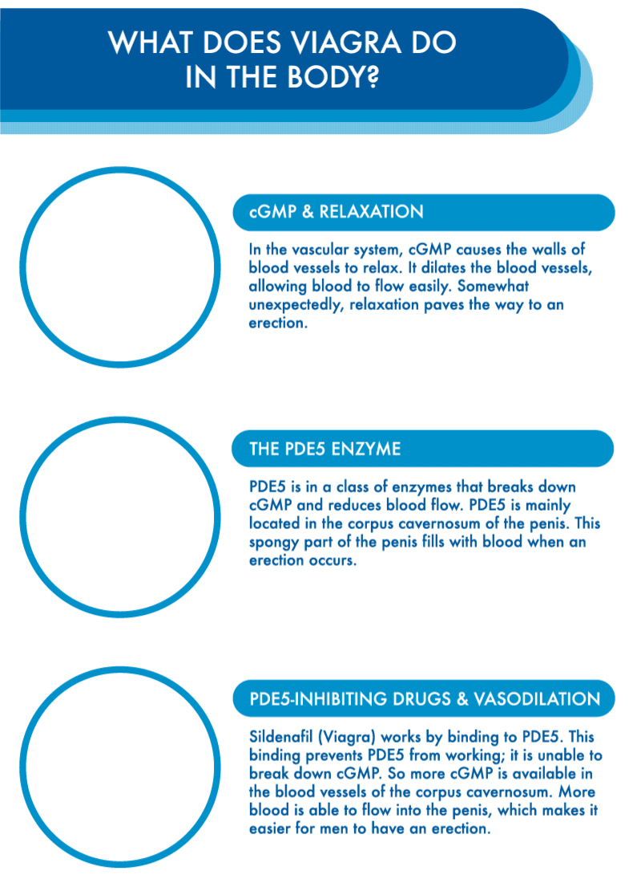
How Does It Work?

Slide 5
Effectiveness

Slide 6
Side Effects
Viagra has several side effects as a result of its ingredients including:
Back pain
Dizziness
Flushing
Headache
Indigestion
Muscle aches
Nausea
Stuffy or runny nose

Slide 7
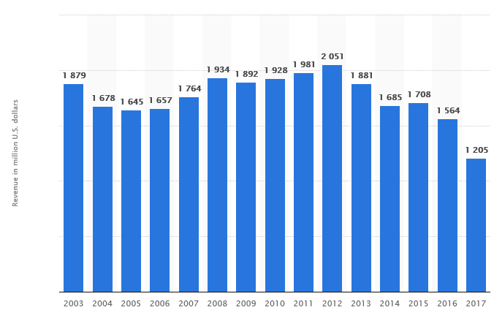
Earnings
The cost for Viagra oral tablet 25 mg is around $447 for a supply of 6 tablets, depending on the pharmacy you visit.

Slide 8
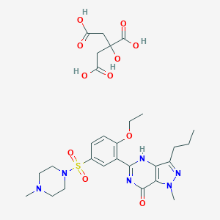
Extra Information
Viagra was originally named sildenafil citrate.
The chemical formula for Viagra is C₂₈H₃₈N₆O₁₁S
The chemical structure for Viagra is on the right.

Slide 9
My Thoughts
I believe Viagra is a very positive drug which was far ahead of its time, providing a multitude of uses.
Viagra is a drug that can be utilized several ways and ultimately is something good for us to have in our society

