Slide 1
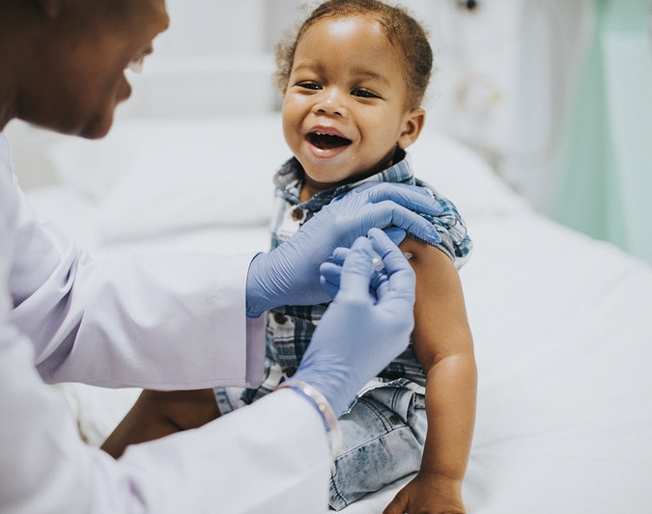
Vaccines
By: Ashley Lainez

Slide 2
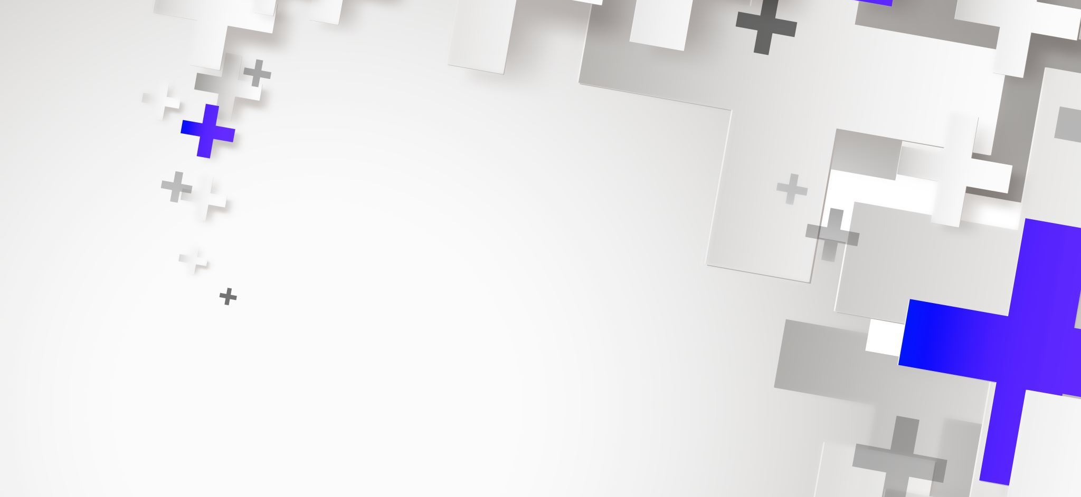
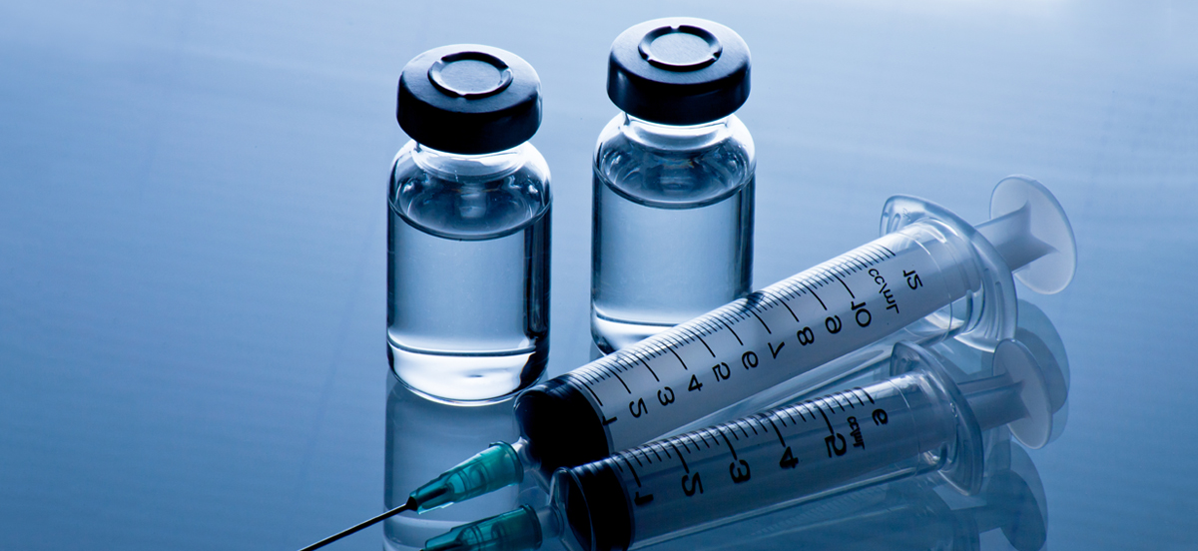
Every day, it seems, there are news reports or rumors suggesting that vaccines may cause death or autism or myriad other unfortunate results.
And as they hold their children to receive shots or vaccine boosters, parents know that their child is at some risk.
This Photo by Unknown author is licensed under CC BY-SA-NC.

Slide 3
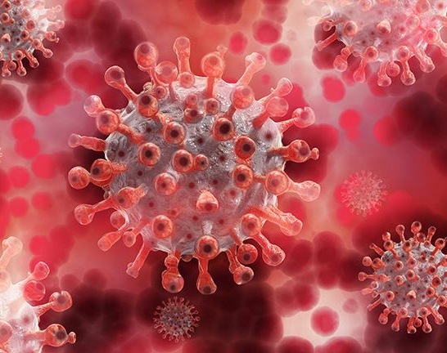
COVID-19
acute disease in humans caused by a coronavirus, which is characterized mainly by fever and cough and is capable of progressing to severe symptoms and in some cases death, especially in older people and those with underlying health conditions. It was originally identified in China in 2019 and became pandemic in 2020.
This Photo by Unknown author is licensed under CC BY.

Slide 4
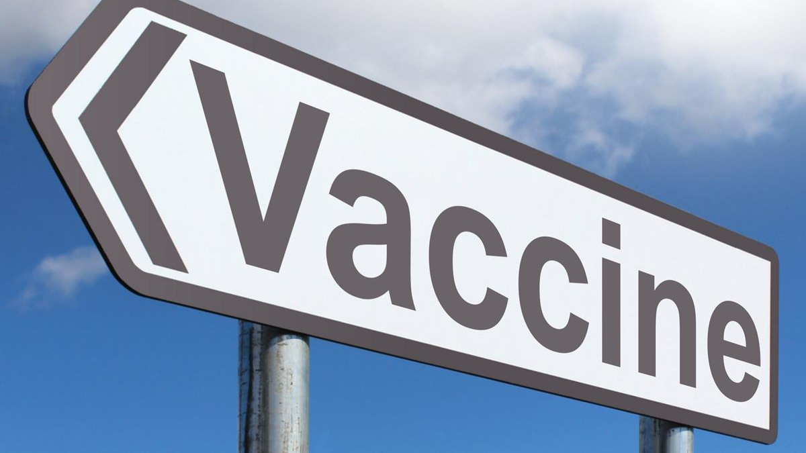
COVID-19 vaccine
This Photo by Unknown author is licensed under CC BY-SA.

Slide 5
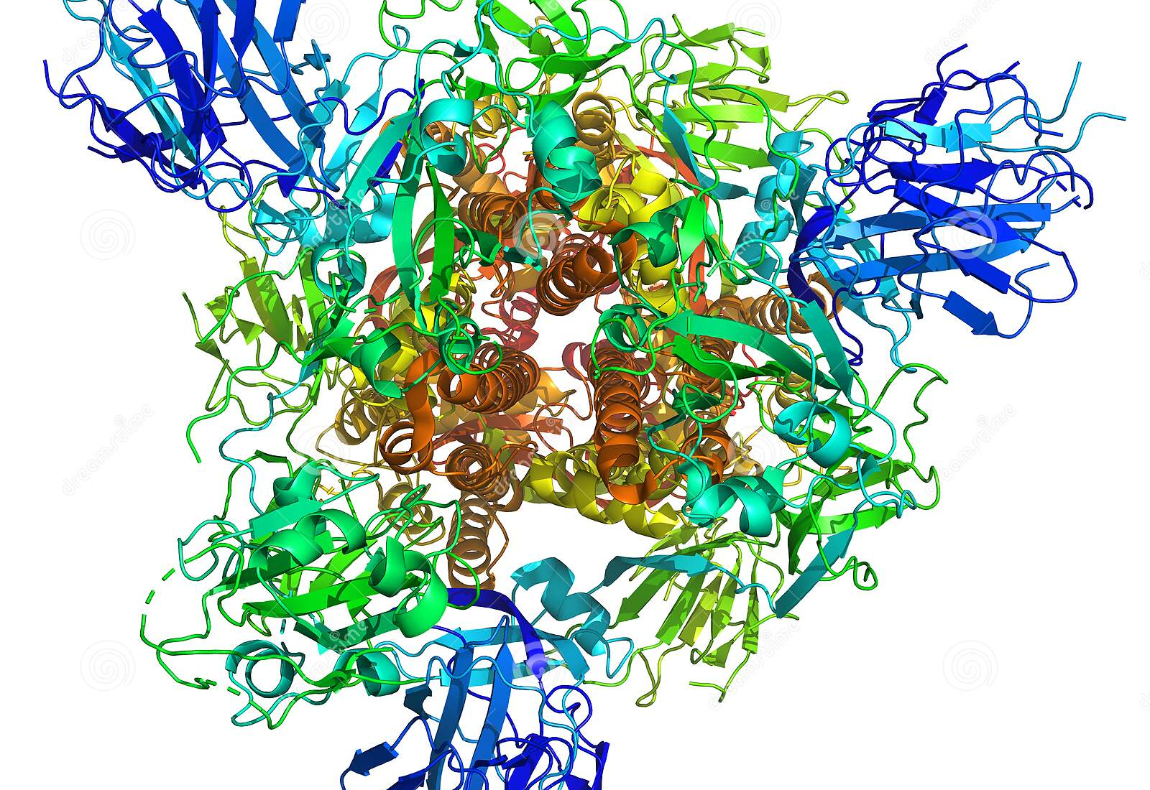

Slide 6
Messenger RNA (mRNA) vaccine
This type of vaccine uses genetically engineered mRNA to give your cells instructions for how to make the S protein found on the surface of the COVID-19 virus. After vaccination, your muscle cells begin making the S protein pieces and displaying them on cell surfaces. This causes your body to create antibodies. If you later become infected with the COVID-19 virus, these antibodies will fight the virus.
After delivering instructions, the mRNA is immediately broken down. It never enters the nucleus of your cells, where your DNA is kept. Both the Pfizer-BioNTech and the Moderna COVID-19 vaccines use mRNA

Slide 7
6LZG
​
Structure of novel coronavirus spike receptor-binding domain complexed with its receptor ACE2

Slide 8
Illustration:
Molecular view of soap and water.

Slide 9
Illustration:
Soap attacking the lipid bilayer membrane of coronavirus.

Slide 10
Illustration:
Coronavirus before and during soap action.
Open links in new tab
RCSB PDB: Homepage

