Slide 1
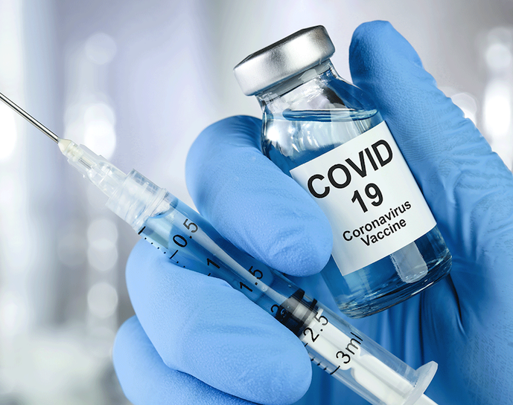
Vaccines - Covid 19
By Emmanuel Rangel
And Ramiro Magallon

Slide 2
What IS The Covid VACCINE?
The person who discovered/made the COVID vaccine was Pfizer.
The “COVID-19 Vaccine” was first introduced in December 18 2020.
It became a therapeutic medicine in June 11th 2020.

Slide 3
What does the covid vaccine treat?
The covid vaccine treats Covid-19, and it is caused by being spread by a person infected person by droplets through their nose and mouth.

Slide 4
How does the covid vaccine work in the body?
Different types of vaccines work in different ways to offer protection. But with all types of vaccines, the body is left with a supply of “memory” T-lymphocytes as well as B-lymphocytes that will remember how to fight that virus in the future.

Slide 5
Covid Vaccine Side Effects
Difficulty breathing
Swelling of your face and throat
A fast heartbeat
A bad rash all over your body
Dizziness and weakness

Slide 6
Covid Vaccine Ingredients
These are the ingredients to the Pfizer vaccine, and they include mRNA, lipids ((4-hydroxybutyl)azanediyl)bis(hexane-6,1-diyl)bis(2-hexyldecanoate), 2 [(polyethylene glycol)-2000]-N,N-ditetradecylacetamide, 1,2-Distearoyl-sn-glycero-3- phosphocholine, and cholesterol), potassium chloride, monobasic potassium phosphate, sodium chloride, dibasic sodium phosphate dihydrate, and sucrose.
The Pfizer vaccine does not contain eggs, preservatives, or latex.

Slide 7
Covid Vaccine Enzymes
The COVID-19 pandemic has taken a significant toll on people worldwide, and there are currently no specific antivirus drugs or vaccines. Herein it is a therapeutic based on catalase, an antioxidant enzyme that can effectively breakdown hydrogen peroxide and minimize the downstream reactive oxygen species, which are excessively produced resulting from the infection and inflammatory process, is reported.

Slide 8
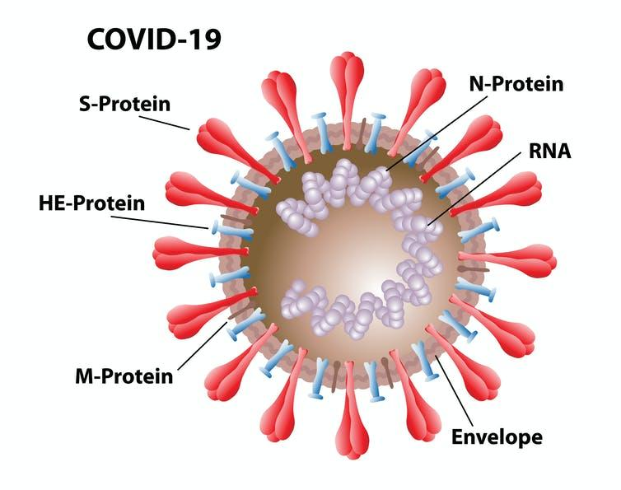
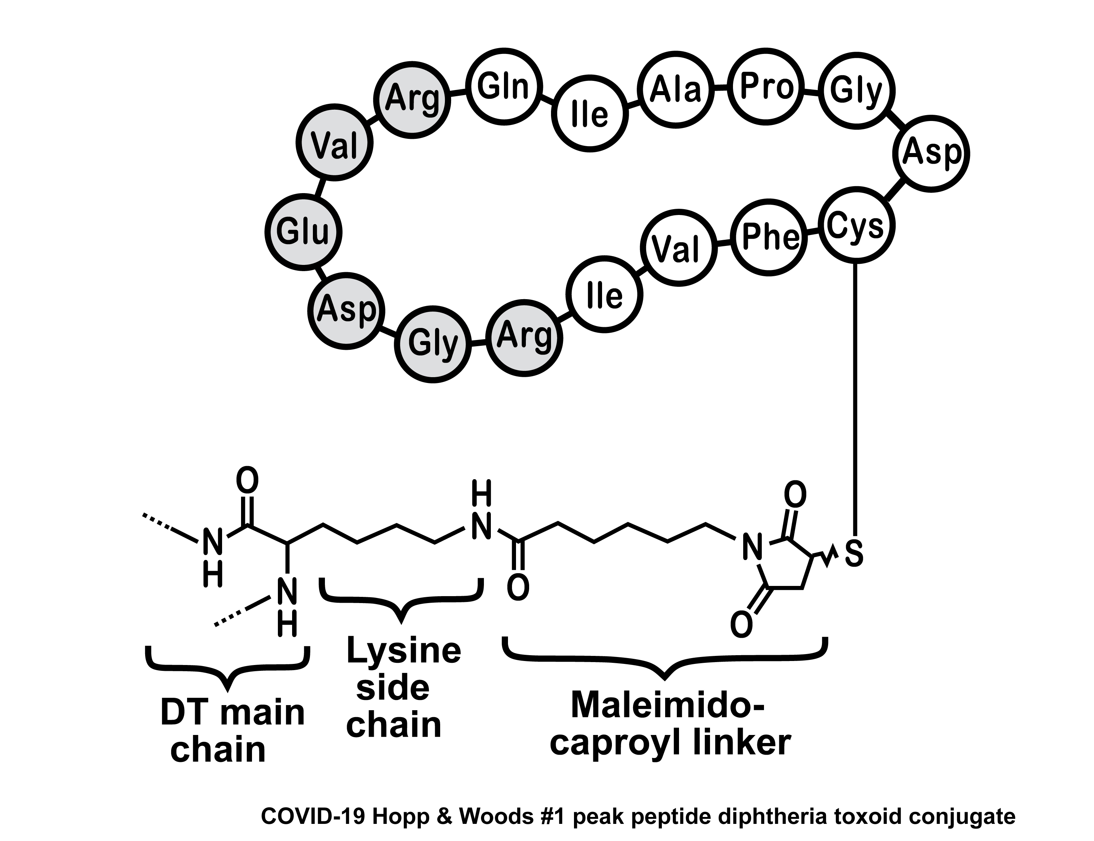
Covid-19 Vaccine Structure And Formula

Slide 9
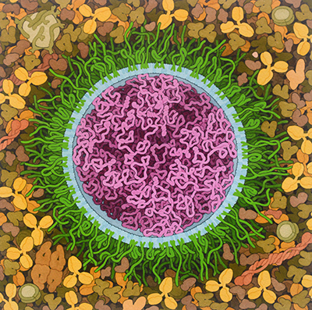
How The SARS-CoV-2 mRNA Vaccine, 2020
Looks Like

Slide 10
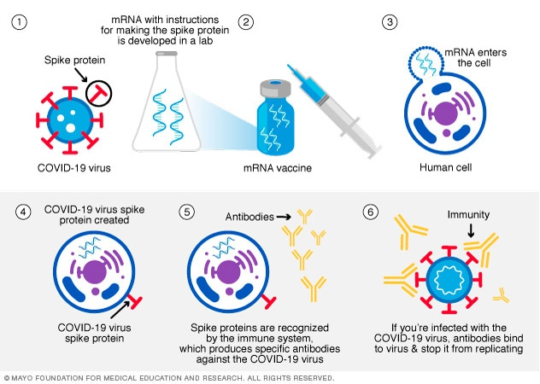
Messenger RNA (mRNA) vaccine
Both the Pfizer-BioNTech and the Moderna COVID-19 vaccines use mRNA.

Slide 11
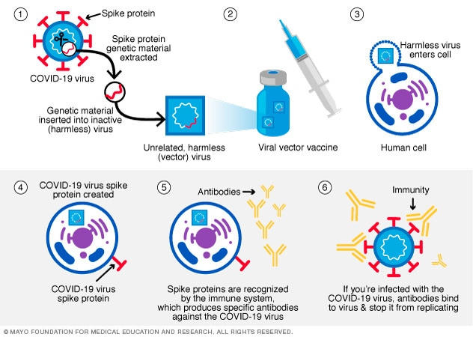
Viral Vector Vaccine
In this type of vaccine, genetic material from the COVID-19 virus is placed in a
modified version of a different virus (viral vector). When the viral vector gets into your cells,
it delivers genetic material from the COVID-19 virus that gives your
cells instructions to make copies of the S protein.

Slide 12
Protein Subunit Vaccine
Subunit vaccines include only the parts of a virus that best stimulate your immune system.

Slide 13
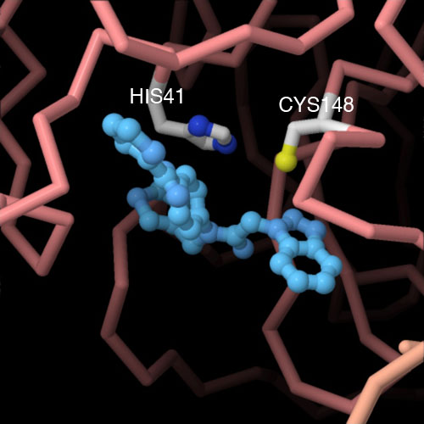
Bat Coronavirus Main Protease with Inhibitor

Slide 14
How Washing Your Hands Kills Covid-19
Corona Virus before and after soap action
Molecular view of soap and water

Slide 15
Is the Covid-19 Vaccine Expensive?
The vaccine is free for everyone, the federal government is rooting the bill for all those who live in the United States.

Slide 16
For how millions of dollars was the drug sold for?
The Pfizer vaccine had Sales worth $11.3bn (£8bn) were made by Pfizer in the first half of this year from the Covid-19 jab that it developed with Germany’s BioNTech. In July it lifted its 2021 sales forecast to $33.5bn.

Slide 17
Sources
Covid-19 vaccines: the contracts, prices and profits
https://www.theguardian.com/world/2021/aug/11/...
PDB-101: Browse: Coronavirus
https://pdb101.rcsb.org/browse/coronavirus

