Slide 1
Vaccine
By: Shannon Pablo, David Chacon, Eduardo Racancoj, Geraedo

Slide 2
A)History of the Drug
1. who discovered the drug ? The practice of immunization dates back hundreds of years. Buddhist monk drank snake venom to confer immunity to snake bites and variolation was practice in 17th century China. Edward Jenner is considered the founder of vaccinolgy in the west in 1796.
2. When was the drug first introduced ? Edward Jenner invented a method to protect against small pox in 1796.
3. When did it become a therapeutic medicine ? Therapeutic Vaccines represent a viable option for active therapy of cancers that aim to treat late stage disease by using a patient’s own immune system.

Slide 3
B)Mechanism of therapeutic action
1. Which disease this drug treats? What causes the disease in the body ? The diseases that vaccines treats are smallpox, rabies, plague, diphtheria, pertussis, tuberculosis, tetanus, yellow fever, injectable polio vaccine, oral polio vaccine, measles, mumps, rubella, hepatitis B. These diseases are very contagious and that’s how they spread.
2. How does the drug work in the body to cure the disease? The Vaccine helps the body develop immunity against the disease that it is treating.
3. Is the drug very effective in the treatment of the disease? Yes, vaccines are very effective and they’re the best protection against many serious diseases.
4.How does the drug cause undesired side effects? Common side effects are mild fever, shivering , and fatigue.

Slide 4
C) Cost
1. Is the drug expensive? Vaccines are expensive as a prefilled syringes cost an average of $136 in the United States.
2. For how millions of dollars is the drug sold yearly? At $6.25bn that how much it sells yearly.

Slide 5
D) Names an other names
Other names for vaccines are tetanus (reduced) Diphtheria, (reduced) Pertussis.

Slide 6
CAS registry
There are many places were you can get vaccines these are some examples:
Your local Walmart
Your community blood drive
Any school

Slide 7
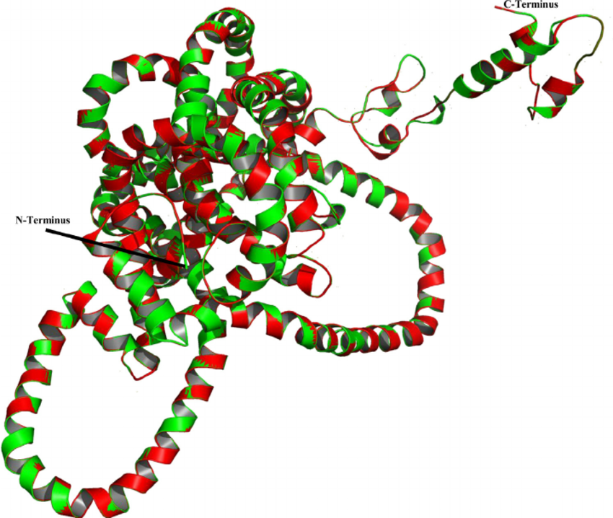
Structure

Slide 8
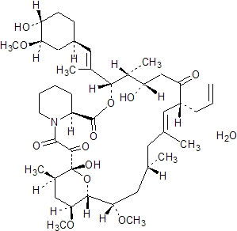
Chemical Formula

Slide 9
Personal Opinion
We think that vaccines are great and that they help a lot of people. We understand though that not everyone is on board with vaccines, yet we still think they are very useful and we shouldn’t get rid of them. We should try to instead improve the side effects that’s what we believe.

