Slide 1
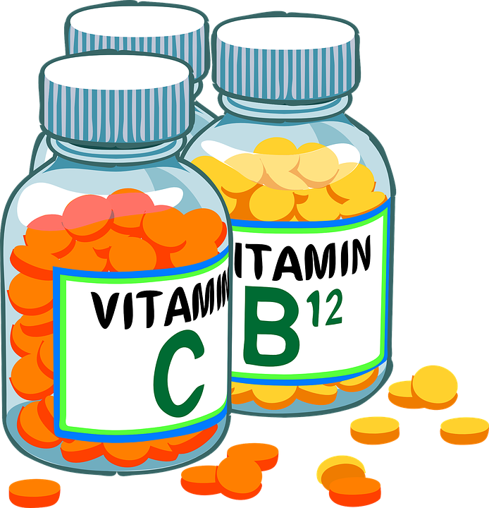
The vitamins C
Name: Jesse Lopez
Hr: 3 Date: 5/10/22

Slide 2
Vitamin C was discovered In 1928 Albert Szent Gvordyi, Professor of Chemistry at the University of Budapest isolated vitamin C from green pepper, a vegetable rich in this vitamin, and because of this discovery and others, he was given the Nobel Prize in Medicine and Physiology in 1937.

Slide 3
Meanwhile, ROCHE RESEARCHERS became interested in vitamins because of their physiological connections to hormones, which the company extracted from animal organs and sold. According to a Roche history published in 1996 to mark the company's centenary, the company was poised to enter the vitamin C market in the early 1930s using a technique developed by the Hungarian chemist Albert von Szent-Györgyi that involved the isolation of the vitamin from paprika.

Slide 4
Vitamin C is essential for the development and maintenance of the body, so its consumption is mandatory to maintain good health as well Vitamin C helps the development of iron absorption, growth and repair of normal connective tissue (softer skin , by the union of the cells that need this vitamin to join), to the production of collagen (acting as a cofactor in the hydroxylation of the amino acids lysine and proline), fat metabolism and wound healing. It is also considered an enhancing factor for the immune system, although some studies question the latter activity of vitamin C.

