Slide 1
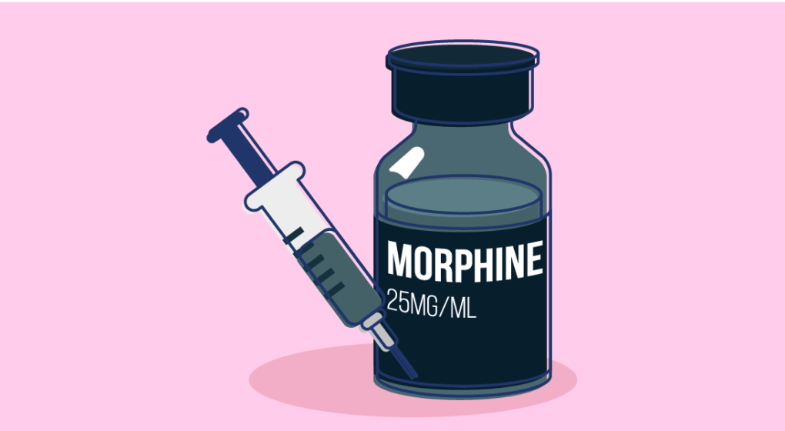
Morphine
by Gladys Sanchez

Slide 2
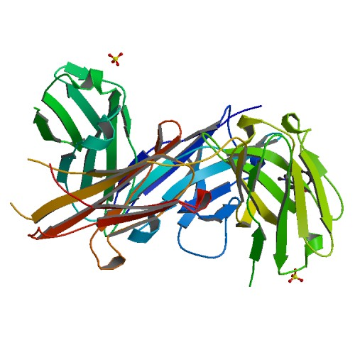
Introduction to Morphine
Who discovered the drug ?
Morphine was discovered by Friedrich Sertürner, a German pharmacist.
2) When was the drug first introduced ?
Morphine was first introduced in the year 1803.
3) When did it become a therapeutic medicine ?
In 1827, morphine was being used and sold as therapeutic medicine

Slide 3
What is Morphine used for ?
1&2) Which disease does the drug treat ? What causes the disease in the body How does the drug work in the body to cure the disease ?
Morphine is depressant that attaches to activate opioid receptors in the brain, spinal cord and also the gut. The drug is given by mouth or with an injection. Morphine is used to treat pain, such as chronic pain.

Slide 4
Morphine Side Effects
3&4) Is the drug effective ? How does the drug cause undesired side effects?
The number one negative side effect is the possibility of patients becoming addicted to morphine. The patient could become physically dependent of the drug and develop the slowing down of the brain. There could also be lack of sleep, respiratory problems and abnormal thoughts. Which could all eventually end with the consumer’s death.

Slide 5
Chemical Formula & Structure
Other names & CAS registry
Other names for Morphine:
7,8-Didehydro- 4,5-epoxy-17-methylmorphinan-3,6-diol
CAS registry :
57- 27 - 2

Slide 6
My Opinion on Morphine / Experts Opinion
I think there should be more exploration with other forms of relieving pain before people urgently go off and buy the medicine when it's not an “emergency situation"
I know that Morphine can be very helpful and beneficial to those who actually are in need of it. But it can be very easy for others to become needy and addicted to this medecine. I thinking that those willing to purchase the medicine should have some kind of test to be eligible to take the “pain killer” home.

