Slide 1
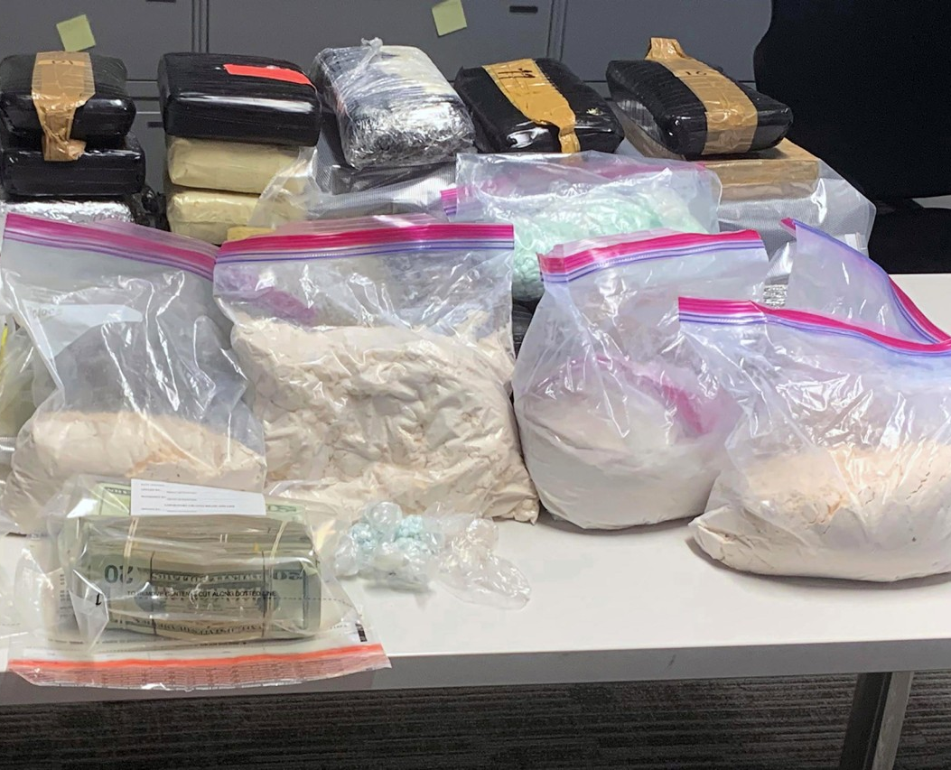
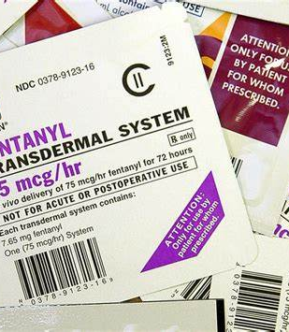
Fentanyl
One of the Strongest Opioids
by: Alejandra Ozornia (5th Hour)

Slide 2
History of the Drug:
fentanyl (fentanyl citrate) was discovered by chemist Paul Jansse
the drug was first introduced in 1960
fentanyl (fentanyl citrate) became a therapeutic medicine around the 1960s, as it was mainly used for surgical anesthesia and pain reliever

Slide 3
Mechanism of Therapeutic Action:
this drug was used to treat "breakthrough cancer pain or other types of moderate-to-severe chronic pain, including back pain and pain caused by sickle cell anemia."
the drug, fentanyl, is extremely effective in treating chronic pain that is a symptom of cancer and sickle-cell anemia

Slide 4
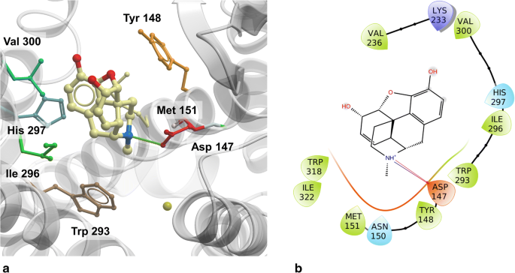
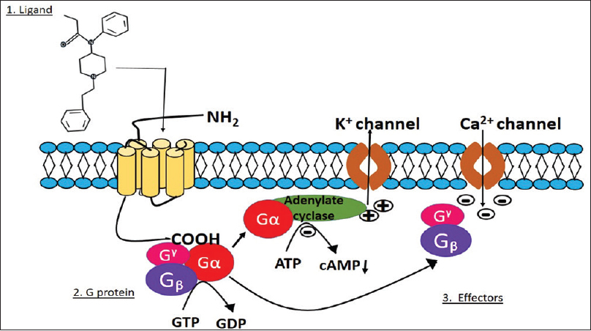
Mechanism of Action:
“Fentanyl is a[n] m-opioid receptor agonist with high lipid solubility and a rapid onset and short duration of effects. It rapidly crosses the blood-brain barrier.”

Slide 5
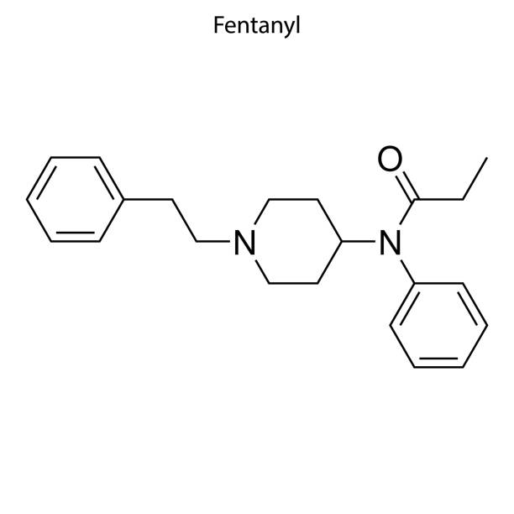
Cost of Fentanyl on the Street and Prescribed:
according to AddictionResource.net, fentanyl on the street is "one of the most dangerous and unfortunately also one of the cheapest opioids found... today."
the price of prescription fentanyl can vary depending on the type it is, the brand, and whether your insurance will cover it

Slide 6
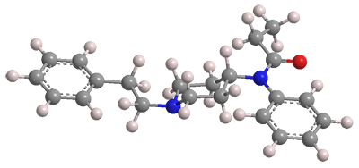
Name and the Other Names:
scientific name: N-Phenyl-N-[1-(2-phenylethyl)-4-piperidinyl]propanamide 2-hydroxy-1,2,3-propanetricaboxylate
other names: Actiq, Duragesic, Fentanest, Leptanal, Pentanyl, and Sublimaze

Slide 7
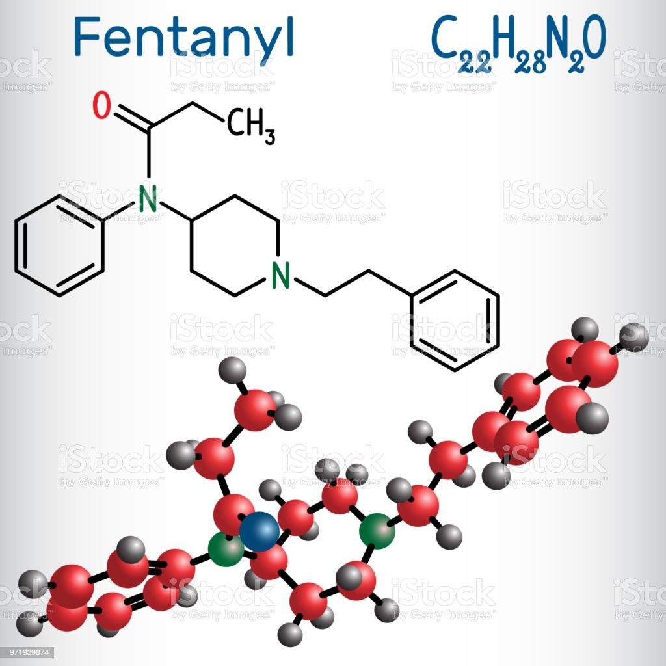
CAS Registry, Chemical Formula, and Structure:
CAS registry: 990-73-8
chemical formula: C₂₂H₂₈N₂O
chemical structure: down below :)

Slide 8
Reversing a Fentanyl Overdose:

Slide 9
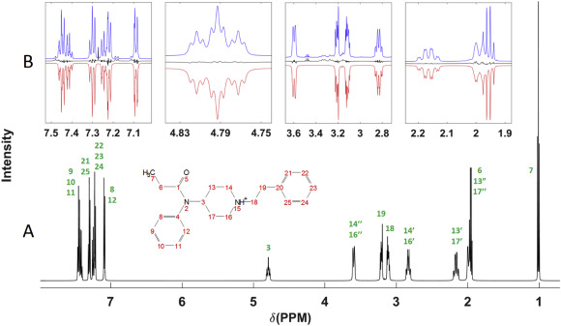
Fentanyl NMR:

Slide 10
Fentanyl IR:

Slide 11
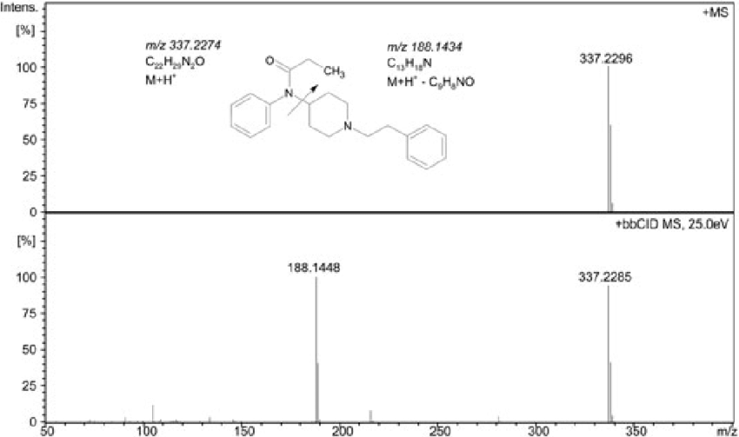
Fentanyl MS:

Slide 12
Synthesis of Fentanyl:

Slide 13
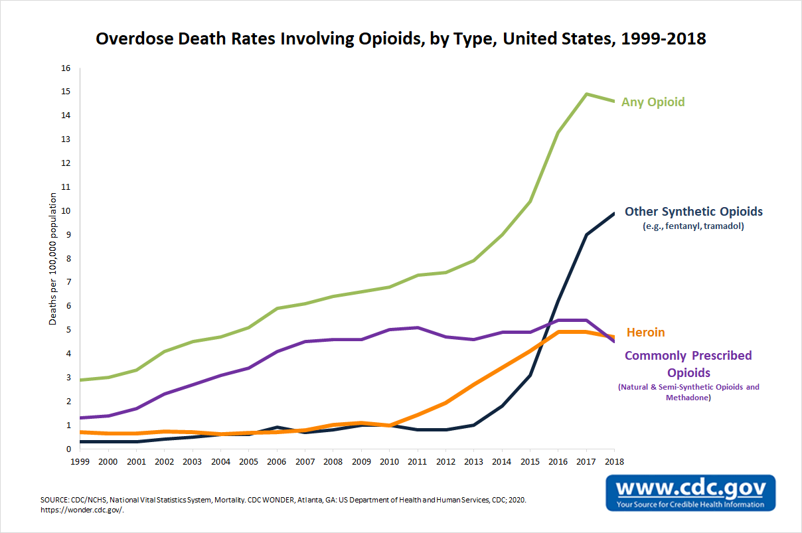
Personal Opinion :
Fentanyl is a drug that only requires a small amount to become lethal. It is typically prescribed to individuals with severe pain, but it is now a staple in the drug industry; many deaths involving fentanyl were considered "accidental" as the buyers were not aware of its presence in the "drugs" they purchased

Slide 14
Major Sources:
C&EN Special Issue: Top Pharmaceuticals: Drug Index (acs.org)
How Much Does Fentanyl Cost On The Street? - Addiction Resource
Opioid Abuse Nursing CEU - Nursing CE Central
credits to the owners of the Google Images :)

