Slide 1
Prozac
By: Shelby Hernandez-Olguin
5th Hour
Antidepressant

Slide 2
History of the Drug
Bryan B Molloy and Klaus K Schmiegel from Eli Lilly and company were who discovered Prozac
This drug was first introduced/announced in 1974
It became a therapeutic medicine as soon as clinical trials proved it to be effective
Cost:
$1,664 for one capsule of 10 mL​
Sales:
631 million in 2003

Slide 3
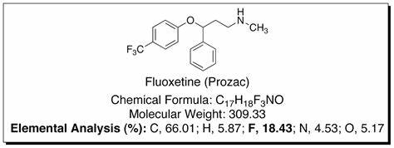
Chemical structure
CAS registry: 56296-78-7
Originally was named
Fluoxetine
Other names are N-Methyl
(Trifluoromethyl) and
benzenepronamine ​​
CAS registry:
56296-78-7

Slide 4
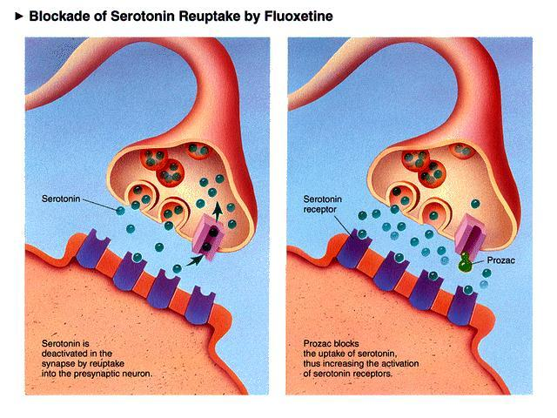
Function
Prozac treats depression.​
Depression is said to be caused, at least somewhat, by problems in the regulation of certain neurotransmitors, like serotonin. ​
​

Slide 5
Elimination route of Prozac in body

Slide 6
Molecular structure of Prozac

Slide 7
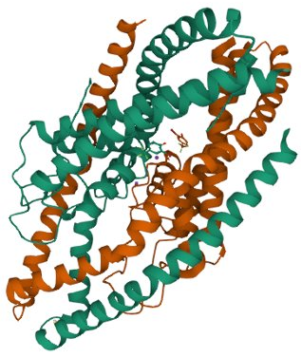
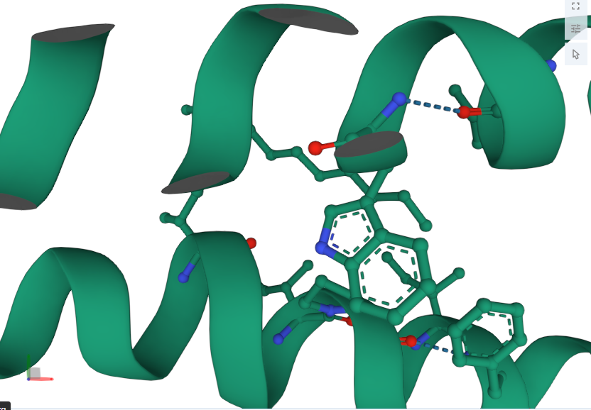
Crystal structure of human two pore domain potassium ion channel TREK2 (K2P10.1) in complex with a brominated fluoxetine derivative.

Slide 8
Pharmacophore of Prozac

Slide 9
Pharmacokinetics of Prozac

Slide 10
Synthesis of Prozac

Slide 11
Side Effects
Weight gain
Reduced positive feelings
Feeling dependent on the drug
Feeling emotionally numb
Prozac causes side effects to occur because it’s effect on the human system is not specific and this messes with lots more receptors that aren’t related to depression​

Slide 12
Withdrawal from Prozac
Digestive issues
Sleep problems
Bizarre sensations
Motor control problems
Dizziness

Slide 13
Thoughts on progression for Prozac...
Despite having Prozac proved to improve people's depression in a manner that doesn't cause many side effects, it still has it's impacting flaws and it must be addressed.
If it's possible to have less side effects than other antidepressants, there may be a chance there can be more side effects taken away. It may impact the effectiveness of the drug but that is also something that needs to be worked on

Slide 14
Sources:
1: The three-dimensional structure of two enzymes with bound... | Download Scientific Diagram (researchgate.net)
Are There Any Anxiety Medications That Cause Weight Loss (etuttor.com)
Prozac Withdrawal: Symptoms, Timeline & Treatment (verywellmind.com)
What Prozac Means (wisc.edu)
The effect of fluoxetine administration on the pharmacokinetics of... | Download Scientific Diagram (researchgate.net)
Mapping of the pharmacophore in (a) promethazine, (b) fluoxetine, (c)... | Download Scientific Diagram (researchgate.net)
Prozac SSRI Antidepressant Drug Structre Model made with Indigo Instrument (indigoinstruments.com) Atoms & Bonds.
Fluoxetine Pathway, Pharmacokinetics (pharmgkb.org)
currentsinbiology.tumblr.com
molecular structure of prozac; i'll probably have a bunch of different molecules in the tattoo | Molecule tattoo, Molecular, Molecular structure (pinterest.com)
Chemical & Engineering News: Top Pharmaceuticals: Prozac (acs.org)

