Slide 1
Prozac
By Ivan Alvarado

Slide 2
History of the drug
1. Who discovered the drug?
2.When was the drug first introduced?
3.When did it become a therapeutic medicine?
A: Molly and Klaus K. Schmiegel discovered Prozac
A: This drug was introduced in1987 by Eli Lilly and Company.
A: Prozac became a Therapeutic medicine in 1974

Slide 3
Mechanism of the therapeutic medicine
1.Which disease this drug treats? What causes the disease in the body?
2.How does the drug work in the body to cure the disease?
A: The disease that the drug cures is depression, what causes depression is problems in the regulation of certain neurotransmitters, particular serotonin, so levels of serotonin are usually.
A: The way the drug works in the body to cure the disease is by SSRI's blocks the reuptake pump on the sending cell, makes more serotonin available in the synapse to be taken in by the receiving cell.

Slide 4
3. Is the drug very effective in the treatment of the disease?
4.How does the drug cause undesired side effects?
A: The drug is effective but it had a few side effects and it works good on certain people.
A: The way the drug caused side effects was by long term change of structure in the brain. Examples of this is Blurred Vision, Headaches and Hypertension

Slide 5
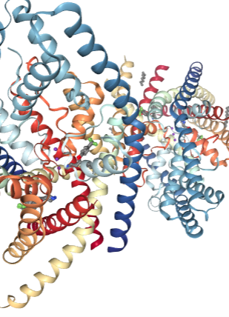
EnZYME
Prozac(fluoxetine)

Slide 6
Cost
1.Is the drug expensive?
2.Sales: For how millions of dollars is the drug sold yearly?
A: This drug is not expensive its really economical since it’s an over the counter drug.
A: The drug sells $631 million a year

Slide 7
Other Names
Prozac is also called Fluoxetine

Slide 8
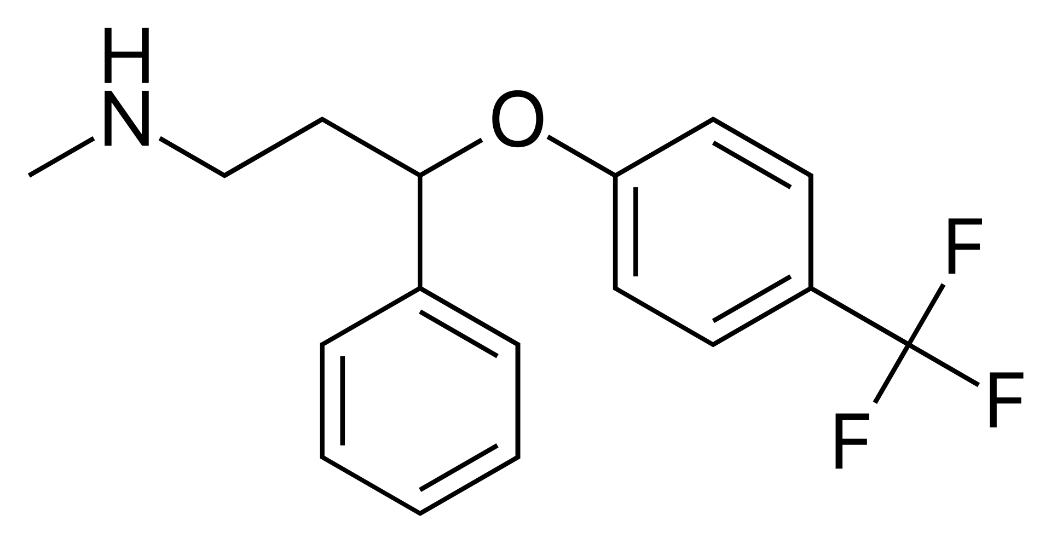
Cas Registry, formula, and structure
CAS:54910-89-3 Structure Formula:C17H18F3NO

Slide 9
My opinion
In my opinion I believe this drug is really good compared to other drugs that treat depression since it doesn’t really have many side effects. The only down side of this drug is that not many people react to it good which makes their depression worst. So overall I believe this drug is just ok and before getting consider a doctor about it.

Slide 10
The end

