Slide 1
Aspirin
Analgetic
Daniel Bustamante
Western international 5/26/2022

Slide 2
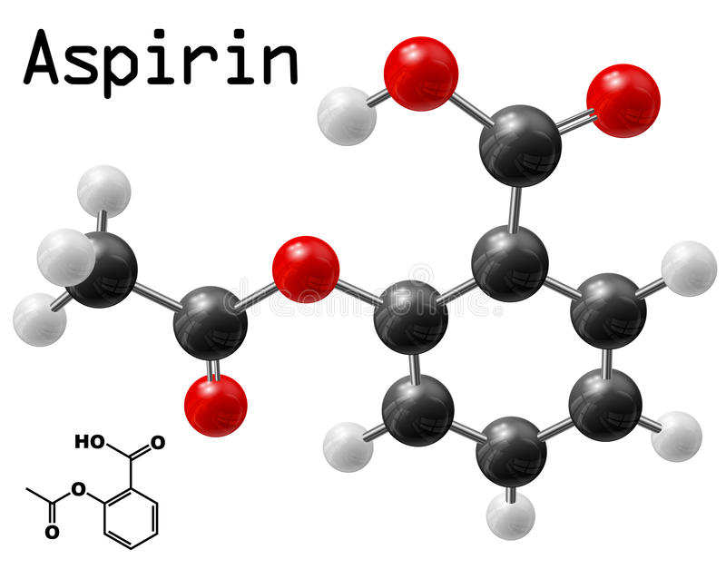

Slide 3
Despite being one of the world's oldest and most common drugs--perhaps the oldest drug used solely for therapeutic reasons--aspirin has been reluctant to give up its secrets. people have been using aspirin or naturally occurring analogs to treat pain and inflammation
History of the drug: aspirin
aspirin was discovered by Hoffmann a chemist.
Aspirin was first introduced in in 1899.
Aspirin became a therapeutic medicine in 1971.
Side effects Gastric acid hypersecretory conditions
Gastrointestinal irritation
Nause
Vomiting
Heartburn
z

Slide 4
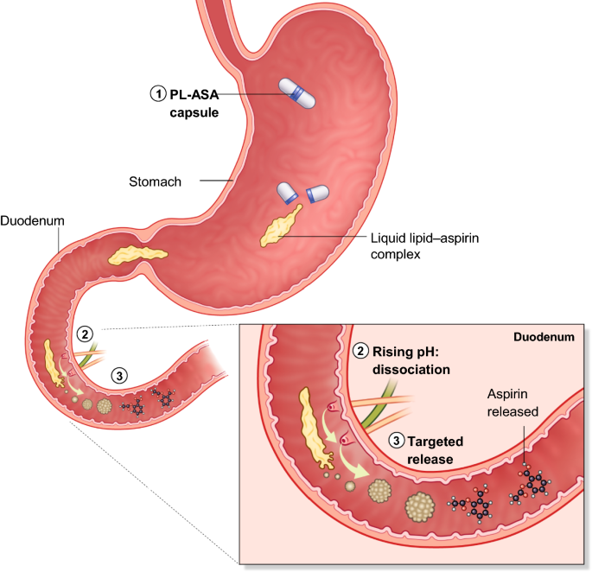
Long term effects:
Anemia (low red blood cell count) easy bruising and abnormal bleeding. inflamed stomach lining, stomach bleeding and peptic ulcers. vomiting blood that may look like coffee grounds and bowel motions that look like black tar
VAZALORE's drug delivery system employs a pH-dependent release mechanism that relies on chemical association of lipidic excipients with active pharmaceutical ingredients to selectively release them to targeted portions of the GI tract.

Slide 5
Synthesis of aspirin

Slide 6
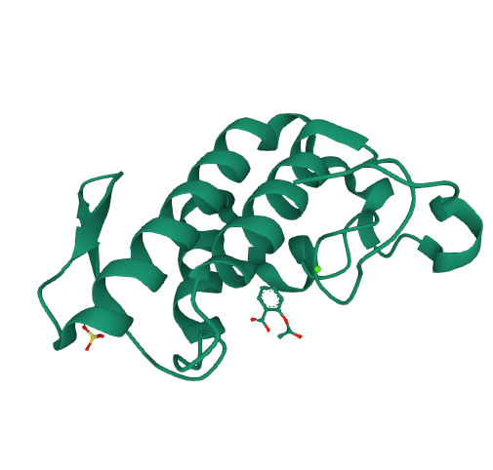
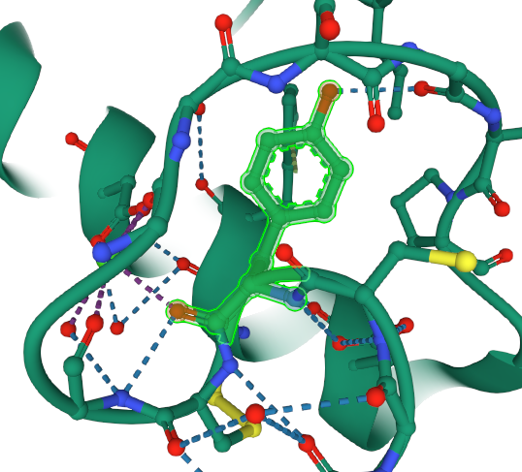
Crystal structure of a complex formed between group II phospholipase A2 and aspirin at 1.86 A resolution

Slide 7
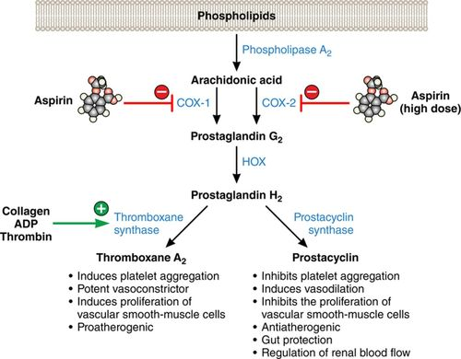

Slide 8
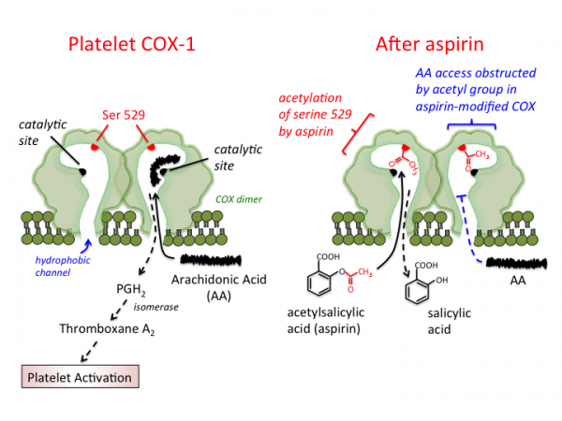

Slide 9
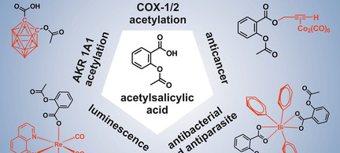
pharmacophore of aspirin

Slide 10
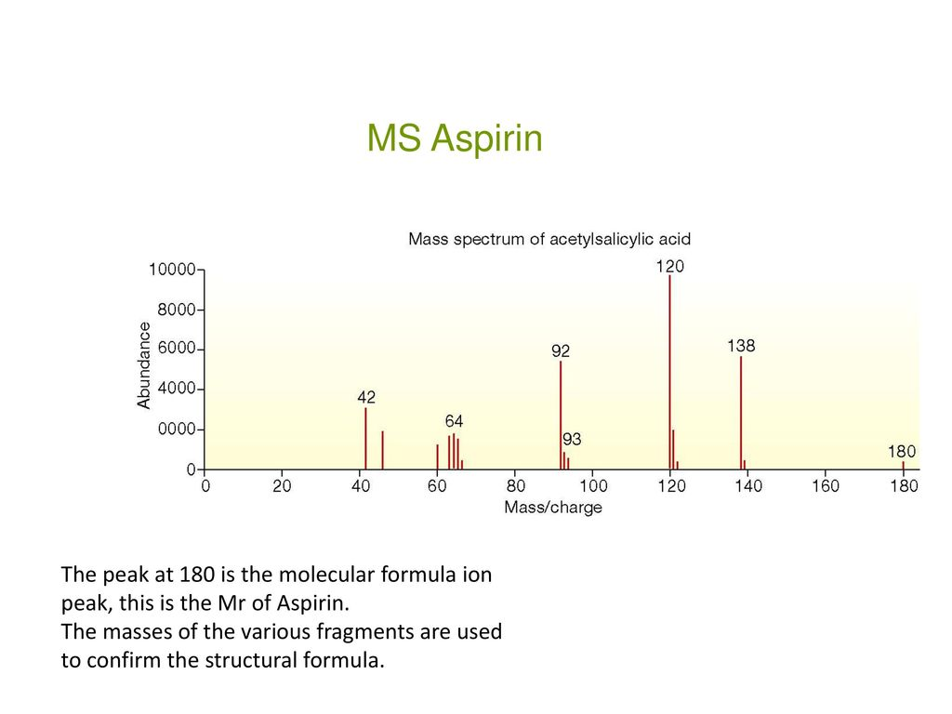
Mass spectrometry

Slide 11
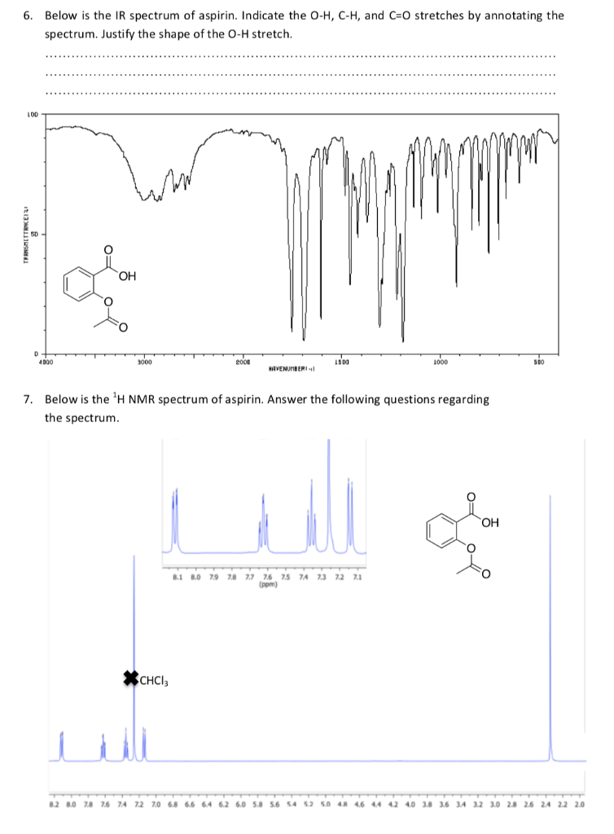
Infrared (IR)and nuclear magnetic resource (NMR) spectroscopy

Slide 12
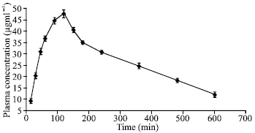
pharmacokinetics of aspirin

Slide 13
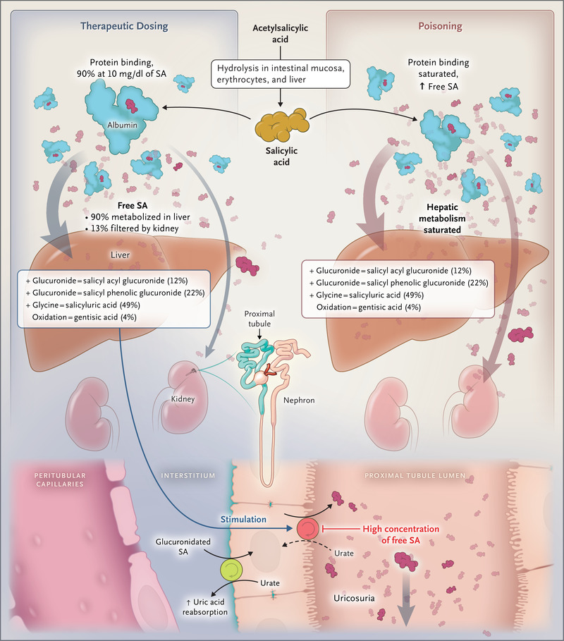
Toxicity of aspirin

Slide 14
Resources
http://nhsaab.weebly.com/
http://pubsapp.acs.org/cen/coverstory/83/8325/8325list.html?
http://pubsapp.acs.org/cen/coverstory/83/8325/8325aspirin
https://www.rcsb.org/

