Slide 1
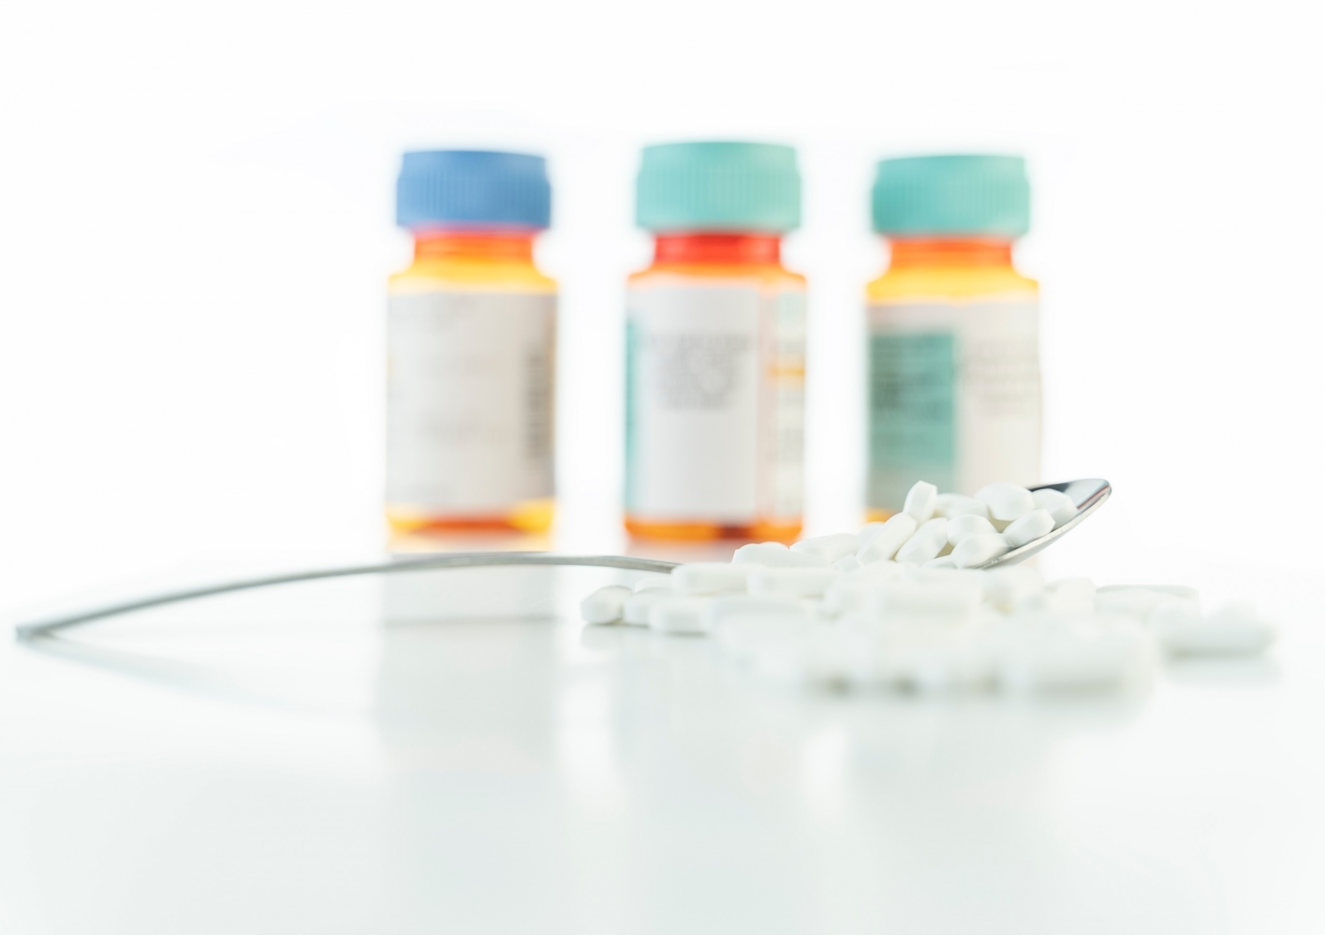
Rybelsus by Kayla Crowe hour: 7th

Slide 2
History of the drug
After several years of trial and error, Novo Nordisk became the first company to bring an oral GLP-1 receptor agonist to market. The diabetes drug is called Rybelsus.
Rybelsus was approved in the US in September 2019

Slide 3
Mechanism of Therapeutic Action
Rybelsus is used with diet and exercise to improve blood sugar control in adults with type 2 diabetes mellitus. Rybelsus is usually given after other diabetes medicines have been tried without success. Rybelsus is not for treating type 1 diabetes. It is used to manage blood glucose in conjunction with exercise and healthy diabetic meals.
Rybelsus also helps reduce the risk of heart disease and the risk factors for heart disease.
Rybelsus reduced the risk of heart- related deaths by 51% but did not have a meaningful difference on the risk of heart attack or stroke.

Slide 4
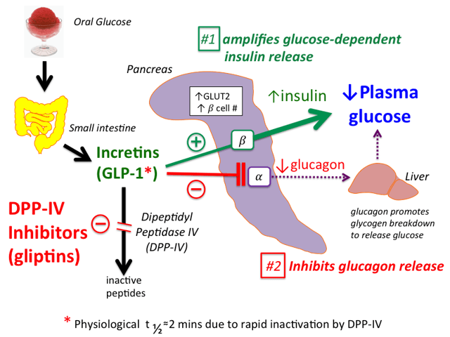

Slide 5
Side effects
Common side affects are …
-diarrhea
-nausea
-constipation
-vomiting
-acute abdominal pain
-appetite changes
-etc…

Slide 6
Rybelsus dosage
The Rybelsus dosage your doctor prescribes will depend on several factors. These include:
the severity of the condition you’re using Rybelsus to treat
other medical conditions you may have
Typically, your doctor will start you on a low dosage. Then they’ll adjust it over time to reach the amount that’s right for you. Your doctor will ultimately prescribe the smallest dosage that provides the desired effect.
The following information describes dosages that are commonly used or recommended. However, be sure to take the dosage your doctor prescribes for you. Your doctor will determine the best dosage to fit your needs.
Rybelsus comes as a tablet that you swallow. It’s available in the following strengths: 3 mg, 7 mg, and 14 mg.

Slide 7
Cost and sales
The cost you find on GoodRx.com is what you may pay without insurance. The actual price you’ll pay depends on your insurance plan, your location, and the pharmacy you use.
Your insurance plan may require you to get prior authorization before approving coverage for Rybelsus. This means that your doctor and insurance company will need to communicate about your prescription before the insurance company will cover the drug. The insurance company will review the request and let you and your doctor know if your plan will cover Rybelsus.
If you’re not sure if you’ll need to get prior authorization for Rybelsus, contact your insurance company.
Novo Nordisk’s launch of Rybelsus (semaglutide) in Q4 2019 has defied full-year sales expectations in 2020, a year defined by the Covid-19 global pandemic. Full-year 2020 global sales for Rybelsus were DKK1.873gn ($305M), which exceeded many forecast estimates that took the Covid-19 pandemic into consideration.

Slide 8
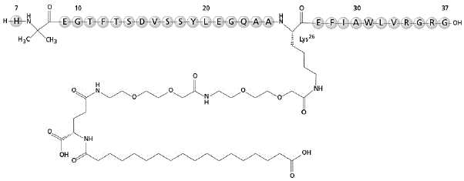
Chemical structure

Slide 9
Rybelsus and insulin
Rybelsus and insulin
You may be more likely to have hypoglycemia if you take Rybelsus and any type of insulin.
Examples of insulin include:
insulin aspart (Novolog)
insulin detemir (Levemir)
insulin glargine (Lantus)
insulin human (Novolin R, Humulin R)
If you’re taking insulin, tell your doctor before you start using Rybelsus. They can create a plan to monitor your blood sugar. Also, your doctor may want to decrease your dose of insulin during your Rybelsus treatment.

Slide 10
Sources
www.rxlist.com
www.pharmaceutical-technology.com
www.drugs.com
www.rybelsus.com
www.medicalnewstoday.com

