Slide 1
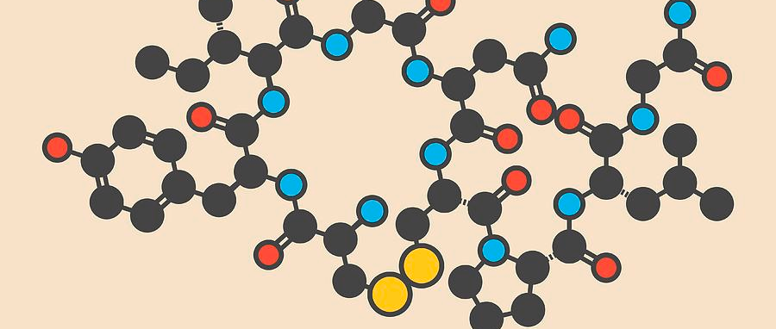
Oxytocin
Hormone
By: Christopher Bustamante

Slide 2
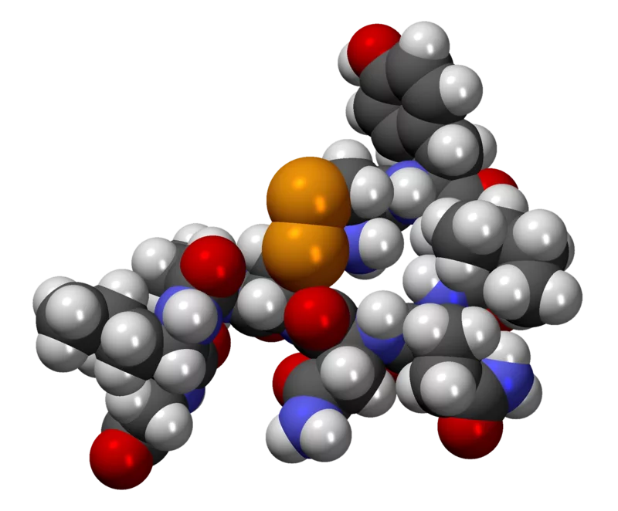
Chemical Structure
Molar mass: 1007.19 g/mol
C₄₃H₆₆N₁₂O₁₂S₂

Slide 3
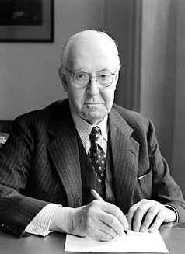
History of the Drug
Oxytocin was first discovered in 1909 by Sir Henry H. Dale who used the extract from the human posterior pituitary gland to contract the uterus of a pregnant cat.
Oxytocin has been in use ever since 1911 and is still used as a method of inducing as well as augmenting labor.
1909
1909
1911
The drug was first introduced in 1909 to an animal but by 1911 physicians began to use the new drug to stimulate childbirth contractions.

Slide 4
Therapeutic Usage
Men
Oxytocin is also present in men, playing a role in transport and production of testosterone by testes. Oxytocin at 10 micrograms significantly increased both the output of fluid and the number of spermatozoa by twofold. Oxytocin at 100 micrograms produced a greater increase in both fluid output and the number of spermatozoa within 10 min of administration of the peptide.
Oxytocin also referred to as the “love hormone” or “cuddle chemical” due to its effects on human behaviors such as sexual arousal, recognition, trust, romantic attachment, and mother-infant bonding which can lead to long term use or addiction for both men and females
Women
This drug helps induce and augment women when they’re in labor as well as contracting the smooth- muscle cells surrounding the mammary glands to move milk into the nipple. Also causes a lot of unexplored effects on the human brain. The drug works by contracting the uterus of the pregnant person helping them with labor. It stimulates the uterine muscle to contact allowing for a strong and ready body response.

Slide 5
Mechanism of Action
It activates G protein coupled receptors that trigger increases in intracellular calcium levels in uterine myofibrils.
G Protein Receptor- G protein coupled receptors (GPCRs) are integral membrane proteins that are used by cells to convert extracellular signals into intracellular responses, including responses to hormones, neurotransmitters, as well as responses to vision, olfaction and taste signals.

Slide 6
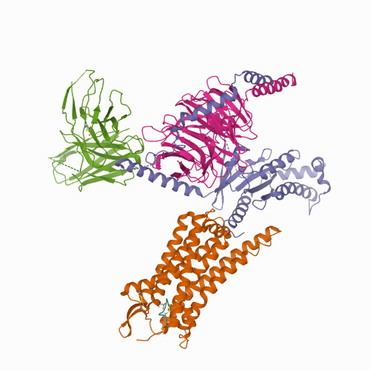
Biological Assembly
Ligand Assembly
,

Slide 7
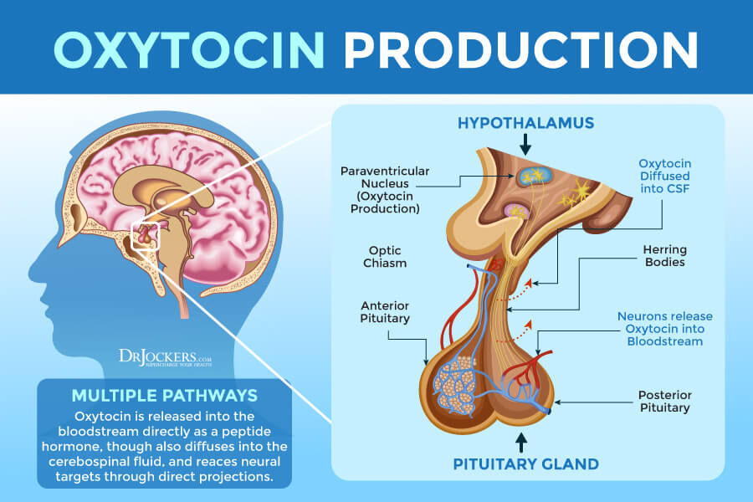
In vivo Synthesization
Oxytocin is synthesized from the longer precursor in the paraventricular nucleus of the hypothalamus and then deposited in the posterior pituitary. The precursor protein consists of 160–170 amino acid residues and is split during transportation along the axon to the terminals in the posterior pituitary.

Slide 8
In vitro Synthetization

Slide 9
Economy and Cost
The cost for oxytocin injectable solution (10 units/mL) is around $29 for a supply of 25 milliliters, depending on the pharmacy you visit.
The oxytocin market is valued at US$25.242 million for the year 2019 growing at a CAGR of 5.46% reaching the market size of US$36.628 million by the year 2026.

Slide 10
Effects Of Drug Use
The drug is very effective and usually prescribed to mothers struggling to produce milk to help them.
Can cause confusion, convulsions, heavy breathing, etc. The drug has the opposite effect of adrenaline leading to said effects
The negative effects of having too much oxytocin are linked to prostatic hyperplasia, a condition that affects more than half of men over 60 causing difficulty passing urine as it directly affects the prostate.
The negative effects of having too little oxytocin are also unclear but it has been linked to a lack of milk ejection reflex for nursing mothers as well as to autism an autistic spectrum disorders.

Slide 11
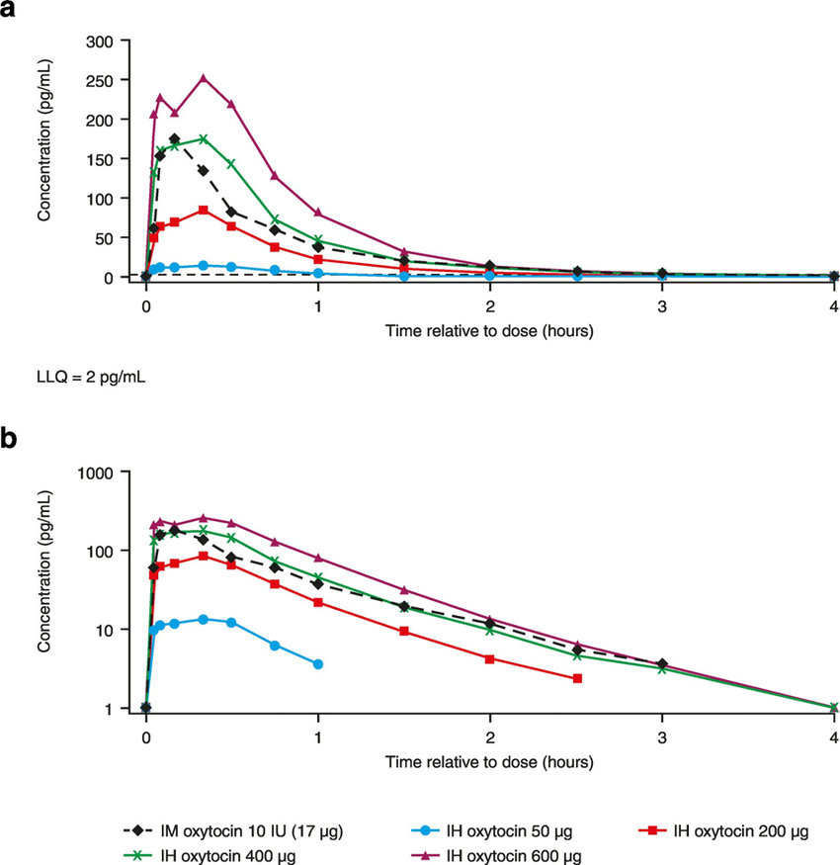
Pharmacokinetic of Oxytocin

Slide 12
References
Oxytocin: The love hormone - Harvard Health
Oxytocin Uses, Side Effects & Warnings - Drugs.com
Oxytocin: Uses, Interactions, Mechanism of Action | DrugBank Online
Pitocin (oxytocin) dose, indications, adverse effects, interactions... from PDR.net
Oxytocin | C43H66N12O12S2 - PubChem (nih.gov)

