Slide 1
Morphine
Narcotic
Daniel Cabanas
Alyssa Gonzalez
Juan Gutierrez
Western International High School

Slide 2
The history of the drug
Discovery of morphine. Morphine was discovered by Freidrich Wilhelm Adam Serturner (1783-1841) an obscure, uneducated , 21-year-old pharmacist’s assist with the little equipment but loads of curiosity. Serturner wondered about the medicinal properties of opium, which was widely used by 18th-century physicians.
German scientist Friedrich Sertuner first isolated morphine from opium in 1803.

Slide 3
Morphine: An opioid analgesics
This medication is used to treat severe pain. Morphine belongs to a class or drug known as opioid analgesics. It works in the brain to change how your body feels and responds to the pain.
Depending on your specific product this medication is given by injection into a vein, into a muscle or have a doctor do it for you. Another way is by taking Morphine to relieve short-term or long-term severe pain.
Morphine is a very effective medicine for pain management that is used often in both adults and children. It’s a strong pain reliver and it can also be used to manage shortness of breath. When you take a tablet of Morphine, you’ll likely start to feel pain relief in 4 to 6 hours.
When taking Morphine, it may cause some unwanted side effects. The more common side effect are blurred vision, drowsiness, shortness of breath, sweating, unusual tiredness or weakness, difficulty in passing urine etc.
Less common side effects are dry mouth, bloating, diarrhea, muscle pain or cramps, constipation, vomiting etc.

Slide 4
Cost
Morphine is an excellent drug for use in developing countries. It is cheap, effective, simple and easy to administer by mouth.

Slide 5
(5alpha,6beta)-7,8-Didehydro-4,5-epoxy-17-methylmorphinan-3,6-diol
CAS Registry
57-27-2
Molar mass: 285.34 g/mo

Slide 6
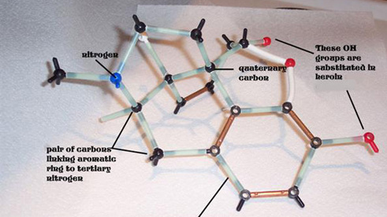
Chemical structure

Slide 7
MECHANISM OF ACTION
The drug is a central nervous system depressant that binds to and activates opioid receptors in the brain, spinal cord, and gut. It competes with endorphins--the endogenous opioids in the body that attenuate pain--for the receptors.
See slide below

Slide 8
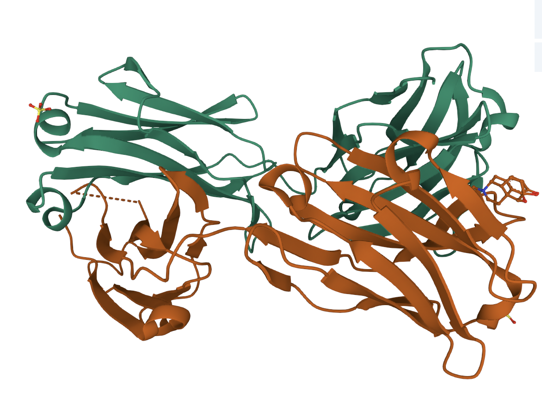
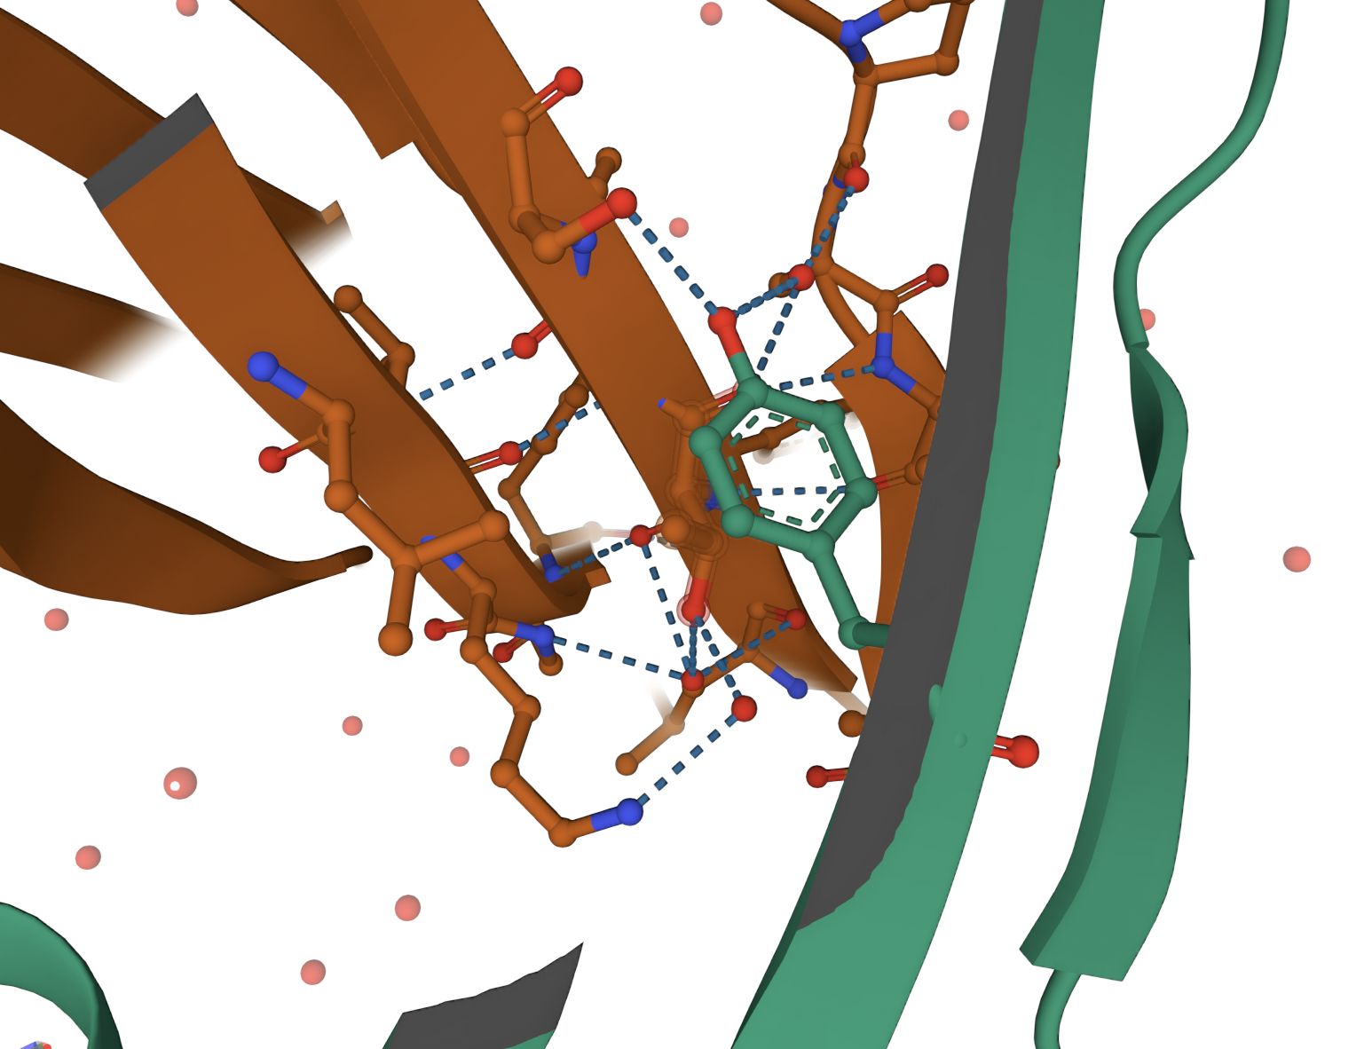

Slide 9
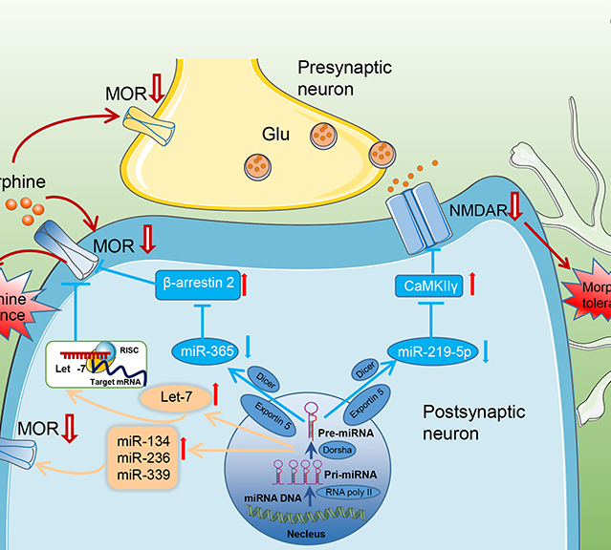
Morphine at the molecular level
The net effect of morphine is the activation of descending inhibitory pathways of the CNS as well as inhibition of the nociceptive afferent neurons of the PNS, which leads to an overall reduction of the nociceptive transmission.

Slide 10
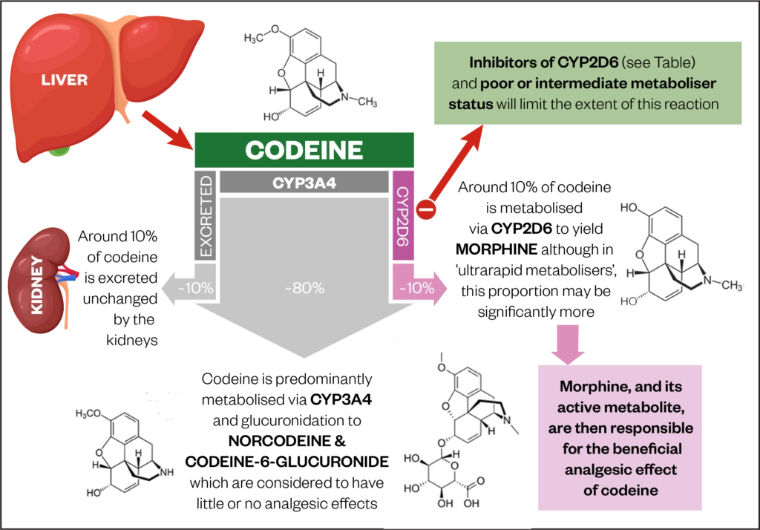
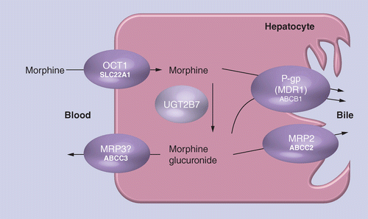
pharmacokinetics of morphine

Slide 11
pharmacophore morphine

Slide 12
IN VITRO SYNTHYESIS OF MORHPINE

Slide 13
morphine in brain

Slide 14
how to reverse overdose of morphine

Slide 15
My opinions
My opinion to morphine if that. This drug is really gods for pain as people say it works perfectly by doing its job but At the same time this drug can cause lot of issues like possibly death or can get you to Disease, but I feel it depends on how people use it, but I think this drug is very powerful

