Slide 1
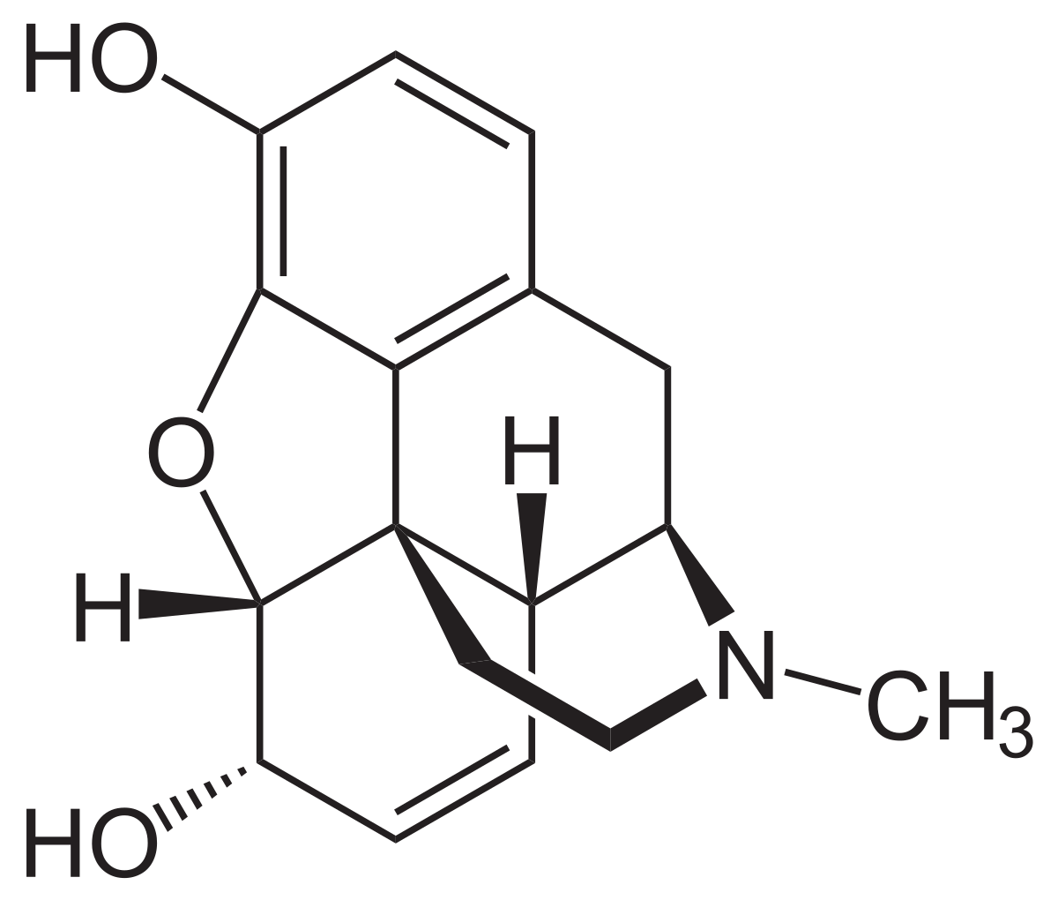
Morphine

Slide 2
What is morphine?
Morphine is the most abundant analgesic opiate found in opium and is a potent pain reliever.
The drug is used in clinical pain relief but is also used illicitly for recreational purposes among drug users.
It is potentially highly addictive and can cause intense physical dependence that leads to abuse of the substance.

Slide 3
A) History of morphine
Who discovered the drug? Friedrich Wilhelm Adam Sertürner.
When was the drug first introduced ? Morphine was first isolated between 1803 and 1805, Merick began marketing it commercially in 1827.
When did it become a therapeutic medicine? 1830’s

Slide 4
B) Mechanism of therapeutic action :
1) Which disease does this drug treat? What causes the disease in the body?
2) How does the drug work in the body to cure the disease?
Morphine has treated breathless in patients with severe chronic obstructive pulmonary disease (COPD).
It works on your nervous system and brain to reduce the amount of pain you feel.

Slide 5
Continuation of B) (2) Mechanism of therapeutic action:
3) Is the drug very effective in the treatment of the disease?
4) How does the drug cause undesired side effects?
Effectiveness of inhaled opioids is however still a matter of controversy.
The side effects of morphine vary somewhat and while some of the adverse effects seem with initial therapy are short-term, others may be long-term, especially when the drug is used over longer durations of time.

Slide 6
C) Cost :
1) Is the drug expensive? The lowest GoodRX price for the most common version of morphine ER is around $26.30, 66% off the average retail price of $77.92. 2) For how millions of dollars is the drug sold yearly? 389.6 million.

Slide 7
D) morphine medicine names
Mister Blue •God’s Drug
Dreamer •Morpho
•MS •Morf and more

Slide 8
E) CAS registry
57 – 27 – 2

Slide 9
F) Chemical formula and structure
Chemical Structure
Chemical Formula? C17H19N03

Slide 10
G) Our opinion about morphine.
My opinion on Morphine is that it’s good medicine when you are in serious pain. Morphine taken by mouth produced good pain relief for most people with moderate or severe cancer pain. Morphine immediate release is rapidly absorbed, and would usually be taken every four hours. Though it helps many people, this medication may sometimes cause addiction. So only use when given directions from your doctor.
By: Yadira, Katherine, Daniela, Mariana, Lizbeth, Sawel / Chemisty 6th hour

