Slide 1
Top Pharmaceuticals Project
Narcotic: Morphine

Slide 2
History of drug
Friedrich Wilhelm Adam Sertürner was a German pharmacist. He is best known for his discovery of Morphine.
Morphine was first isolated in pure form from dried poppy resin by German apothecary Friedrich W. Sertürner (1783-1841) in the early 1800s.
Between 1805 and 1816, a pharmacist’s assistant called Friedrich W. Sertürner managed to isolate a yellowish-white crystalline compound from crude opium after immersing it in ammoniated hot water.

Slide 3
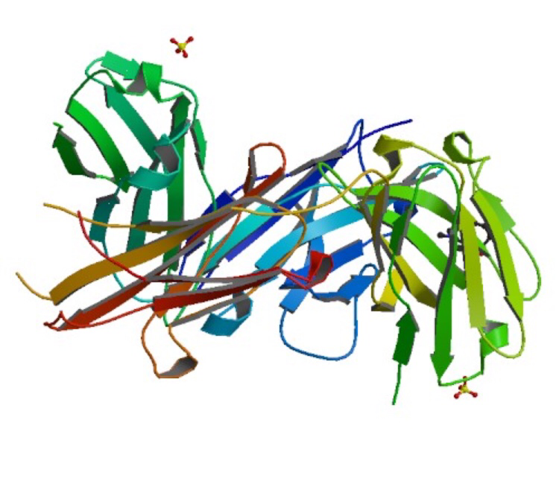

Slide 4
Mechanism of therapeutic action
The morphine drug treats the narcotic disease. The withdrawal syndrome from narcotics generally includes signs and symptoms opposite of the drug’s intended medical and effects.
Morphine can be effective in the treatment of the disease.
There are several general side effects of opioid medications such as morphine that can affect some people, such as drowsiness, dizziness, headaches, dry mouth, and urinating less often.
Morphine works by activating opioid receptors that naturally exists in your body, which have a number of effects on your body. One of these is to provide analgesia and relieve pain, which is what the drug is used for.

Slide 5
Cost
Morphine can be expensive, like it can be cheap. It depends where and from whom you buy it.
Yearly, morphine is sold for about 147.2 to148.4 millions of dollars.

Slide 6
Opiod receptors
Definition: opioid receptors are a group of inhibitory G protein-coupled receptors with opiods as ligands
How do they work?: in many ways, the field of protein interactions is at the forefront of opiod receptor molecular pharmacology, as research moves from previous work in heterologous expression system to in vivo approaches
Types of Opioid receptors: MOP receptor, DOP receptor, KOP receptor, and NOP receptor
Morphine is a MOP receptor

