Slide 1
MEDICAL MARIJUANA Antiemetic
By: Jesse Lopez
Western International high school
2021-2022

Slide 2
History of the drug
Irish physician William O'Shaughnessy reintroduced cannabis to British medicine after noting its benefits to patients in India in 1830.
In the 1840s and 1850s, medical marijuana was introduced to treat headaches, increase appetite, and ease sleep.
This drug is approved for medical use in 2013

Slide 3
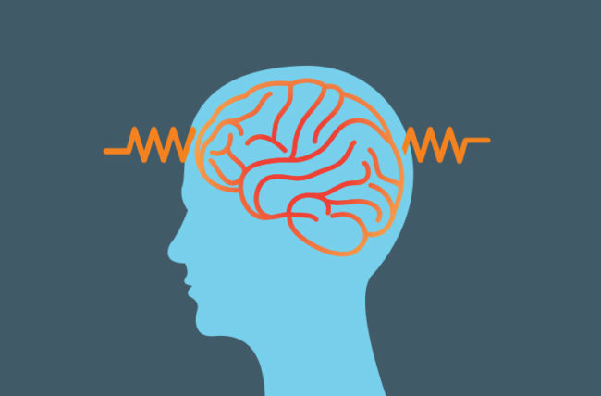
What does this drug treat?
Ease the pain
Control nausea and vomiting
Make a person feel like eating
Multiple sclerosis
Crohn's disease
inflammatory bowel disease
Epilepsy
Cancer
HIV/AIDS

Slide 4
Cureness of Disease
On an aesthetic level, they help maintain the appearance of healthy and toned skin.
It is also used to treat skin problems with an inflammatory process and an autoimmune component, such as dermatitis, eczema, psoriasis and rosacea.
It is also used for decontracting and relaxing massages, helping to maintain function and flexibility, relieving discomfort.

Slide 5
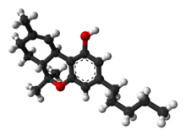
Chemical Formula and Structure
The fully systematic name for this THC isomer is (−)-(6aR,10aR)-6,6,9-trimethyl-3-pentyl- 6a,7,8,10a-tetrahydro-6H-benzo[c]chromen-1-ol. Two related substances, Δ⁹- tetrahydrocannabinol-2-oic acid and Δ⁹-tetrahydrocannabinol-4-oic acid (THCA), are also present in cannabis, sometimes in large amounts.

Slide 6
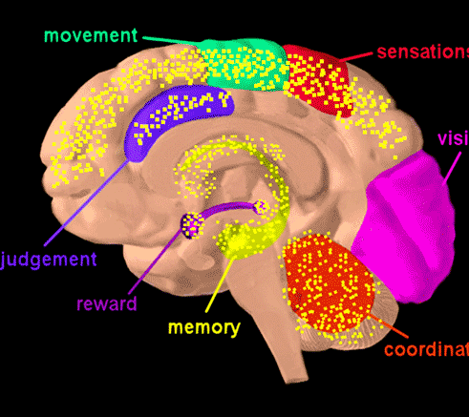
Side Effects
Fast or irregular heartbeat
Dizziness
slow reaction times
Drowsiness
A strong sense of joy or well-being
short-term memory loss
trouble concentrating
Confusion
Decrease or increase in anxiety

Slide 7
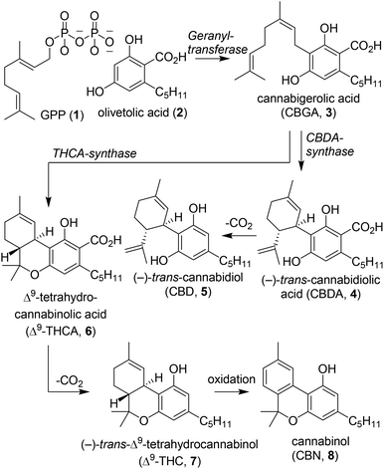
Lab systhesis of cbd
Although a large collection of synthetically prepared cannabinoids has been reported, the synthetic approaches employed have not yet been systematically reviewed for tetrahydrocannabinol. Here we will provide an overview of the most prominent synthetic pathways towards the THC scaffolding.

Slide 8
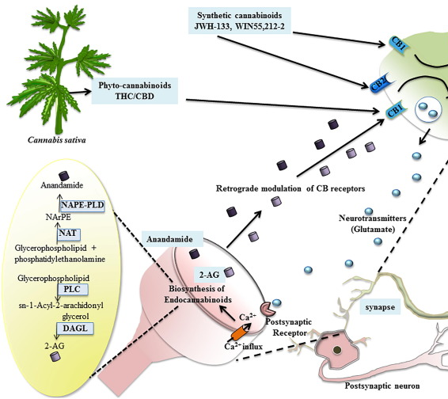
Mechanism of Action
Cannabinoids function by stimulating two receptors, cannabinoid receptor type 1 (CB1) and type 2 (CB2), within the endocannabinoid system. This system is a complex network of organs throughout the body, expressing the cannabinoid receptors and playing a homeostatic role.

Slide 9
Additional Facts
The US Food and Drug Administration (FDA) has not approved the use of cannabis for the treatment of any medical condition.
United States federal law prohibits the use of the entire Cannabis sativa plant or its derivatives for any purpose.
Marijuana leaves and buds contain substances known as cannabinoids. THC is a cannabinoid that can affect the brain and change your mood or consciousness.

Slide 10
Credit
Medical marijuana - Mayo Clinic
https://essencevegas.com/es/blog-es/como-se-descubrio-la-marihuana-una-historia-completa-de-la-marihuana/#:~:text=En%20el%20siglo%20XIX%2C%20cuando,los%20pacientes%20en%20la%20India.
https://medlineplus.gov/spanish/ency/patientinstructions/000899.htm

