Slide 1
Marijuana Medicine
By: Jasson Bustillo and Alison Porfirio

Slide 2
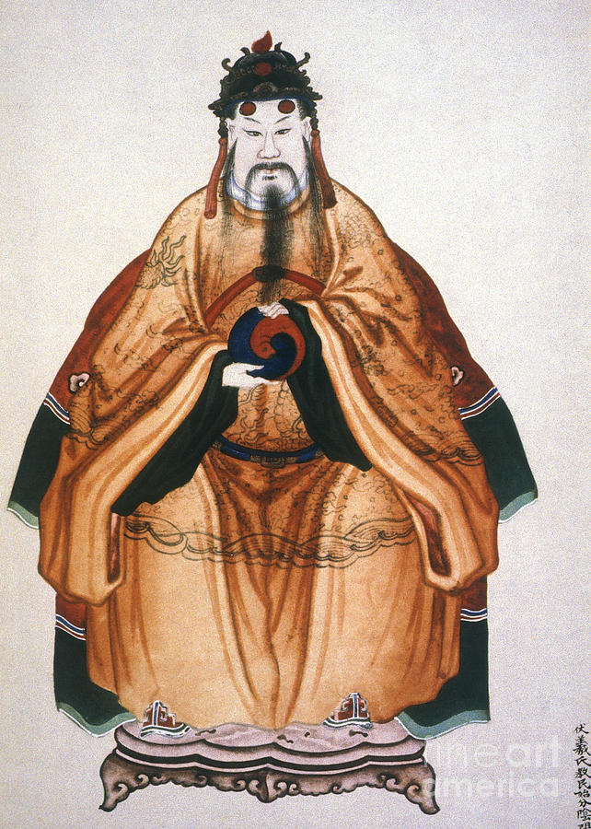
Who discovered the drug?
The Chinese Emperor Fu Hsi(vs. 2900B.C.), whom the Chinese credit with bringing civilization to China, seems to have made reference to Ma, the Chinese word for cannabis, noting that cannabis was very popular medicine that passessed both Yin and Yang.

Slide 3
When was the drug first introduced?
The drug was first introduced in the 2900 B.C.

Slide 4
When did it become a therapeutic medicine?
Between 1996 and 1999, right U.S. states supported cannabis prescription opposing policies of the federal government. Most people who are prescribed marijuana for medical purposes use it to alleviate severe pain.

Slide 5
Which disease does this drug treat?What causes the disease in the body?
This drug is mainly used to relieve pain. The pain can be headechesbl, a disease like cancer, or a long-term condition, like glaucoma or nerve pain.

Slide 6
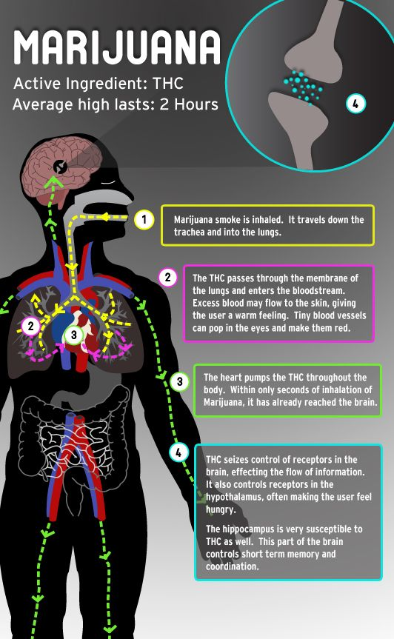
How does the drug work in the body to cure the disease?
Cannabinoid interact with your body by way of naturally occurring cannabinoid receptor embedded in cell membranes throughout your body. There are cannabinoid receptors in your brain, lungs, liver, kidneys, and immune system. Both the therapeutic and psycharicellve properties of the marijuana occur when a cannabinoid activates a cannabinoid receptor.

Slide 7
Is the drug very affective in the treatment of the disease?
The drug helps to relieve pain but it's not to cure a medical problem. This is only to relieve and release pain from your body.

Slide 8
How does the drug cause undisered side effects?
An additional concern with "medical marijuana" is that little is known about the long-term impact of its use by people with health- and/or age-related vulnerabilities—such as older adults or people with cancer, AIDS, cardiovascular disease, multiple sclerosis, or other neurodegenerative diseases.

Slide 9
Is The Drug Expensive?
Depending on location and state regulations. However, on average they will be around $80 to $150 for new medical marijuana.

Slide 10
For How Many Millions Of Dollars Is The Drug Sold Yearly?
Medical marijuana sales are predicted to hit $9.7 billion in 2017, a 33% increase over 2016, according to a new report.

Slide 11
Others Names For Medical Marijuana Are:
Cannabis indica
Cannabis ruderalis
Cannabis sativa

Slide 12
The CAS Registry For Medical Marijuana:
1972-08-3

Slide 13
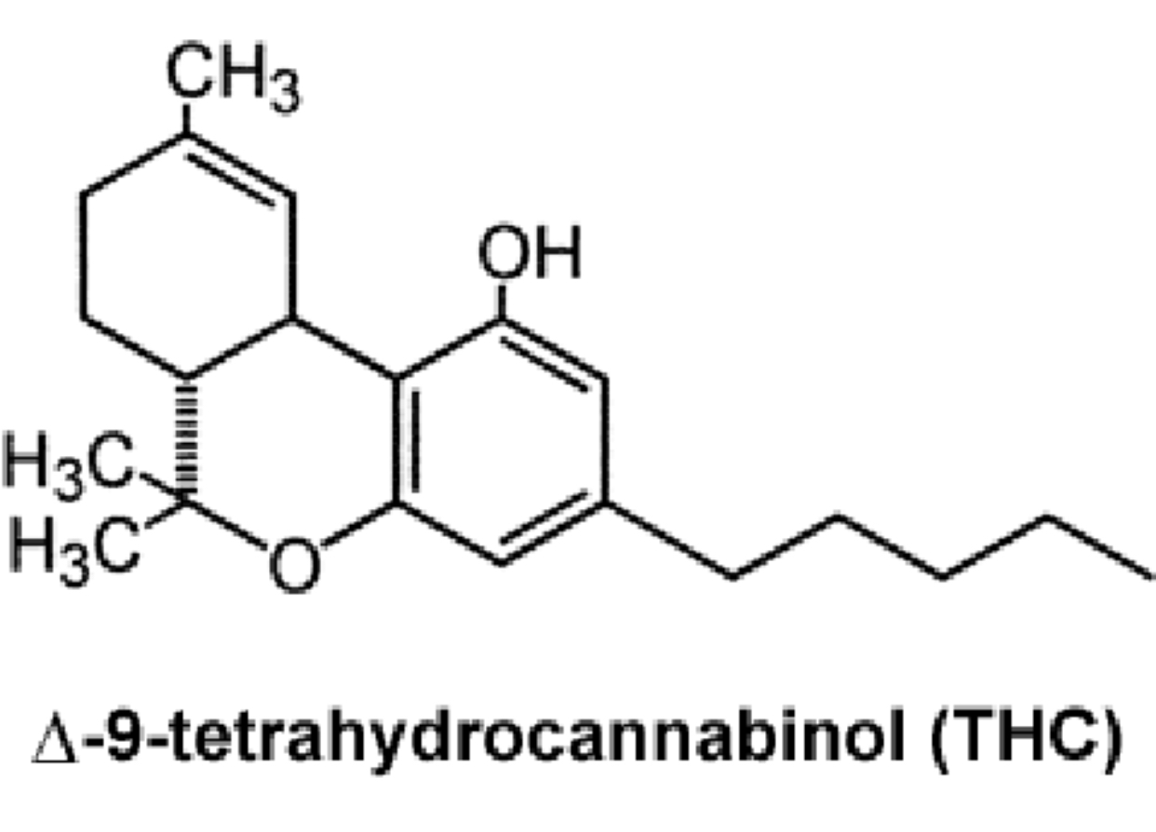
Chemical Formula and Structure for medical Marijuana:
Chemical Formula
C21H30O2
Structure

Slide 14
Our Opinion This Drug:
Medical marijuana shows considerable promise in reducing chronic pain from a widespread number of causes. But there is a lack of high quality data that shows marijuana for most medical purposes is both safe and effective.

