Slide 1
Librium
Antianxiety
by Josue Mejia
Western International High School :2021-2022

Slide 2
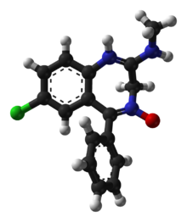
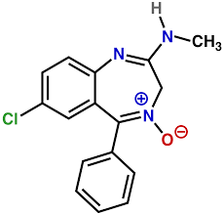
Librium: CHLORDIAZEPOXIDE HYDROCHLORIDE

Slide 3
C₁₆H₁₄ClN₃O.ClH or C₁₆H₁₅Cl₂N₃O
7-Chloro-N-methyl-5-phenyl- 3H-1,4-benzodiazepin-2-amine 4-oxide hydrochloride
CAS Registry
438-41-5
Other Names
Librium
A-Poxide
SK-Lygen

Slide 4
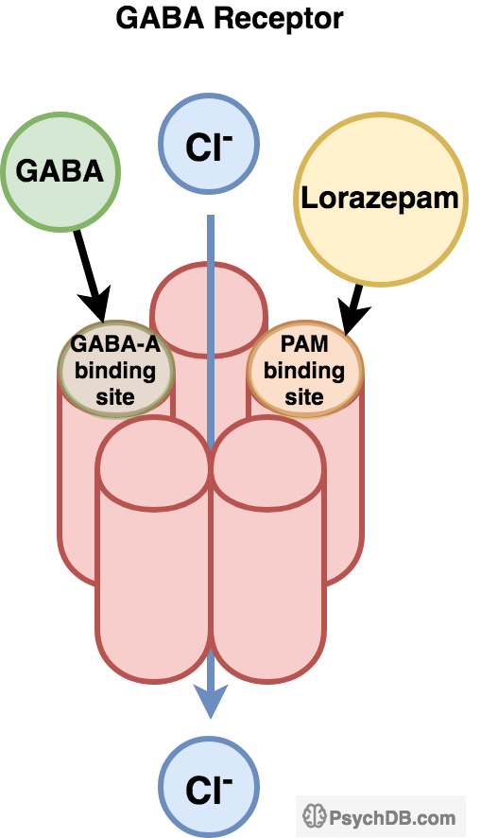
Mechanism of action
It apparently works by affecting the actions of the inhibitory neurotransmitter *-aminobutyric acid (GABA) in the brain.

Slide 5
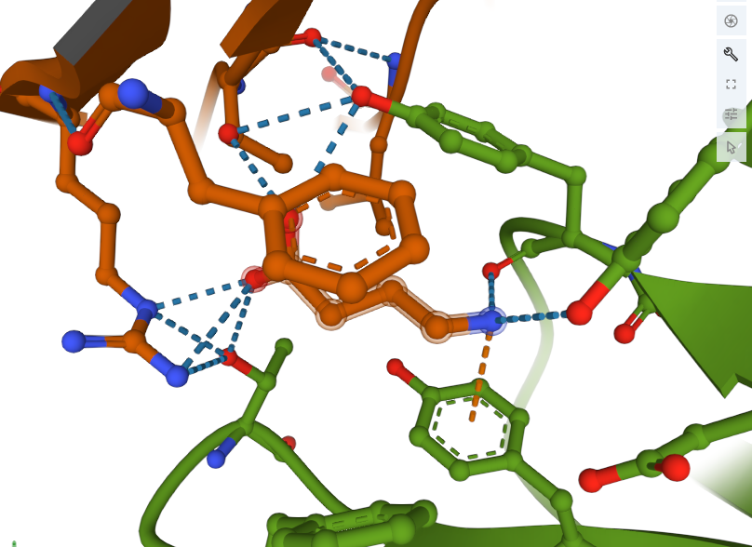
Cryo-EM structure of the benzodiazepine-sensitive alpha1beta1gamma2S tri-heteromeric GABAA receptor in complex with GABA (ECD map)

Slide 6
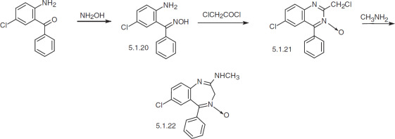
In Vitro Synthesis of Librium

Slide 7
Who discovered the drug? When was it indroduced?
Leo strenbach was responsible for li i think it was introduced in the 1930s or 1950s .
It became a therapeutic medicine in 1960.
the trade name Librium as a tranquilizer, finding it effective for relieving anxiety; treating insomnia, muscle spasms, and the symptoms of alcoholism; and preventing seizures.

Slide 8
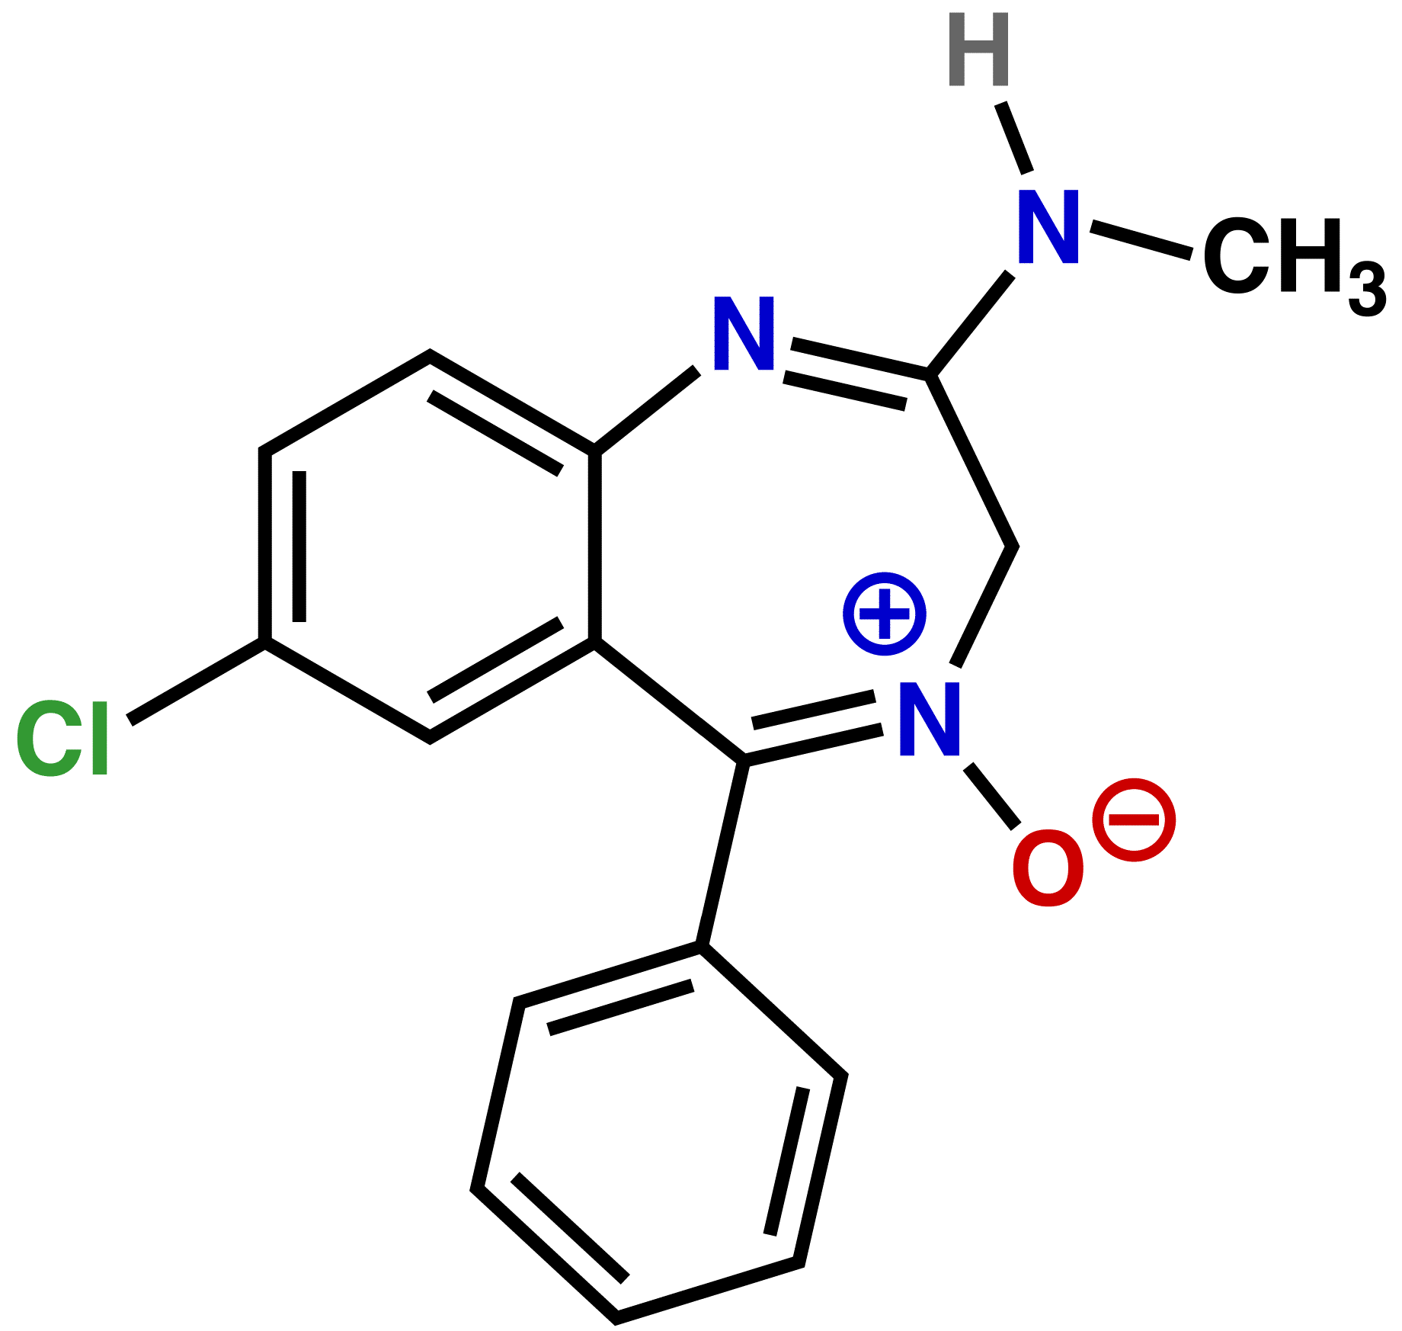
The enzyme of librium is
ain activity is slowed as it releases fewer excitatory neurotransmitters, which results in the dampened emotions, relaxed muscles, and impaired memory seen with benzodiazepine use.
it is estimated that benzodiazepines may be abused by 90% of alcohol abusers and illicit drug users. One of the compounds, Rohypnol, considered about 10 times more potent than Valium as a CNS depressant, is known as the date-rape drug because of its association with that crime.
the main problem was that benzodiazepines were found to be addictive.

Slide 9
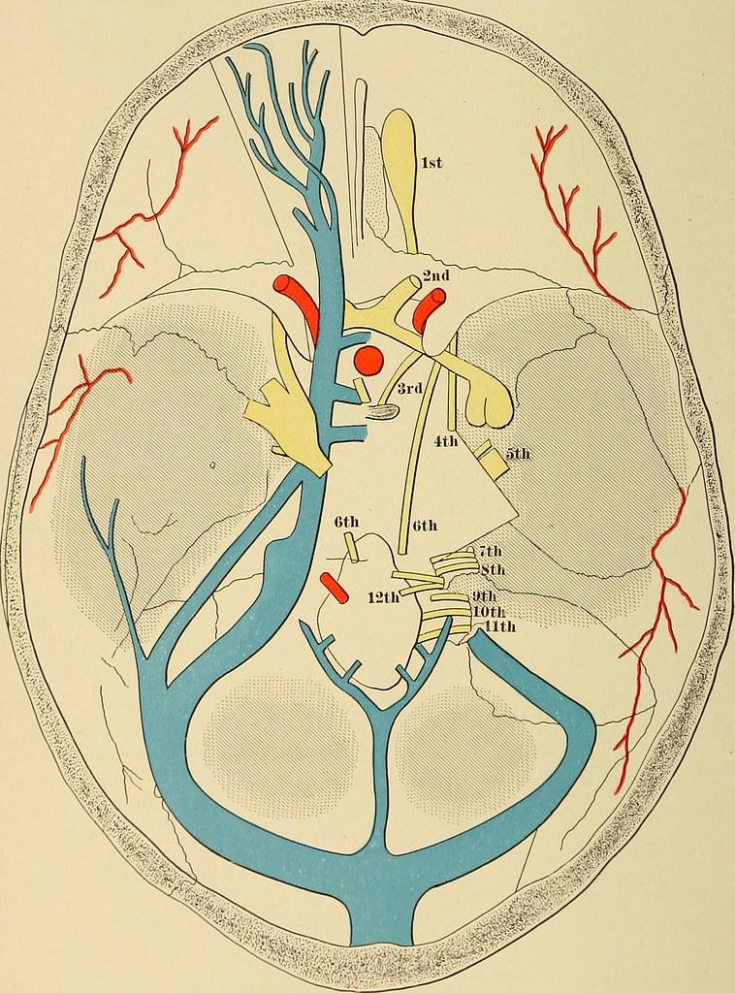
Cost
The cost for chlordiazepoxide oral capsule 25 mg is around
10 dollars for a supply of 3 capsules.
It did not take many years before doctors discovered that these compounds, when discontinued, could cause dangerous withdrawal symptoms such as convulsions, tremors, abdominal and muscle cramps, vomiting, and sweating. So many people became addicted to these drugs that the problem appeared in novels, movies, jokes, and, eventually, congressional hearings.

