Slide 1
Librium
By: Gabriela, Juan, and Nancy

Slide 2
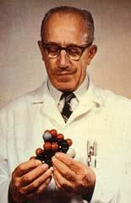
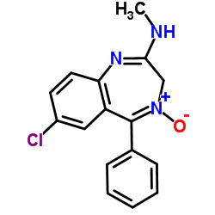
History of the Drug
The drug was discovered by Leo Sternbach.
The drug was first introduced in the 1960s.
It became a therapeutic medicine in the 1970s.

Slide 3
Mechanism of Therapeutic Action
The disease this drug treats is anxiety, alcohol withdrawal symptoms, and tremor. The disease causes it to act on the brain and nerves. The action is not entirely understood.
To cure the disease the drug works by acting on receptors in the brain called GABA that causes the release of a neurotransmitter in the brain. It increases it's claiming effect and results in sleepiness, a decrease in anxiety and relaxation of muscles. It's also used in the treatment of alcoholism for it's sedating and anxiety-relieving effects which help relieve the symptoms of alcohol withdrawal
The side effects of this drug are sedation, sleepiness, drowsiness, confusion, dizziness, and balance problems.

Slide 4
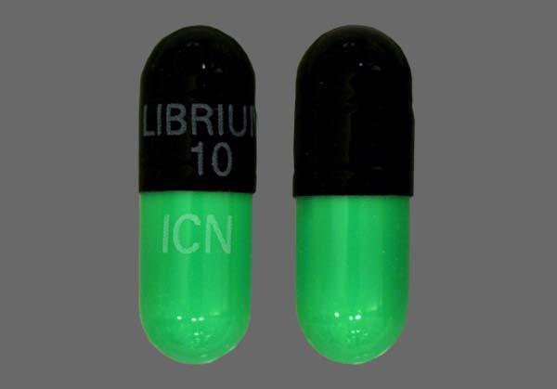
Cost of Drug
This drug isn't so expensive the price is between $ll.29-25.69 dollars.
The drug is sold 2.8 million dollars yearly.

