Slide 1
L-DOPA Antiparkinsonian
Arturo murillo
2nd hour
05//22
Western international high school 2021-2022

Slide 2
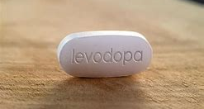
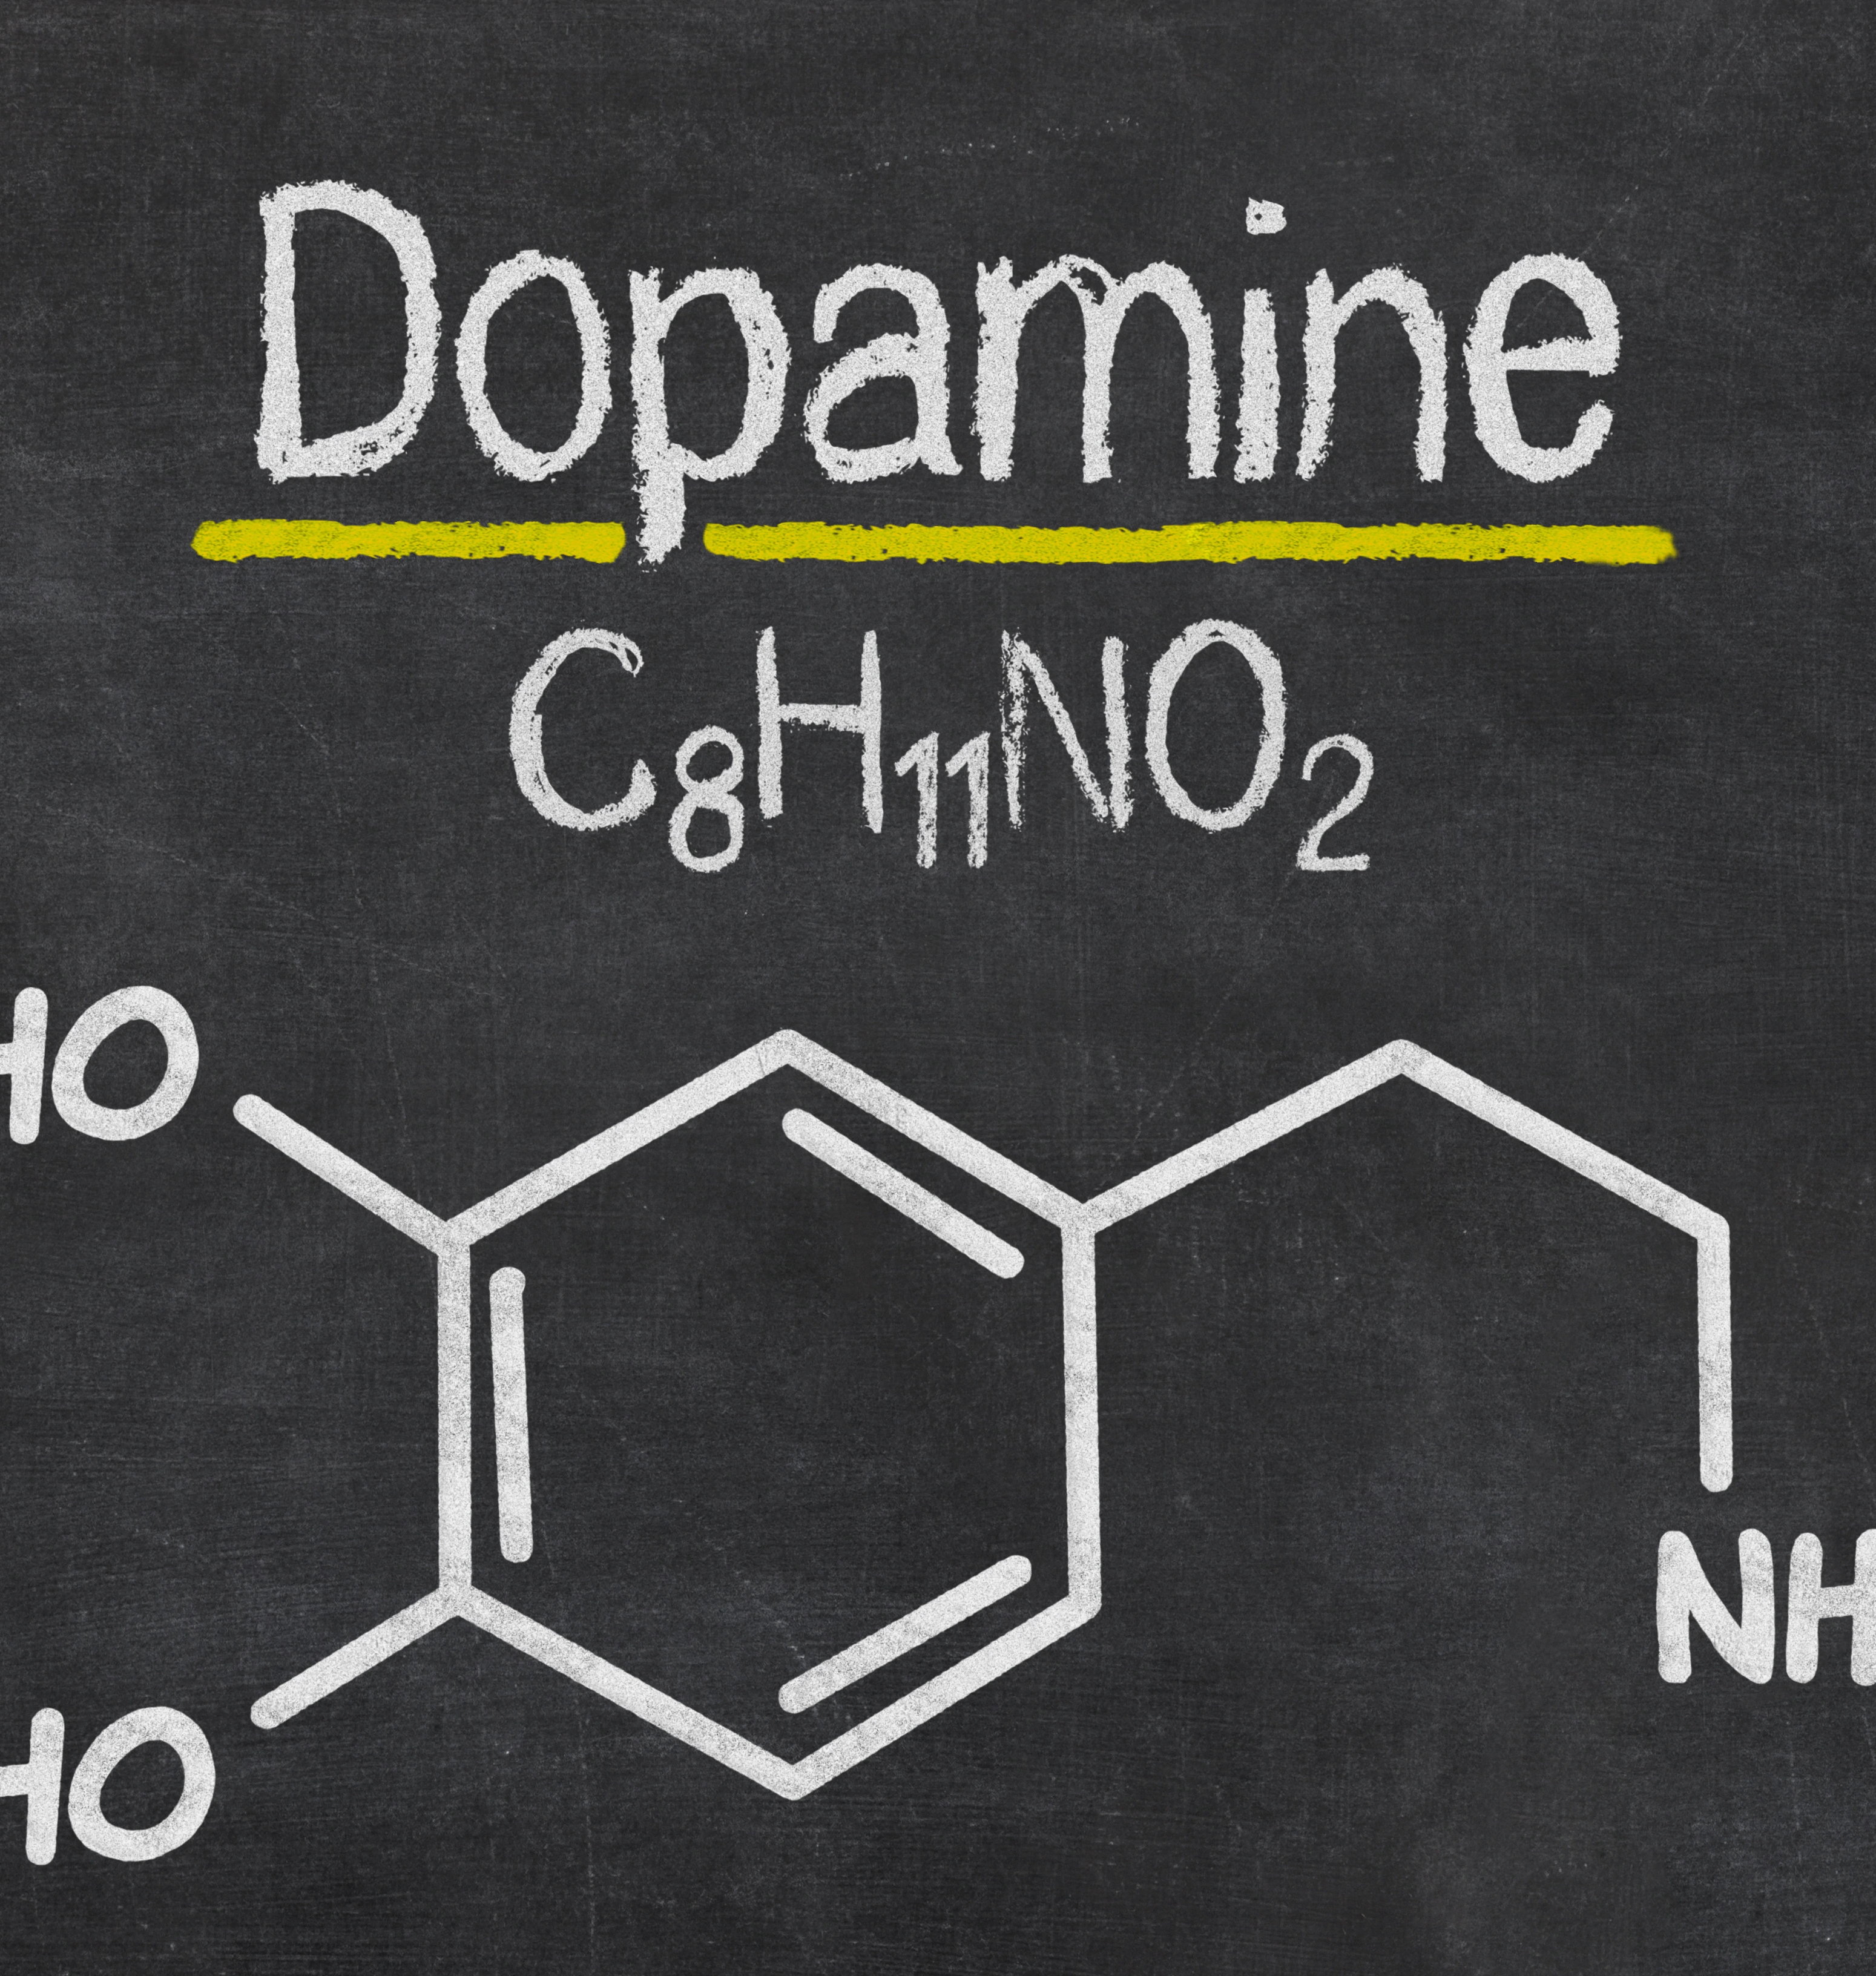
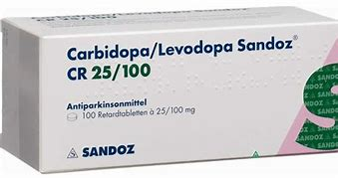

Slide 3
What is l-Dopa?
A very effective pharmacological therapy treatment for Moter symptoms in Parkinson's diseases.
an amino acid that is one of the main precursors to dopamine.

Slide 4
History of l-dopa
L-dopa was actually first discovered in 1913, but was initially considered of no use. Over 40 years later, researchers decided to investigate L-dopa further and discovered its benefits for Parkinson's patients as well as a myriad of other health benefits.

Slide 5
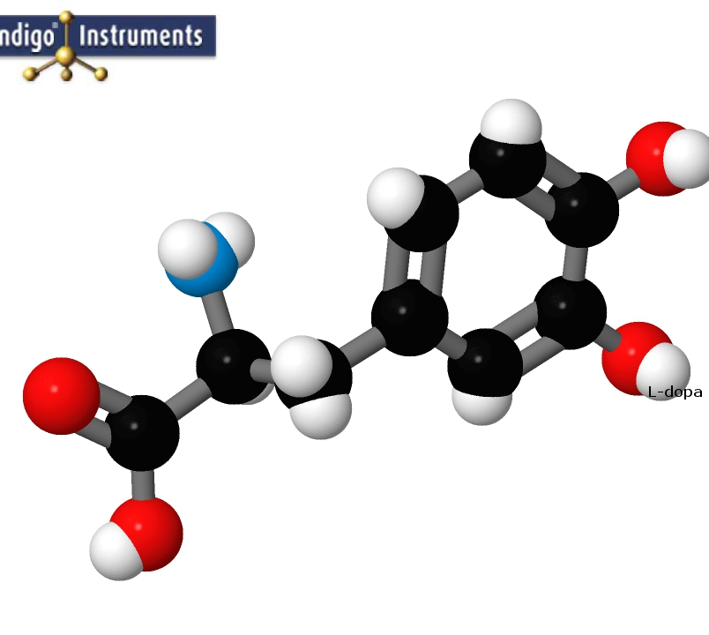
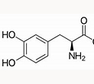
Chemical formula?
C9H11NO4
amino acid

Slide 6
Benefits of l-dopa
aiding individuals who suffer from Parkinson's Disease
L-dopa can help lessen the symptoms of Parkinson's by helping to supply the body with more dopamine
elevate your mood, reduce depression and lessen the symptoms of anxiety
production of more dopamine which in general makes you feel better emotionally
L-dopa can increase both sexual function and libido in men

Slide 7
Symptoms of l-dopa
Muscle cramps
Stiffness in the muscles
Lack of energy
Anxiety
Depression
Constipation
Severe mood swings
Self-harming thoughts or actions
Decreased sex drive

Slide 8
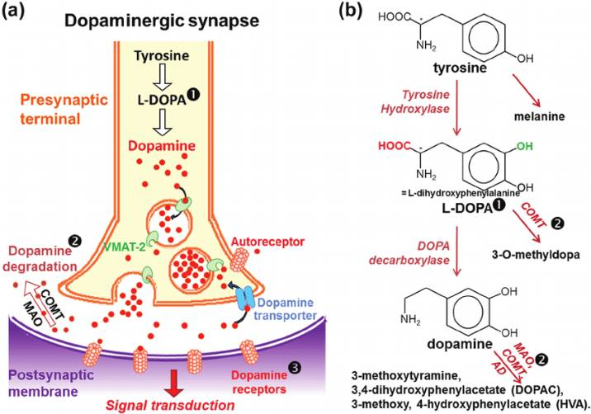
Mechanism of dopamine ?
L-DOPA (LEVODOPA) MECHANISM OF ACTION L-DOPA IS A DOPAMINE PRECURSOR L-DOPA IS A DIRECT PRECURSOR OF DOPAMINE

Slide 9
Inbrija (levodopa) - inhalation

Slide 10
Pharmacokinetics of Inbrija

Slide 11
Pharmacokinetics of LDopa

Slide 12
Resources
https://www.google.com/url?sa=i&url=https%3A%2F%2Flink.springer.com%2Fcontent%2Fpdf%2F10.1007%2Fs00415-006-3009-3.pdf&psig=AOvVaw3rO00LowTkCuIWuXKkmHek&ust=1653660565839000&source=images&cd=vfe&ved=0CAkQjRxqFwoTCOjAlOyr_fcCFQAAAAAdAAAAABAI
https://www.google.com/url?sa=i&url=https%3A%2F%2Fwww.rxlist.com%2Finbrija-drug.htm&psig=AOvVaw0Q9Sgi1ivLaNpqN8o9Yf9I&ust=1653660450759000&source=images&cd=vfe&ved=0CAkQjRxqFwoTCOCwtums_fcCFQAAAAAdAAAAABAD
https://umzu.com/blogs/health/how-to-supplement-with-l-dopa#what

