Slide 1
Research medicine project
Insulin
By Delacy Tart-Morgan 3rd hr chemistry

Slide 2
History of the drug
The drug insulin was discovered on July 30, 1921 by a Canadian physician named Fredreck Banting and a medical student named Charles H. Best. In January 1922 in Toronto, Canada insulin was introduced. When a 14-year-old boy, Leonard Thompson, was chosen as the first person with diabetes to receive insulin.

Slide 3
Mechanism of therapeutic action
The drug insulin is used for the disease known as diabetes. Diabetes is caused when the pancreas can't maintain your A1C and the sugars in your blood. The pancreas is supposed to use the sugars in your blood to create its own insulin which is used to give the body energy but when your pancreas doesn't do so you need to get a form of insulin which is where the medicine comes into play so that a person gets the necessary insulin and energy into there body that they need. When you are given the right amount of insulin into your body and is very effective it helps you keep your energy and your blood sugar levels in check. The Drug is taken right before you eat food so if you take the drug and don't eat a side effect is that you will begin to feel very hungry and you won't have much energy.

Slide 4
Cost
Insulin only costs up to $25 dollars for non insured patients. Yearly insulin costs up to $24 billion dollars. Another name for insulin is soluble insulin other types of insulin names are Humalog or Basaglar. C256H381N65O76S6 is the CAS registry for insulin.

Slide 5
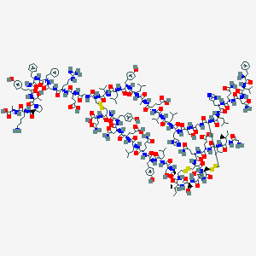
C257H383N65O77S6

Slide 6
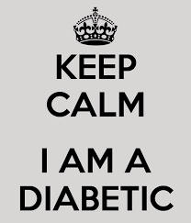
My opinion on the drug insulin
Well I think the drug insulin I think it is very effective it helps and works and gives alot of energy and keeps blood sugars in check and keeps someone very much filled with energy and able to be and stay active I know this because me myself am diabetic and I know lots about the disease and the medicine for it.

