Slide 1
Fosamax
Othman Hussen
Taisser Hussen

Slide 2
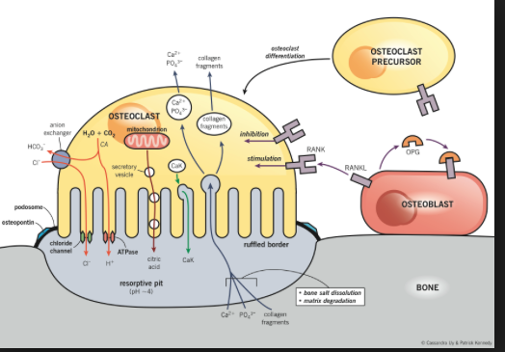
Osteoclast mediated bone resorption

Slide 3
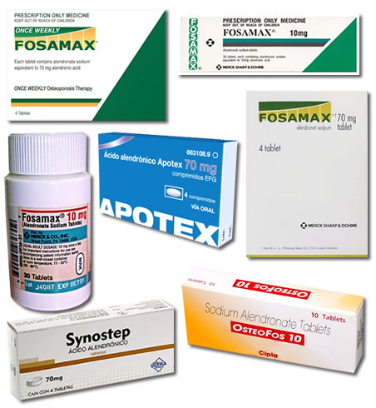

Slide 4
Description
FOSAMAX (alendronate sodium) is a bisphosphonate that acts as a specific inhibitor of osteoclastmediated bone resorption. Bisphosphonates are synthetic analogs of pyrophosphate that bind to the hydroxyapatite found in bone.
Alendronate sodium is chemically described as (4-amino-1-hydroxybutylidene) bisphosphonic acid monosodium salt trihydrate.

Slide 5
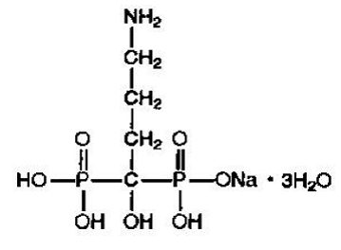
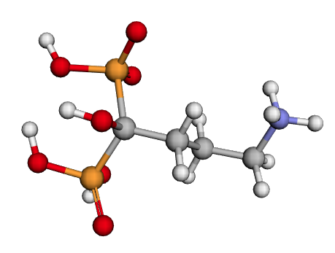
The empirical formula of alendronate sodium is C₄H₁₂NNaO₇P₂ •3H₂O and its formula weight is 325.12.
Alendronate sodium is a white, crystalline, nonhygroscopic powder. It is soluble in water, very slightly soluble in alcohol, and practically insoluble in chloroform.
FOSAMAX tablets for oral administration contain 91.37 mg of alendronate monosodium salt trihydrate, which is the molar equivalent of 70 mg of free acid, and the following inactive ingredients: microcrystalline cellulose, anhydrous lactose, croscarmellose sodium, and magnesium stearate.

Slide 7
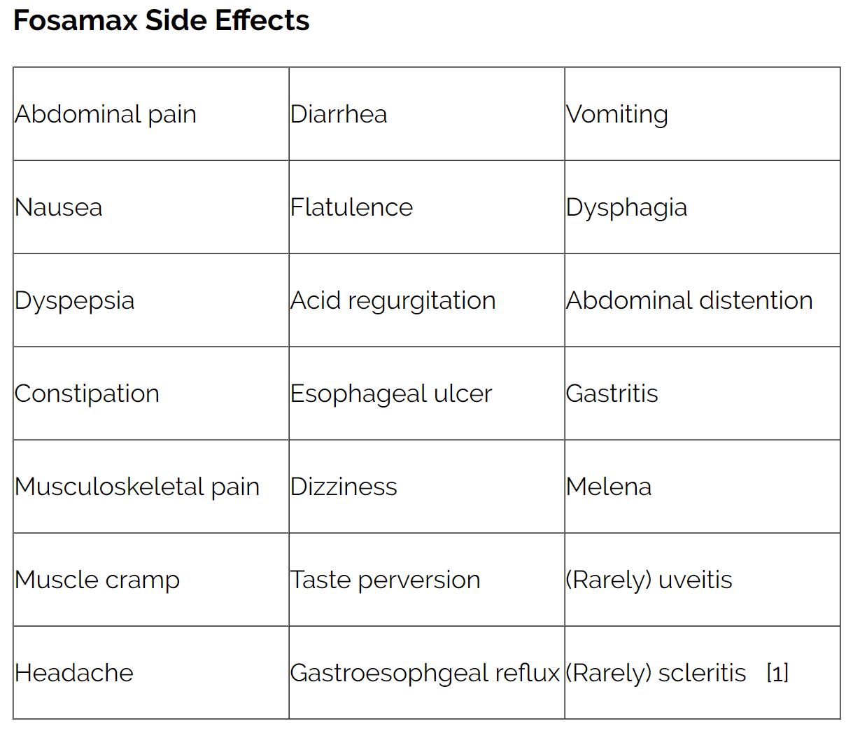

Slide 8
What you can do.
As with any drug, don't take Fosamax unless you're sure you need to. If you've been taking it and are concerned about long-term effects, talk to your clinician about taking a break. Unfortunately, we have little solid evidence to guide us in this area. We know that bisphosphonates stay in bone for years, so it's not clear that a "drug holiday" will lower your risk for possible long-term effects. If you decide to take a break, be sure to have your bone density tested after a year or two. If it has declined significantly, you can always resume bisphosphonate therapy.
Meanwhile, continue all the other measures that help protect and maintain bone density: take 1,200 to 1,500 milligrams of calcium and 800 IU of vitamin D every day; get 30 minutes of weight-bearing exercise at least three times a week; and if you smoke, do your best to stop.

Slide 9
References:
https://www.health.harvard.edu/diseases-and-conditions/whats_the_story_with_fosamax
https://www.healthcentral.com/article/fosamax-side-effects-and-history
https://www.webmd.com/drugs/2/drug-1273-7174/fosamax-oral/alendronate-oral/details
https://www.rxlist.com/fosamax-drug.htm#side_effects_interactions

Slide 10
Thank you for watching

