Slide 1
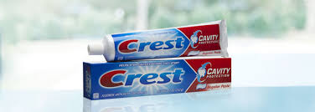
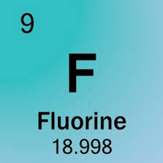
Fluoride
BY:Ocie jackson Jr.

Slide 2
Who discovered the drug?
The name of the person that discovered fluoride is Frederick Mckay. He first discovered fluoride in the early 1900`s when he was a dentist because he noticed that 90% of native had brown staining on their teeth. So Mckay started to make more discovery about fluoride that later was put into toothpaste.

Slide 3
When was the drug first introduced?
This drug was first introduced in the 1801- 1933 was research into mottled tooth enamel called the colorado brown stain. The second was in 1945 when they was focused on the relationship between fluoride concentrations, fluorosis, and tooth decay.

Slide 4
Is the drug expensive?
This type of drug is not expensive because everyone use this drug for their teeth to make them look good and for their breath to smell good.

Slide 5
For how millions of dollars is the drug sold yearly?
This type of drug called fluoride be making about $1.6 billions of dollars each year because of how many people buying toothpaste and mouthwash. Then the denstist also use this type of drug to but the one they use is a little super.

Slide 6
Can this drug treat a disease?
This drug can treat a disease for the teeth in humans and petsa mouth. Because fluoride is a type of drug that sciencetist was studying for that humans can use and that it will not give the human side effects on the teeth.

Slide 7
My opinion on this drug?
My opinion on this drug is that it is very helpful to us because it make our teeth clean and health. I would like to say thanks to the people that found fluoride and that help Fredick Mckay continue his reasearch on this drug.

