Slide 1
What is fentanyl
Matthew cordova
Western International high school
2021-22

Slide 2
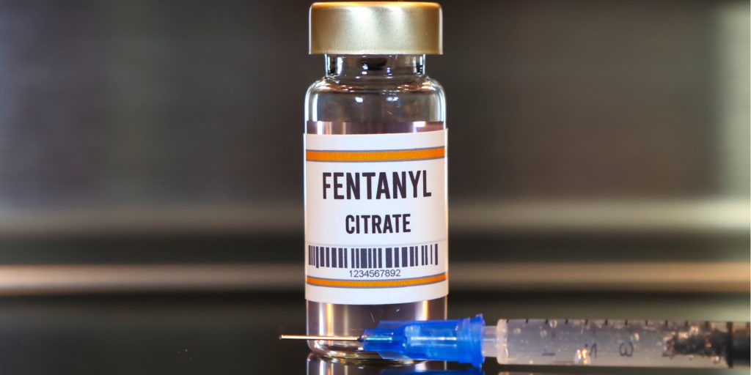
SUBLIMAZE
Sublimaze is used for both general and regional anesthesia and both during after surgery. It acts almost immediately upon injection.Here you can see the liquid form on fentanyl.

Slide 3
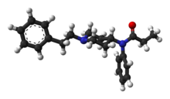
- Fentanyl (CAS-437-38-7) is a piperidine derivative.
Systematic name (IUPAC) N-(1(2-phenethyl)-4 piperidinyl-N-phenylpropanamide.Name
Molecular weight: 336.471 g/mol
Molecular formula: C22H28N2 O

Slide 4
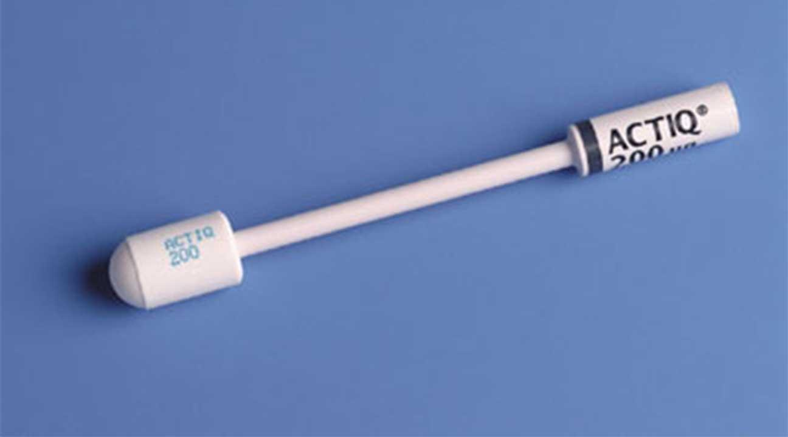
How Does Fentanyl work in the body
Physically, Fentanyl work by binding the mOR, then enables the receptor to associate with G-protein and β-arrestin and activate the related signal pathways or in other words it communicates with your pain and emotions.
Doctors are starting to prescribe fentanyl edibles like a berry flavoured lollipop its to cure patients with cancer or now to people with back or neck pain you can buy these off the black market as “Perk-a-pop”
Its amazing something so little like his can help relax the chronic pain in just seconds of taking it.

Slide 5
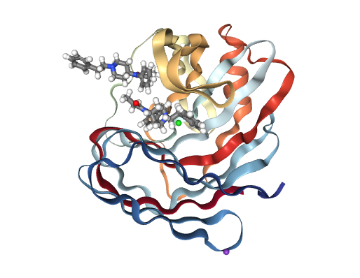
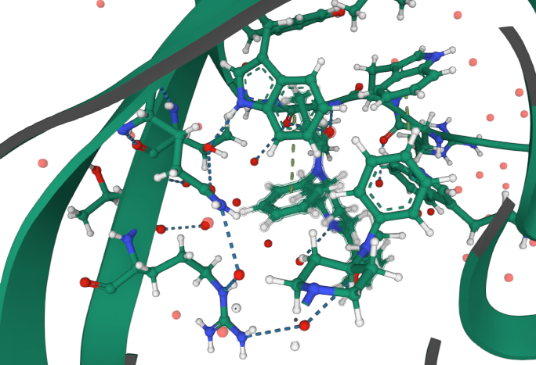
Computationally Designed Fentanyl Binder - Fen49*-Complex
Here you see the fentanyl binding with the body opioid receptors then see all the binds happening.

Slide 6
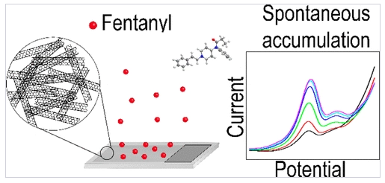
Single-Walled Carbon Nanotube Network Electrodes for the Detection of Fentanyl Citrate

Slide 7
El coche

Slide 8
Bicycle

Slide 9
Bicicleta
Bicycle

