Slide 1
Erythropoietin (EPO) Hormone
By: Hlaa Taher
Western International High School
2021-2022

Slide 2
History of Hormone
Erythropoietin was discovered by Amgen.
Amgen began to sell the drug in 1989.
It’s an anemia drug.
It is used to treat severe amenia in patients on kidney dialysis. It is used to treat HIV too.
Transkaryotic Therapies, Cambridge, Mass., has developed EPO-, and the company recently won a patent fight with Amgen over the right to sell it in Europe. Transkaryotic Therapies will start offering it as the Dyneo brand in 2006.

Slide 3
Erythropoietin
Erythropoietin (EPO) is a 30,400 Daltons glycoprotein, consisting of 165 amino acids produced mainly in the kidney and in the liver and regulating erythrocytosis.
The additional carbohydrate groups increase the activity of the hormone and slow its rate of clearance from the body; thus a dose is required about half as often as EPO.

Slide 4
Erythropoietin

Slide 5
Mechanism of therapeutic
EPO is a glycoprotein (protein-sugar conjugate) that serves as the primary regulator of red blood cells (erythrocytes) in mammals. It stimulates bone marrow stem cells, controls hemoglobin synthesis and red blood cell concentration.
EPO is produced mostly in the liver, but the kidneys become the primary site of EPO synthesis shortly after birth. EPO cproduction is stimulated by reduced oxygen content in arterial blood in the kidneys. Circulating EPO binds to receptors on the surface of erythroid progenitor cells that in turn mature into red blood cells.

Slide 7
Erythropoietin with its receptor

Slide 8
Targeted Delivery of Erythropoietin Hybridized with Magnetic Nanocarri

Slide 9
Athletes abusing the Hormone
EPO can provide a boost in athletic performance by producing extra red blood cells to improve oxygen uptake and thus aerobic power. Endurance athletes such as cyclists, distance runners and cross-country skiers have misused recombinant EPO as a performance-enhancing drug.
Extra red blood cells can cause thickened blood, particularly when athletes are dehydrated, raising the risk of heart attacks and strokes.
The World Anti-Doping Agency has now developed combination urine and blood tests that can detect EPO abuse by athletes.

Slide 10
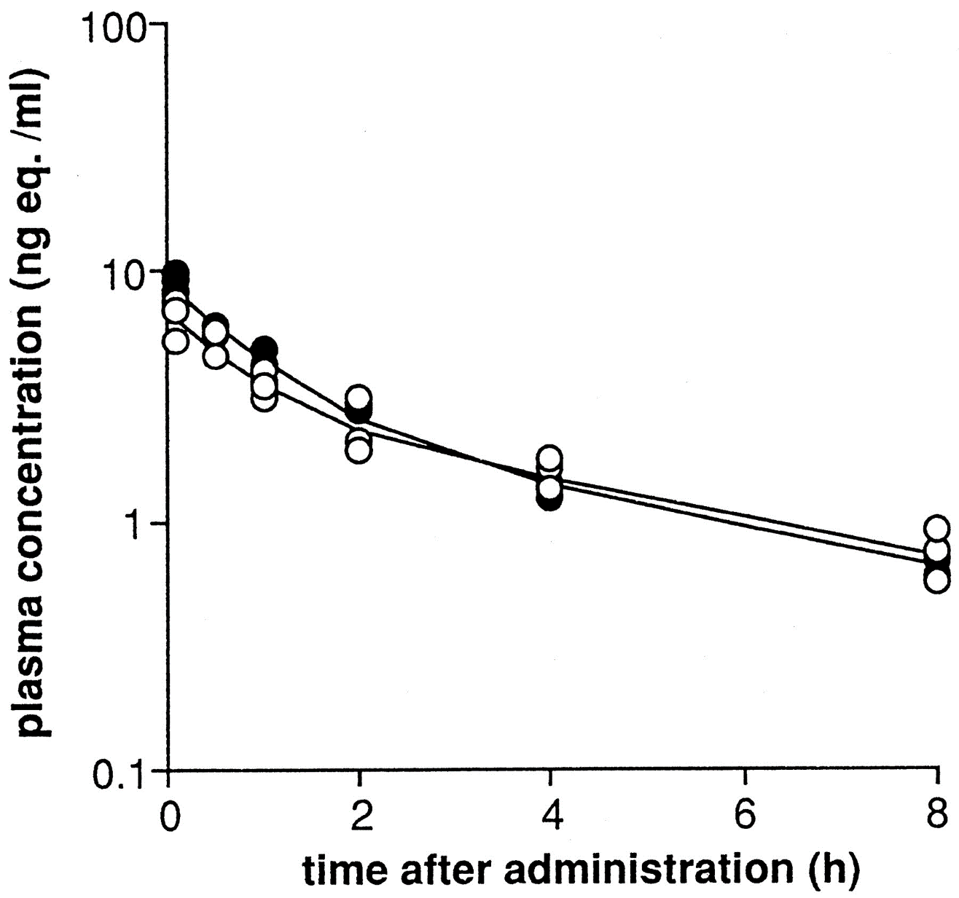
Pharmacokinetics
The bioavailability of epoetin administered intraperitoneally in dialysis fluid is about 3 to 8%, but this may be increased by injecting the drug to a dry peritoneal cavity. Subcutaneous administration results in peak concentrations at about 18 hours which are 5 to 10% of those found after the same intravenous dose.

Slide 11
Synthesis and Elimination
In the last 15 years, EPO became the most widely used drug that was created through recombinant DNA technology, which an identical form of a substance the naturally comes from the body, so erythropoietin is created by replicating human DNA in a laboratory.
EPO is carried to the bone marrow, where it stimulates production of red blood cells. The hormone is active for a short period of time and then eliminated from the body in the urine.

Slide 12
Cost
Amgen's Epogen had 2004 U.S. sales of $2.6 billion, while J&J's Procrit and Eprex had combined 2004 sales of $3.6 billion. Other versions of EPO include Roche's NeoRecormon brand of recombinant EPO-, which had 2004 European sales of $1.7 billion.
Worldwide, Aranesp sales were $2.5 billion in 2004.

Slide 13
Additional Information
Chemical Formula
C42H73NO16
Other names
Procrit
Epogen
Eprex
CAS Registry
113427-24-0

Slide 14
Side Effects
Some people can have an allergic reaction
Blood clot risk
Headaches
Muscle, joint, or bone pain
Flu-like symptoms

Slide 15
References
http://pubsapp.acs.org/cen/coverstory/83/8325/8325list.html?
https://www.dovepress.com/targeted-delivery-of-erythropoietin-hybridized-with-magnetic-nanocarri-peer-reviewed-fulltext-article-IJN
https://pubmed.ncbi.nlm.nih.gov/2029809/#:~:text=The%20bioavailability%20of%20epoetin%20administered,after%20the%20same%20intravenous%20dose.

