Slide 1
Digoxin

Slide 2
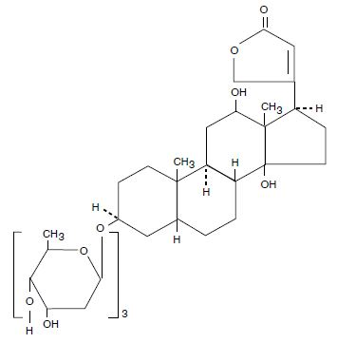
What is Digoxin ?
Digoxin is a medicine that was used to treat irregular heartbeat.

Slide 3
Who discovered the drug ?
William Withering is the first person on discovering the drug called Digoxin in 1775, In those days it was used to be called foxglove or dropsy.

Slide 4
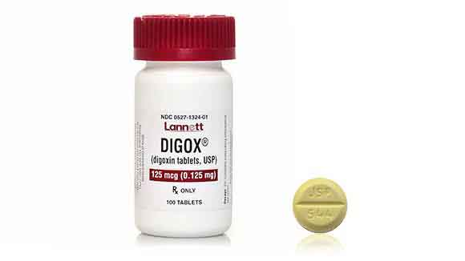
When was the drug first introduced
Digoxin was first introduced in 1930 by a researcher called Sydney Smith, it was first introduced by name of foxglove plant

Slide 5
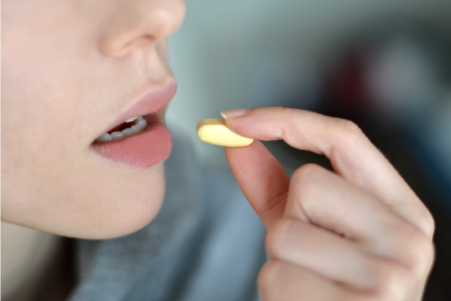
When did the drug became a therapeutic medicine ?
The Digoxin pill was turn into a therapeutic medicine for both genders in for hospitalization due to worsening heart failure, but it doesn’t decrease mortality.

Slide 6
Which disease did this drug treats, What can the drug cause to the body
Digoxin used to treat in certain heart problem's which is known as heart failure. Digoxin can narrow your blood vessels and cause inflammation.

Slide 7
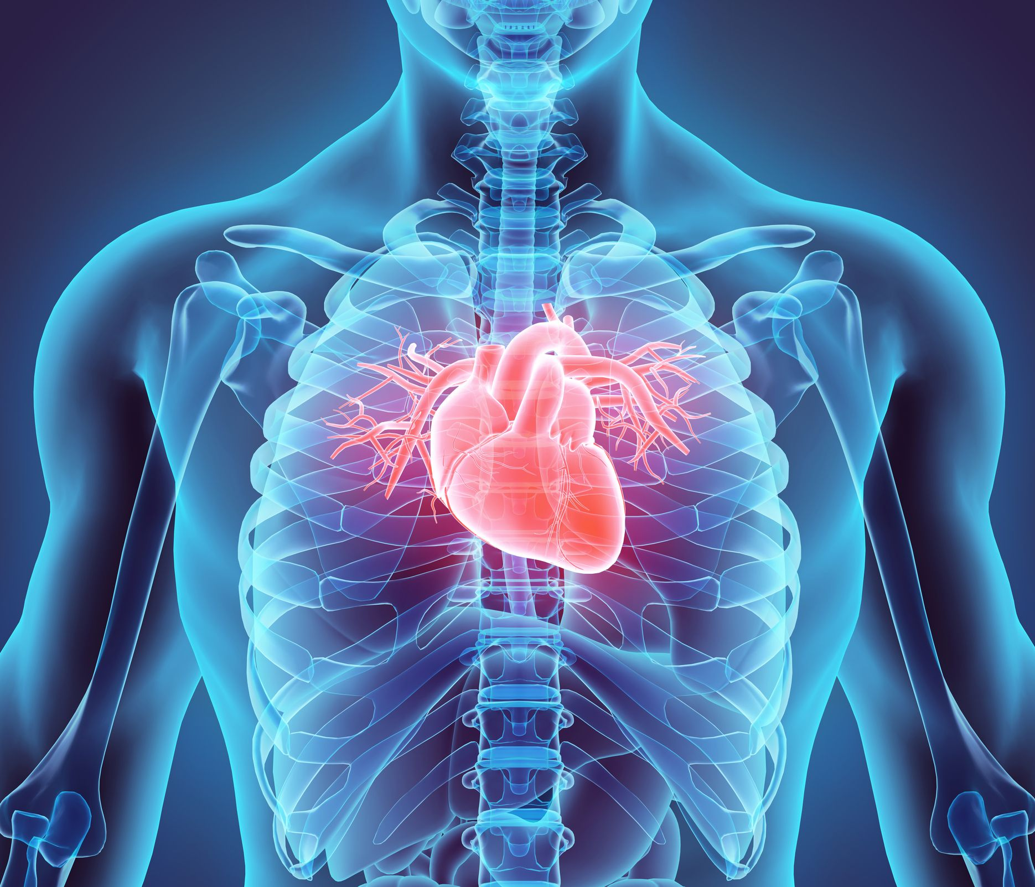
How does the drug work in the body to be cure from the disease.
Digoxin works with minerals in the cells of the heart to reduce strain and keep the heart beating normally.

Slide 8
Is the drug very effective in the treatment of the disease ?
Digoxin used patients with mild to moderate heart failure if the patient doesn’t respond to the angiotensin- converting enzyme inhibitor beta blocker.

Slide 9
How does the drug cause undesired side effects ?
Digoxin may increase the death rate of a women who dealing with heart failure. It makes the heart beats increase to quicky.

Slide 10
Is the drug expensive ?
The average retail price of Digoxin is about 42 in between 92 dollars for 125 mcg tablet of Digoxin.

Slide 11
For how millions of dollars is the drug sold yearly ?
The coast that Digoxin made yearly is 137 million in 2001

Slide 12
My opinion about Digoxin
I think the drug shouldn’t be sell anywhere due to a lot of health problems even though it did help with help with heart. But at the same time, it had so side effects that can cause more problems to the person who dealing health issue.

