Slide 1
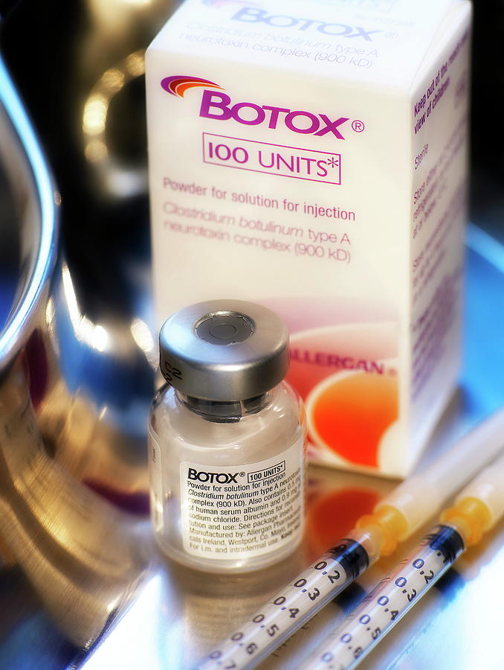
Neuromuscular modulator
Botox
Janeth Demedicis
2nd Hour

Slide 2
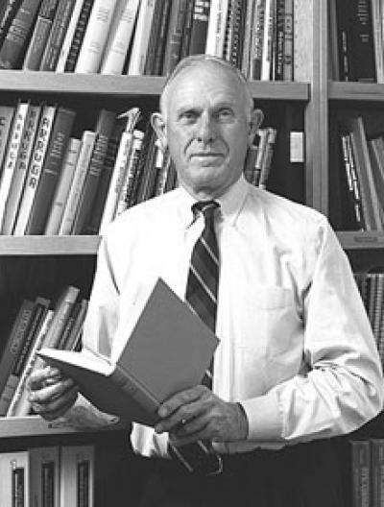
History of the Drug

Slide 3
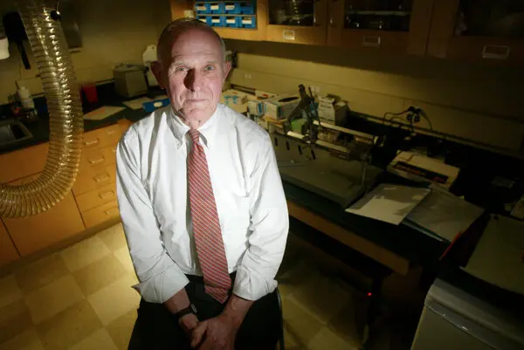
Who discovered the drug?
Alan B. Scott, MD discovered Botox.

Slide 4
When was the drug first introduced?
Botox was first introduced on the market in 1989, the original injectable has become ubiquitous for its ability to “freeze” faces and hold back time. In the decades since its introduction, Botox has quite literally changed the face of humanity.

Slide 5
When did it become a therapeutic medicine?
It was first used in medicine in 1980 to treat strabismus. Although in 1989, the cosmetic effects of Botox on wrinkles were noticed, it was only in 2002, that it gained global recognition as a potential cosmetic therapeutic agent after the approval from Food and Drug Administration

Slide 6
Mechanism of Therapeutic Action
Which disease this drug treats?
What causes the disease in the body?
Botox injections are noted primarily for the ability to reduce the appearance of facial wrinkles. They're also used to treat conditions such as neck spasms (cervical dystonia), excessive sweating (hyperhidrosis), an overactive bladder and lazy eye. Botox injections may also help prevent chronic migraines.
Foodborne botulism is often caused by eating home-canned foods that have not been canned properly. Commercially canned foods are much less likely to be a source of botulism because modern commercial canning processes kill C. botulinum spores.

Slide 7
How does the drug work in the body to cure the disease?
Botox injections are noted primarily for the ability to reduce the appearance of facial wrinkles. They're also used to treat conditions such as neck spasms (cervical dystonia), excessive sweating (hyperhidrosis), an overactive bladder and lazy eye. Botox injections may also help prevent chronic migraines.

Slide 8
Is the drug very effective in the treatment of the disease?
it can also be an effective treatment for some medical conditions—including movement disorders.

Slide 9
How does the drug cause undesired side effects?
Redness
bruising
infection
pain at the injection site
Dizziness, mild difficulty swallowing, respiratory infections such as cold or flu, pain, nausea, headache, and muscle weakness may occur when this medication is used to relax muscles.

Slide 10
Cost

Slide 11
Is the drug expensive?
Botox injections are certainly costly, they're nowhere near the pricing realm of plastic surgery or even injectable fillers like Juvederm or Restylane. At around $10 to $15 per unit, you can expect to pay between $200 and $300 for the 8 to 20 units of an average forehead treatment.

Slide 12
For how millions of dollars is the drug sold yearly?
3.2 billion U.S. dollars worth of Botox was sold globally.

Slide 13
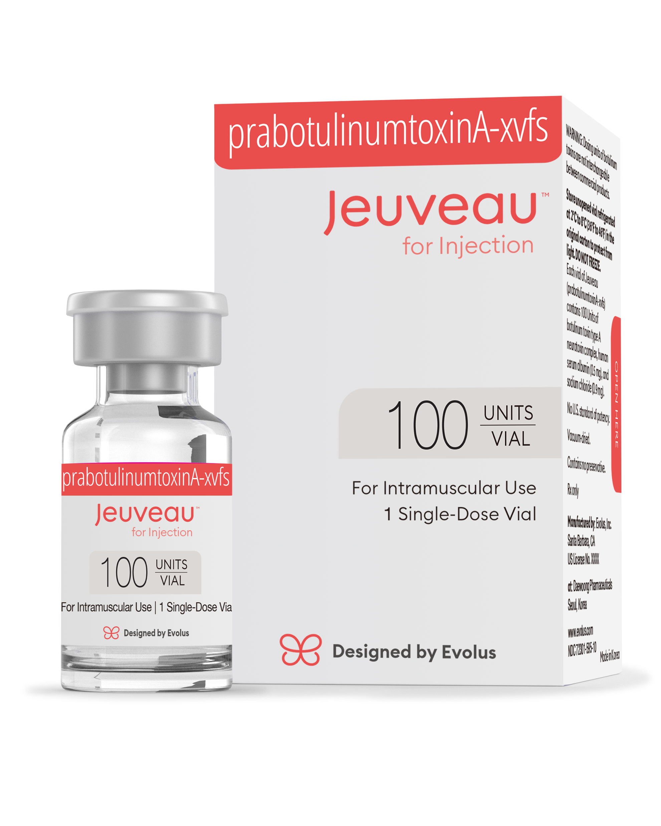
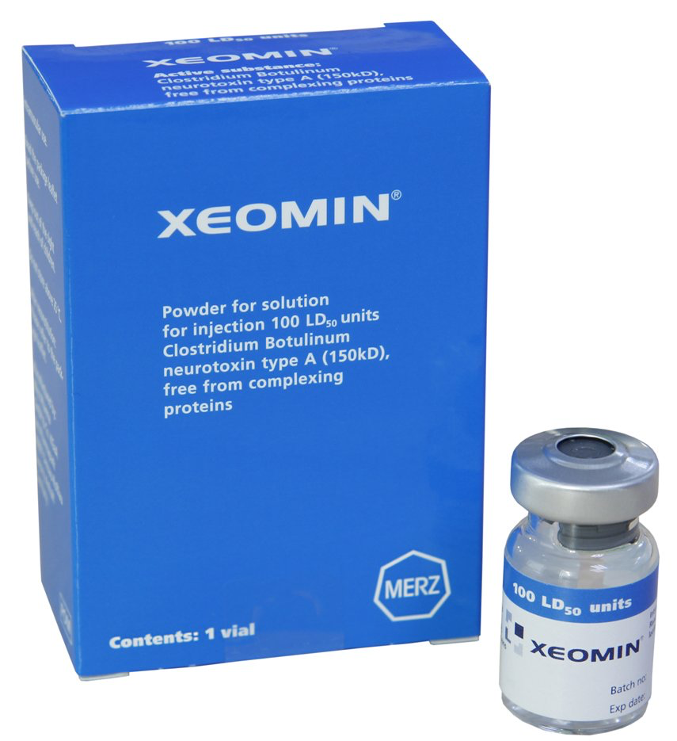
Name an other names
Jeuveau
Xeomin
Cas Registery: Cas93384-43-1

Slide 14
Chemical formula and structure.
C6760H10447N1743O2010S32

Slide 15
Opinion on Botox
In my opinion, I think it’s a good invention. I am looking forward to get Botox in the future. After doing my research, there’s not really any negative effects. I like how it prevents wrinkles, maybe temporarily but it most definitely helps.

