Slide 1
The Project Of Aspirin
Made by :
Wendy De Paz
Erika Hernandez
1st hour for Ms.Nada

Slide 2
Who discovered Aspirin
The one who discovered aspirin was Felix Hoffman
Felix hoffman was born on 21st of january 1868 in ludwigsburg, germany
Fellix never marries
Fellix dies at february 8, 1946 switzerland

Slide 3
When was Aspirin frist intruduced?
Aspirin was frist introduced 1890s as form of acetylsalicylic acid when chemist felix hoffman at bayer in germany used to alleviate his father rheumastic.

Slide 4
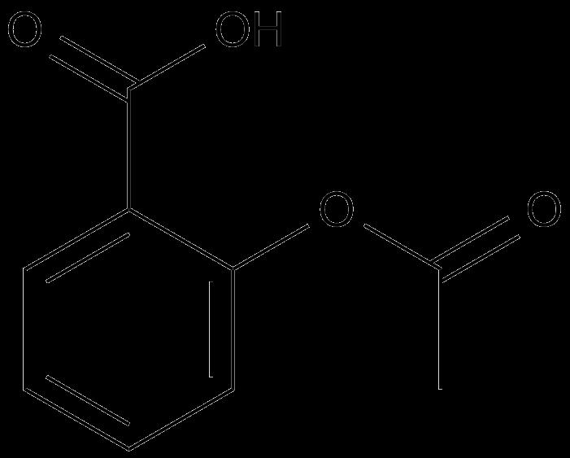
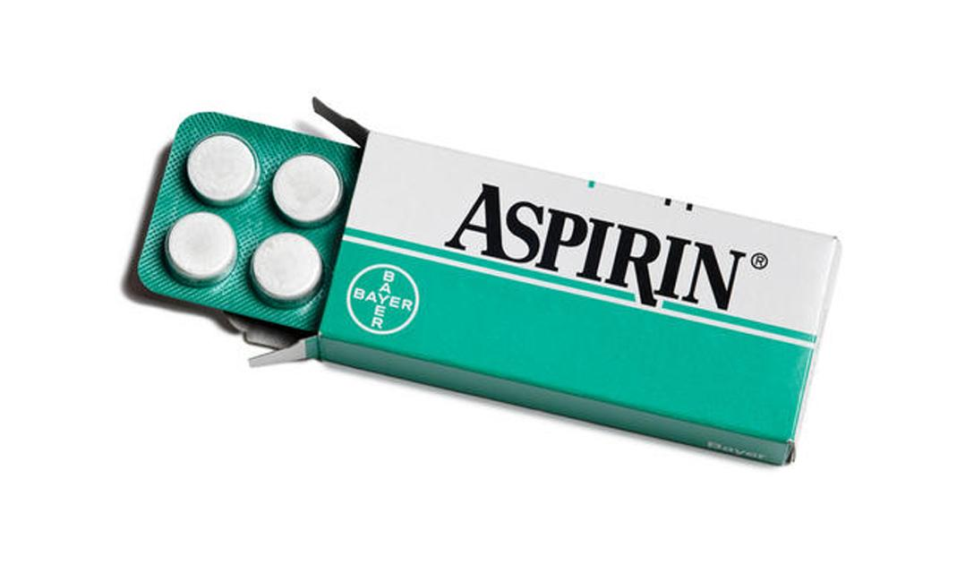
When did Aspirin become a therapeutic medicine
Aspirin became a therapeutic medicine in the 1900s

Slide 5
Which disease does Aspiron treat
Aspirin reduces fever and relieve mild to moderate pain fron conditions such as muscle aches , toothaches , comman colds and headaches.
Aspirin can reduce pain and swelling in conditions suach as arthritis
Aspirin is known as a salicylate and nonsteroidal anti inflamation drug ( NSAID)

Slide 6
How does Aspirin work in the body to cure
Aspirin is known as salicylate and a nonsteroidal anti- inflammatory drug (NSAID) works by blocking a certain natural substance in the bodu to reduce pain and swelling.
The drug found inhabit the synthesis of a group of hormone like substances know as prostaglandis , Aspirin and most (NSAID’s) inhibit cyclooxygenase enzymes which normally drive prostaglandin production.

Slide 7
Is Aspirin a effective treatment
Aspirin is a very effective treatment because aspirin calms down the pain and help us not to feel so much pain in us.
Aspirin us the drug that had been very usful for pain and inflammation.

Slide 8
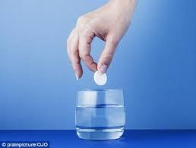
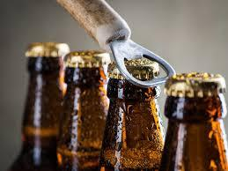
Side effects of Aspirin
Some side affects of aspirin could be rash, gastrointestainal ulcerations , abdominal pain , upset stomach , hearburn , drowsiness , headache , cramping , nausea , gastritis , and bleeding
This side effects could be bad because it bothers us most recomented is to drink water with aspirin and avoid drinking aspirin with alcahol it increases stomach bleeding . Taking ibuprofen (advil ) if also taking asprin to prevent having a stroke or heart attack

Slide 9
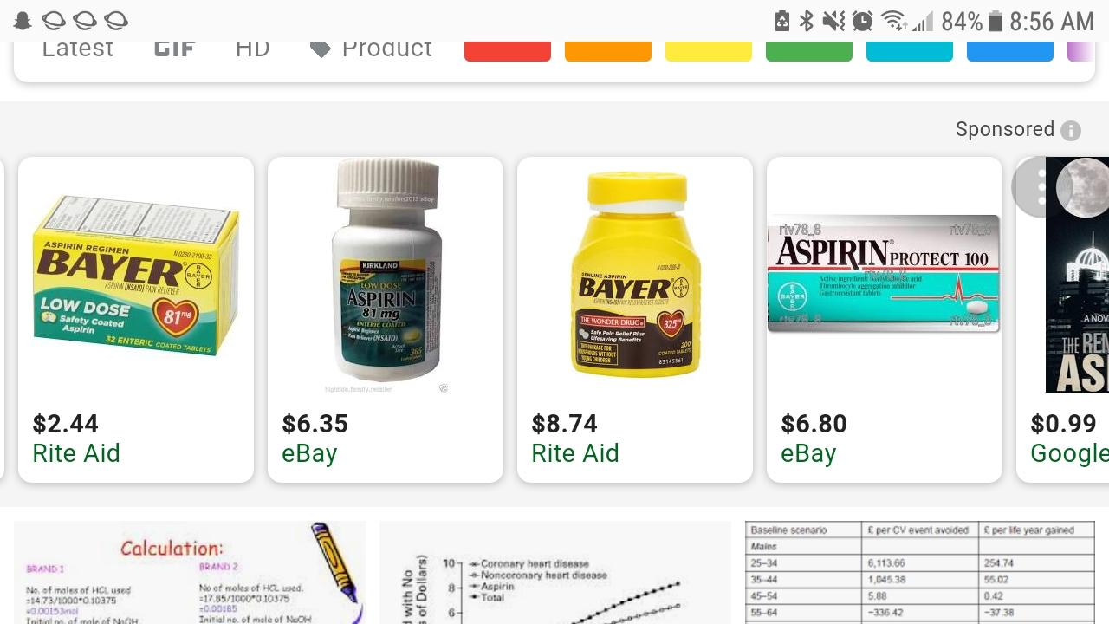
The cost of Aspirin
The cost of Aspirin could be less than 8 dollares it could be 2.24$ , 6.49$ , 6.36$
Aspirin isnt expensive especially if it’s a small bottle of Aspirin But if it’s a big bottle then the amount could be like 8 dollares

Slide 10
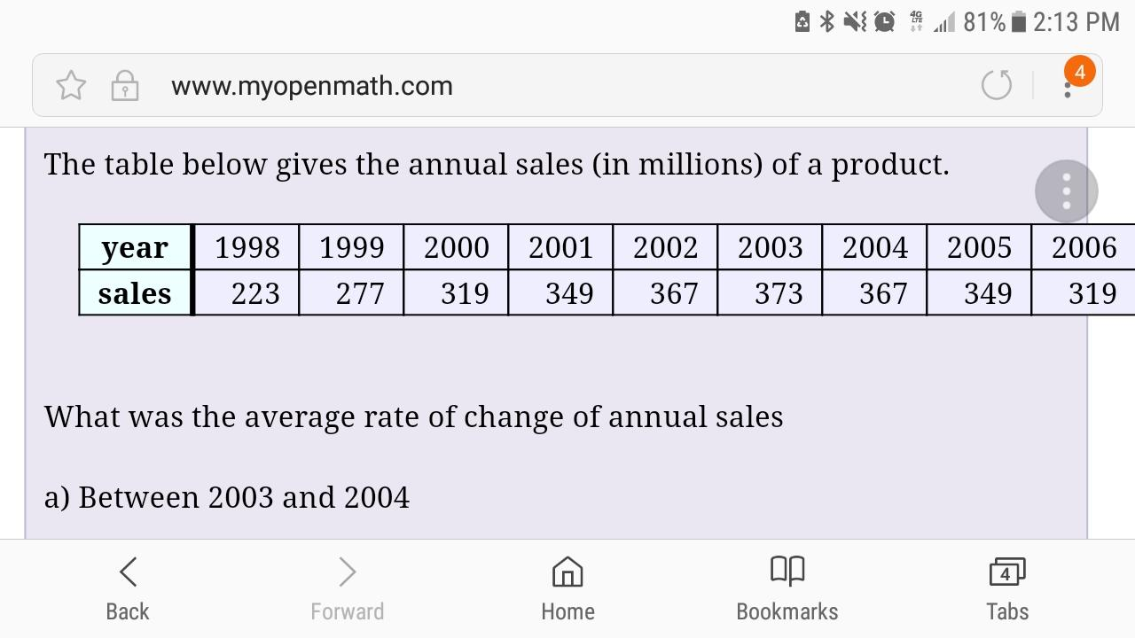
For how much millions of dollares is this drug sold yearly ?
Aspirin is wins 100 millions yearly

Slide 11
Other names for Aspirin
Other names for aspirin are
Acetyl Salicylic Acid
Acetylsalicylate
Alumium Acetyl Salicylate
Ammonium Salicylate
Amyl Salicylate
Arthropan
Ect……….

Slide 12
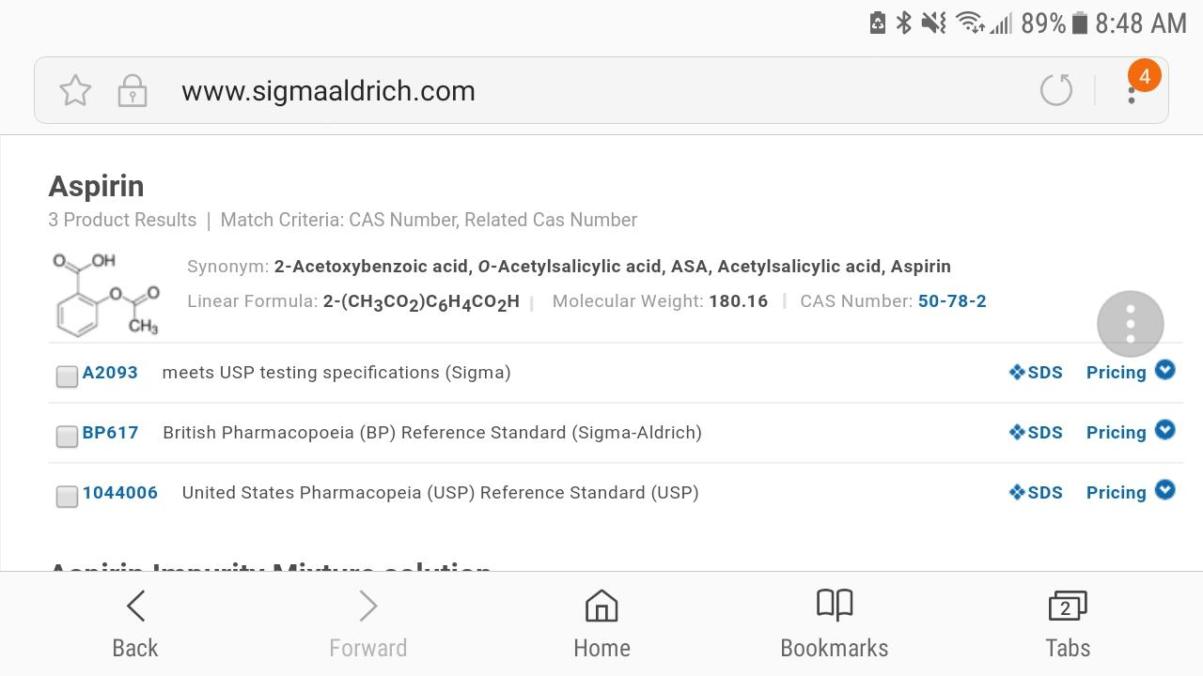
Cas registry of Aspirin

Slide 13
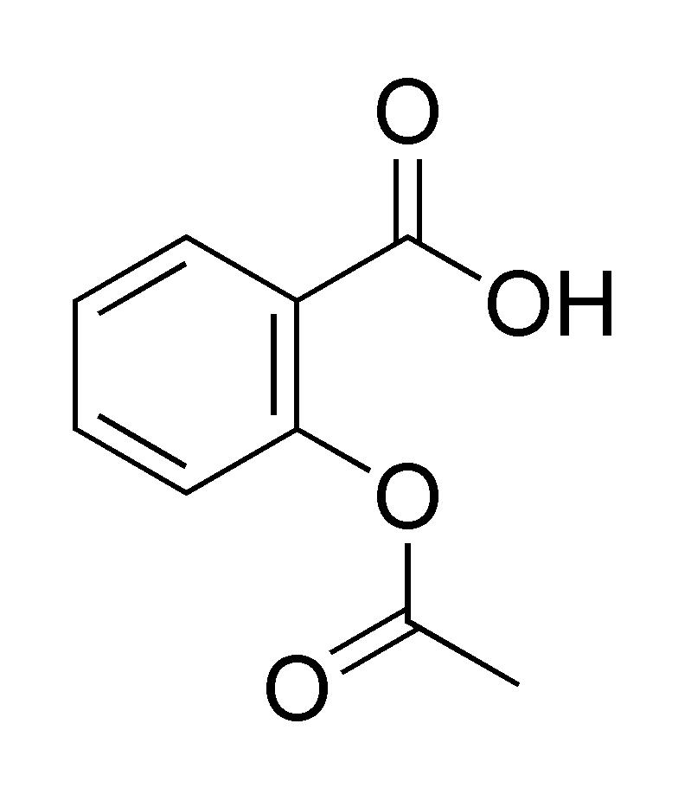
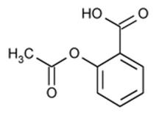
Chemical formula and structure

Slide 14
Opinion about the drug
My opinion about the drug was that this drug is important to us because it helps us reduce the pain , to lower and feel less hurt this is a good way to calm down also the chemical formula and the strucutre is really intresting I think I seen it before here at school

Slide 15
