Slide 1
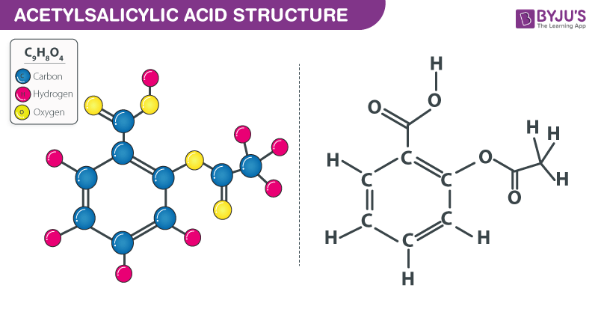
ASPIRIN
TANIAH COLE
3RD HOUR

Slide 2
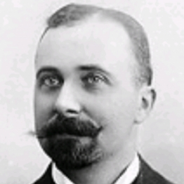
WHO DISCOVERED THE DRUG?
Felix Hoffmann discovered the aspirin.

Slide 3
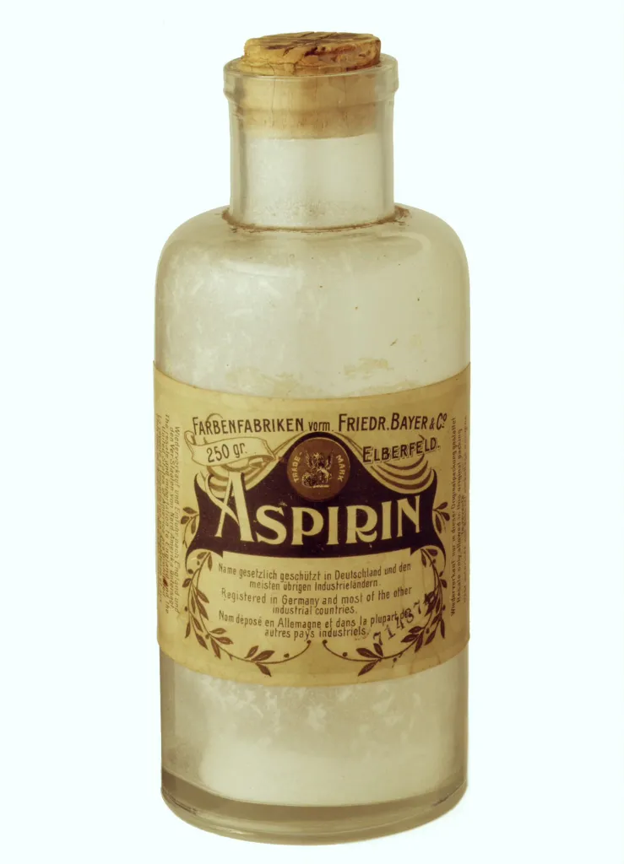
WHEN WAS THE DRUG FIRST INTRODUCED?
Aspirin was first introduced in 1897.
Aspirin became a Therapeutic medicine from the 1960s to the 1980s.
350 million dollars in annual sales

Slide 4
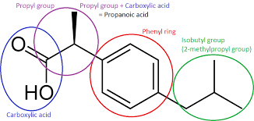
Pharmacophore of Aspirin

Slide 5
WHICH DISEASE THIS DRUG TREATS?
Treatment to prevent a heart attack
Stroke prevention
Rheumatoid Arthritis
Myocardial reinfection prevention

Slide 6
HOW DOES THE DRUG WORK IN THE BODY TO CURE THE DISEASE?
Aspirin works to prevent the platelets in your blood from clumping and clotting in your arteries.
Aspirin has been used as a pain reliever for more than 100 years. Since the 1970s, its also been used to prevent and manage heart disease and stroke.

Slide 7
HOW DOES THE DRUG CAUSE UNDESIRED SIDE EFFECTS?
Ringing in your ears
Confusion
Hallucinations
Rapid breathing
Seizure (convulsions)
Severe nausea

Slide 8
SYNTHESIS OF ASPIRIN

Slide 9
MECHANISM OF ACTION OF ASPIRIN ON CYCLOOXYGENASE
Aspirin acetylates serine-530 of cyclooxygenase-1 (COX-1), thereby blocking thromboxane A (2) synthesis in platelets and reducing platelet aggregation. This mechanism of action accounts for the effect of aspirin on prevention of coronary artery and cerebrovascular thrombosis.

Slide 11
Side Effects of Aspirin Anaemia (low red blood cell count) easy bruising and abnormal bleeding. inflamed stomach lining, stomach bleeding and peptic ulcers. vomiting blood that may look like coffee grounds and bowel motions that look like black tar.

Slide 12
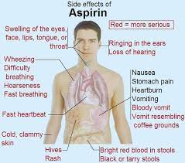

Slide 13
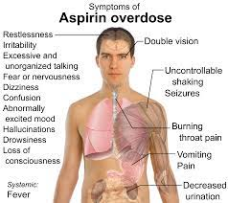

Slide 14
RESOURCES
https://www.reference.com/world-view/natural..
Protein Data Bank
www.nhsaab.weebly.com
C&EN Special Issue: Top Pharmaceuticals: Drug Index (acs.org)
Chemical & Engineering News: Top Pharmaceuticals: Aspirin (acs.org).

