Slide 1
Aspirin Analgesic
Physical science- Ana sofia giraldo Claros
2022

Slide 2
What is aspirin?
Aspirin is used to reduce fever and relieve mild to moderate pain from conditions such as muscle aches, toothaches, common cold, and headaches. It may also be used to reduce pain and swelling in conditions such as arthritis.

Slide 3
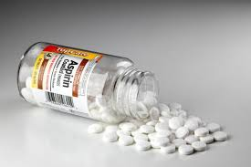

Slide 4
What is aspirin made of?
Aspirin is prepared by chemical synthesis from salicylic acid, through acetylation with acetic anhydride. The molecular weight of aspirin is 180.16g/mol. It is odourless, colourless to white crystals or crystalline powder.

Slide 5
Uses:
Aspirin has many uses, including relieving pain and swelling, managing various conditions, and reducing the risk of cardiovascular events in people with a high risk.Below, we describe these uses in more details.
For severe pain, a doctor may recommend using aspirin alongside another drug, such as an opioid pain reliever or another NSAID.

Slide 6
Pain and swellingAspirin:
can relieve mild to moderate pain, swelling, or both associated with many health issues, such as:
Headaches
a cold or flu
sprains and strains
menstrual cramps
long term conditions, such as arthritis and migraine.

Slide 7
1. Name2-(Acetyloxy)benzoic acid 2. Other Names- Acetylsalicylic acid, ASA, Aspergum, Empirin, Ecotrin , Measurin cas Registry- 50-78-2
Aspirin is prepared by chemical synthesis from salicylic acid, through acetylation with acetic anhydride. The molecular weight of aspirin is 180.16g/mol. It is odourless, colourless to white crystals or crystalline powder.

Slide 8
Important things:
known as NSAIDs (non-steroidal anti-inflammatory drugs).This achievement ultimately garnered the scientist both the Nobel Prize in Physiology or Medicine (1982) and a knighthood. The drugs, he found, inhibit the synthesis of a group of r substances known as prostaglandins.

Slide 9
SIDE EFFECTS:
The most common side effects of aspirin are:
stomach or gut irritation
Indigestion
Nausea

Slide 10
The following adverse effects are less common:
worsening asthma symptoms
Vomiting
stomach inflammation
stomach bleeding
Bruising
Aspirin can also have very serious side effects, such a bleeding in the brain or stomach or kidney failure . A rare side effect of daily low-dose aspirin is hemorrhaging stroke.

Slide 11
VAZALORE
Is heart protection with the stomach in mindTMVAZALORE's drug delivery system employs a pH-dependent release mechanism that relies on chemical association of lipidic excipients with active pharmaceutical ingredients to selectively release them to targeted portions of the GI tract.

Slide 13
Mechanism of aspirin
Aspirin causes several different effects in the body, mainly the reduction of inflammation, analgesia (relief of pain), the prevention of clotting, and the reduction of fever. Much of this is believed to be due to decreased production of prostaglandins and TXA2.

Slide 15
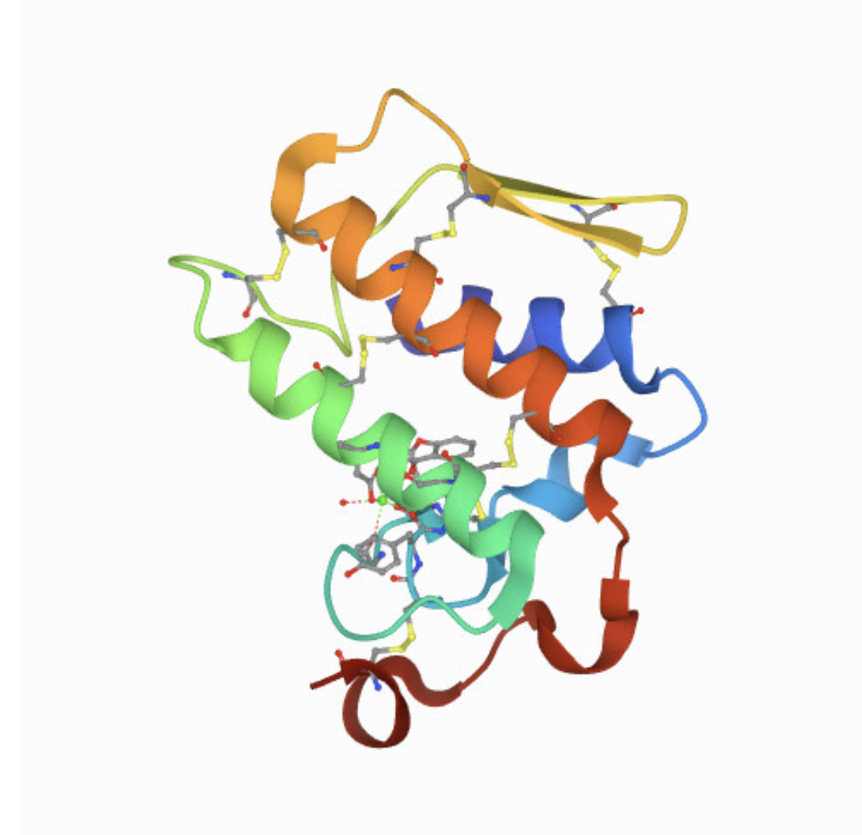

Slide 16
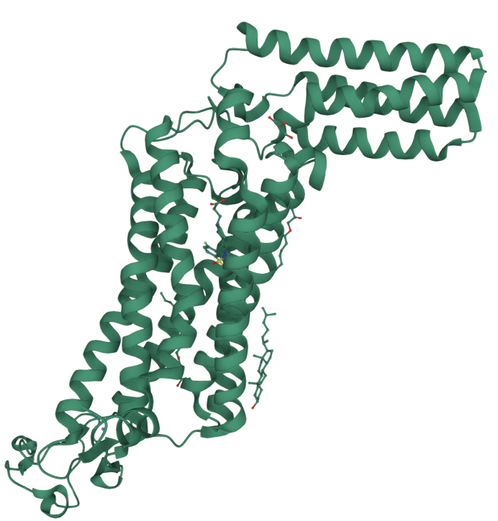
aspirin and thromboxane
Thromboxane are responsible for the aggregation of platelets that form blood clots. Low-dose, long-term aspirin use irreversibly blocks the formation of thromboxane A2 in platelets, producing an inhibitory effect on platelet aggregation.

Slide 17
Effects on cyclooxyrgenase
There are at least two different cyclooxygenaseisozymes: COX-1 (PTGS1) and COX-2 (PTGS2). Aspirin is non-selective and irreversibly inhibits both forms!2][better source needed (but is weakly more selective for COX-1131). It does so by acetylating the hydroxyl of a serine residue . [4] Normally COX produces prostaglandins, most of which are pro-inflammatory, and thromboxane, which promotes clotting. Aspirin-modified COX-2 produceslipoxins, most of which are anti-inflammatory.

Slide 18
Structure of COX-2 inactivated byAspirin. In the active site of each of the two enzymes, Serine 516 has been acetylated. Also visible is the salicylic acid which has transferred the acyl group, and the heme cofactors .

Slide 20
Is aspirin safe for children?
Doctors do not usually recommend aspirin for people under 18.
This is because it can increase the risk of a serious condition called Reye's syndrome, which can appear after a viral infection such as a cold, the flu.or chickenpox. Reye's syndrome can lead to permanent brain injury or death.
However, a clinician may prescribe aspirin to a child under supervision if they have Kawasaki disease or to prevent blood clots from forming after hearts urgent .
For children, doctors usually recommend acetaminophen (Tylenol) or ibuprofen (Advil), inappropriate doses, instead of aspirin.

