Slide 1
Allegra Fexofenadine Hydrochloride Antihistamine
Ala Alryashy
Western International High School ; 2021-2022
Teacher: Dr. Nada Saab

Slide 2
History
Following its approved by the FDA in 1996, the drug was commercialized and marketed as Allegra by Sanofi Aventi. Shortly afterward the FDA pulled terfenadine from the market, soon followed by over a dozen othe medications that were found to pose similar risks
The first modern, pharmaceutical medicine was invented in 1804 by Friedrich Sertürner, a German scientist. He extracted the main active chemical from opium in his laboratory
Allegra is an over-the-counter allergy medication used to treat seasonal allergy symptoms. In 2011, it transitioned from being available by prescription only to being available over the counter and without a prescription.

Slide 3
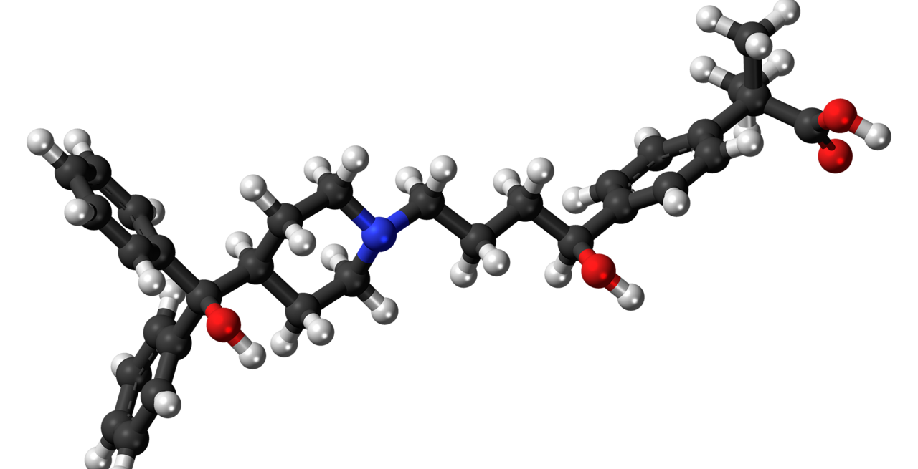

Slide 4
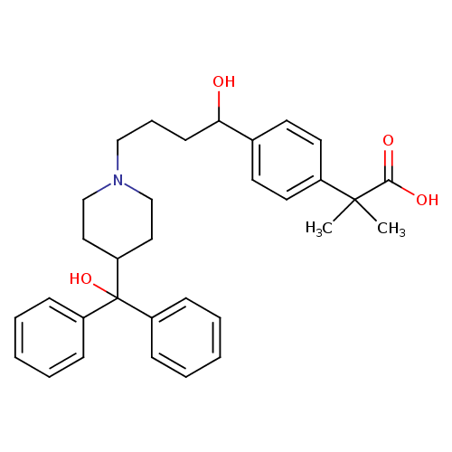

Slide 5
Chemical formula and other names
Formula: C₃₂H₃₉NO₄
Molar mass: 501.656 g/mol
,-Dimethyl-4- [1-hydroxy-4-[4-(hydroxydiphenylmethyl)- 1-piperidinyl]butyl]benzeneacetic acid hydrochloride
Telfast
carboxyterfenadine hydrochloride
terfenadine carboxylate hydrochloride

Slide 6
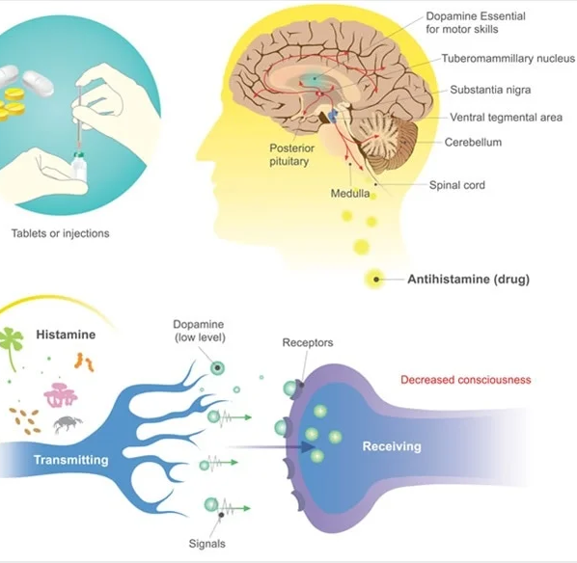
Mechanism of Action
Fexofenadine hydrochloride, the major active metabolite of terfenadine, is an antihistamine with selective H1-receptor antagonist activity. Both enantiomers of fexofenadine hydrochloride displayed approximately equipotent antihistaminic effects.

Slide 7
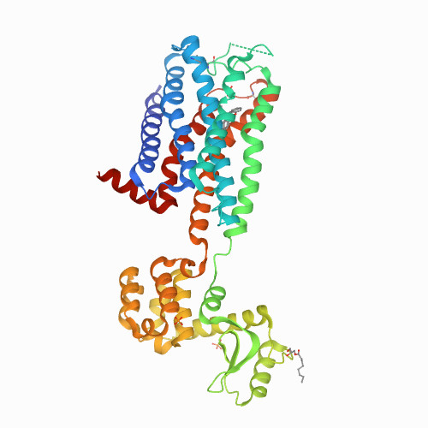
Structure of the human histamine H1 receptor

Slide 8
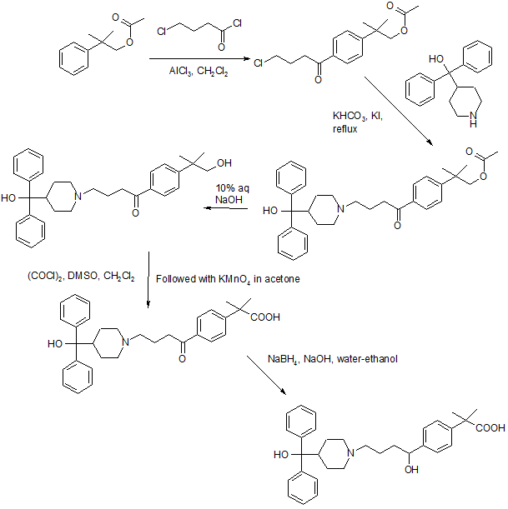
Synthesis of Allegra

Slide 9
1: Allegra is used to
relieve allergy symptoms such as watery eyes, runny nose, itching eyes/nose, sneezing, hives, and itching
2: Drugs work in your body in a variety of ways. They can interfere with microorganisms (germs) that invade your body, destroy abnormal cells that cause cancer, replace deficient substances (such as hormones or vitamins)
Compose
3:
They found that once-daily doses of 120 mg or 180 mg of Allegra were superior to placebo in reducing total symptoms. In addition, the single dose was effective in relieving symptoms for the entire 24-hour period. They also found that Allegra and Zyrtec were comparable in relieving the symptoms of seasonal allergies
4: xofenadine is classed as a non-drowsy antihistamine, but some people still find it makes them feel quite sleepy. Common side effects include headaches, feeling sleepy, dry mouth, feeling sick and dizziness

Slide 10
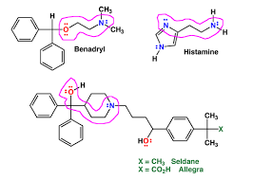
Pharmacophore of Allegra

Slide 11
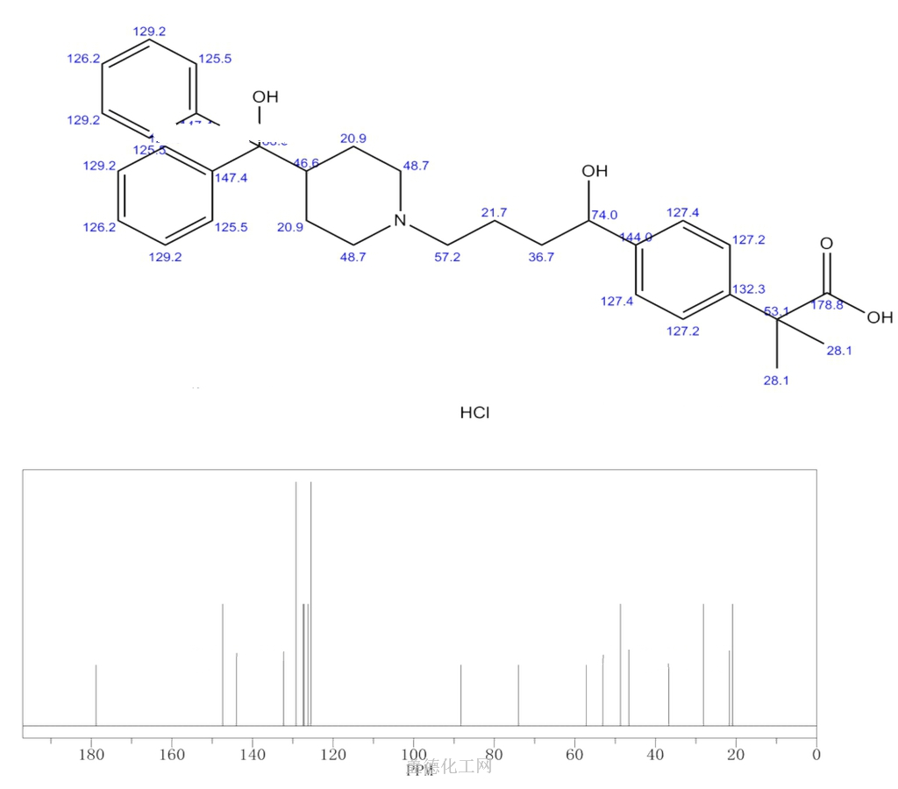
NMR- C13 Spectrum

Slide 12
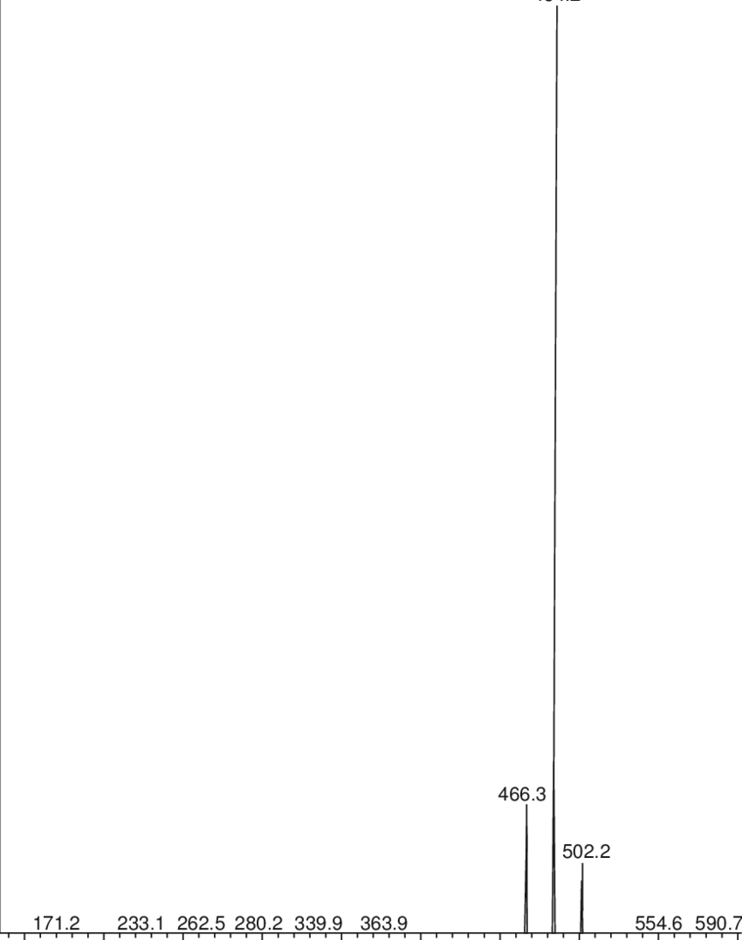
MS Spectrum of Allegra

Slide 13
COST
A typical Allegra purchase of #30, 180 mg tablets can cost about $23, but you can get the generic form, fexofenadine, for about $12 with a Single Care coupon

Slide 14
Resources
Dr. Nada H. Saab-Ismail - Home (weebly.com)
C&EN Special Issue: Top Pharmaceuticals: Drug Index (acs.org)
Chemical & Engineering News: Top Pharmaceuticals: Allegra (acs.org)
RCSB PDB: Homepage

